Slide 1

Perfion Features
Highlights from 2025 and onwards

Slide 2
2025-R3
Build: 5.8.0
Released: December 2025

Slide 3
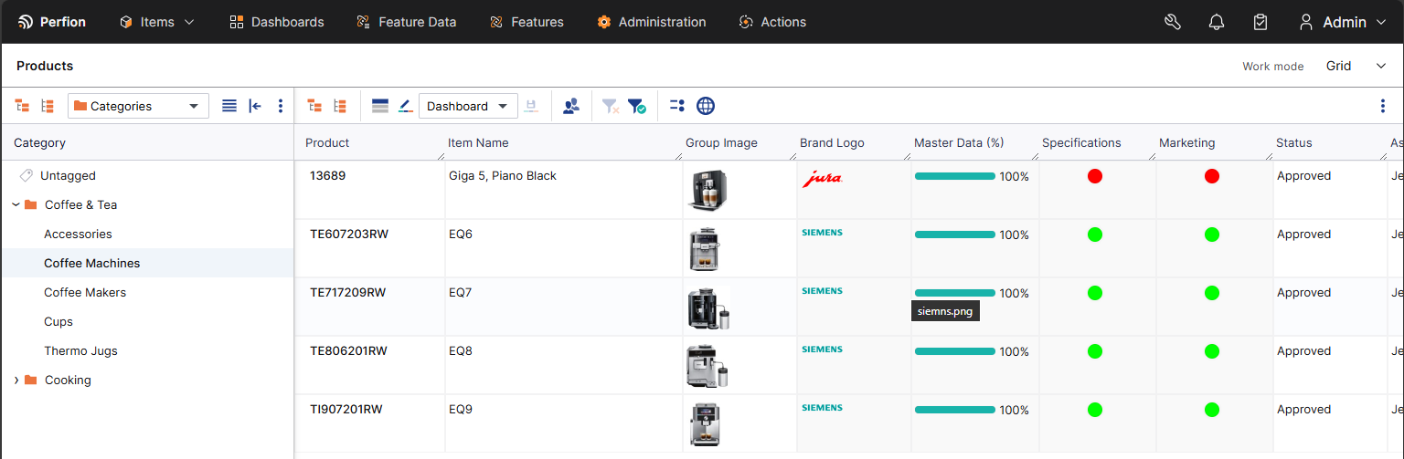
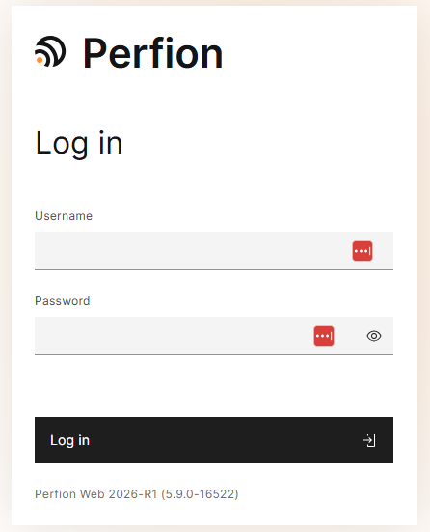
Boyum Makeover Part I
Perfion 2025-R3
New Modern Look
Alignment with the Boyum brand look and feel
Accessibility updates (readable text, more contrast in colours, theming, keyboard navigation, ease of use etc)
Technical update for the frontend to achieve additional value for customers (brand ability)
Also important focus: We are not restructuring, trying not to disrupt current customers, keeping familiarity in the architecture as much as possible

Slide 4
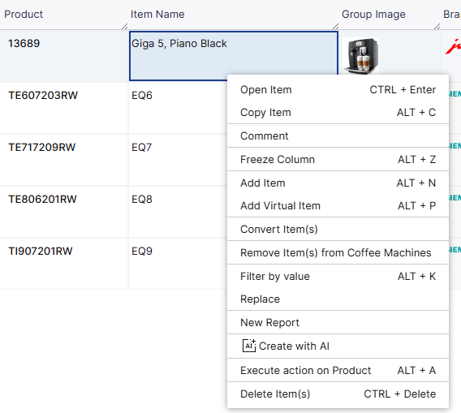
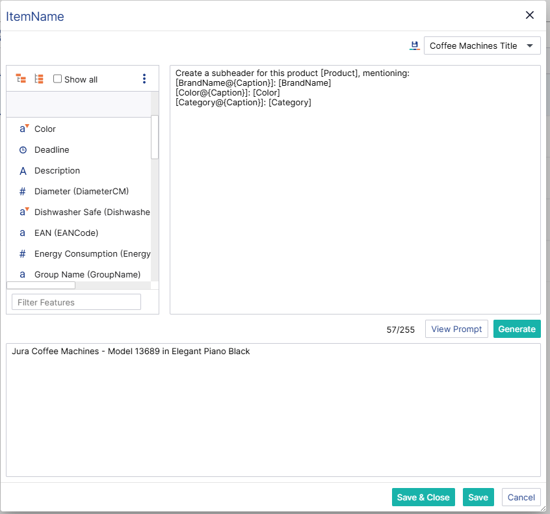
AI – Template Based Value Generation
Perfion 2025-R3
Create Text With AI
On string & text features you can now "Create with AI"
Use feature values in prompts dynamically
Save templates and reuse them
Works with Rich Text
Build on the formula editor

Slide 5
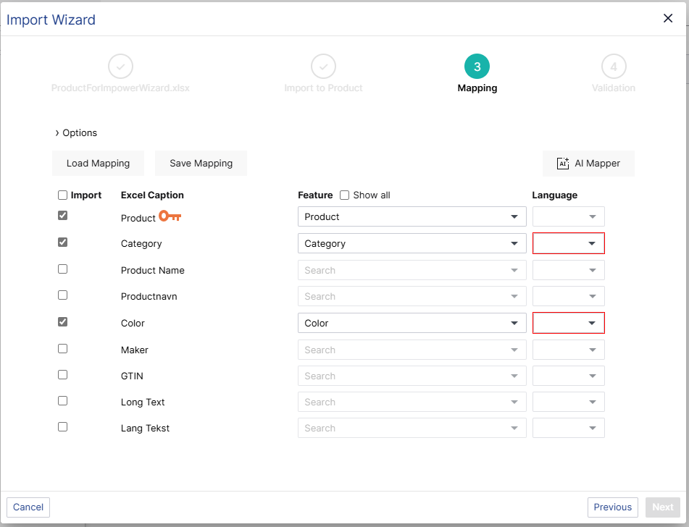
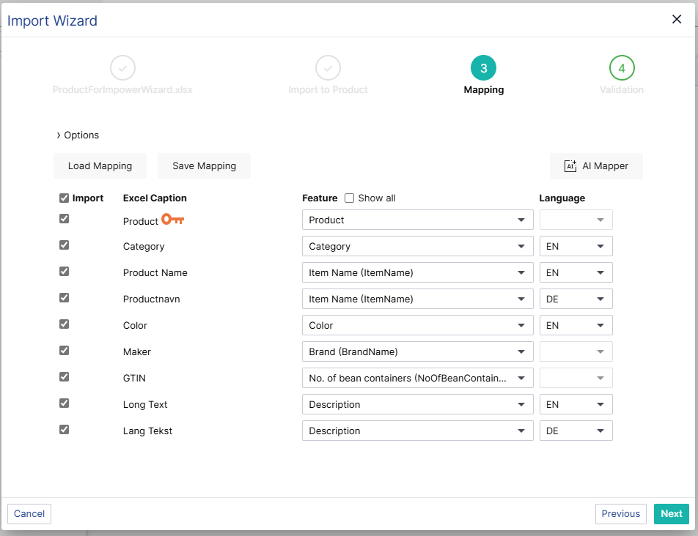
AI – Automapping in Import Wizard
Perfion 2025-R3
Use AI To Help Map Large Import Files
Saves times
Also maps languages

Slide 6
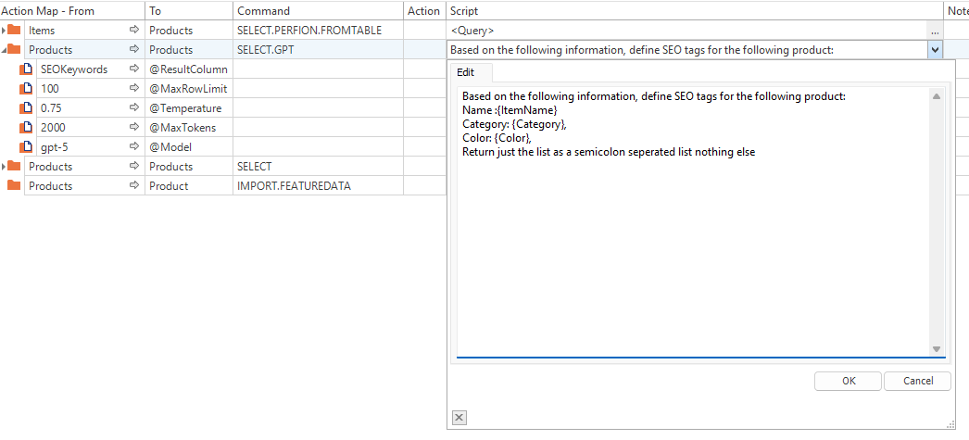
AI – Dedicated AI/GPT Command
Perfion 2025-R3
AI Actions without coding
Calls LLM for each row in input table
Write dynamic texts
Customize call with temperature, tokens usage and which model to use

Slide 7
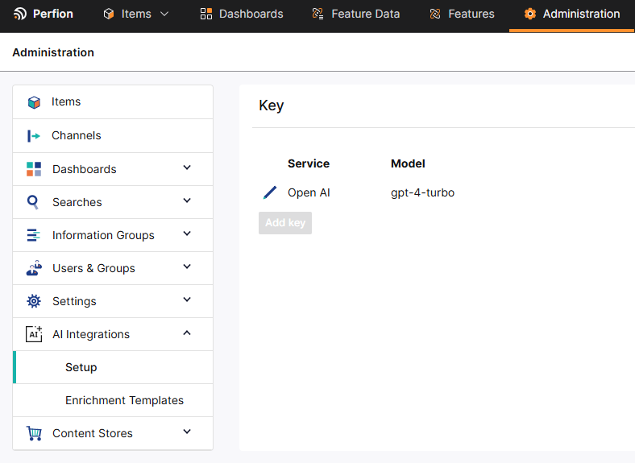
AI – Administration
Perfion 2025-R3
Prompt Templates and AI Keys can be managed in Administration
Define the default gpt model
Manage license key
Define enrichment template for users

Slide 8
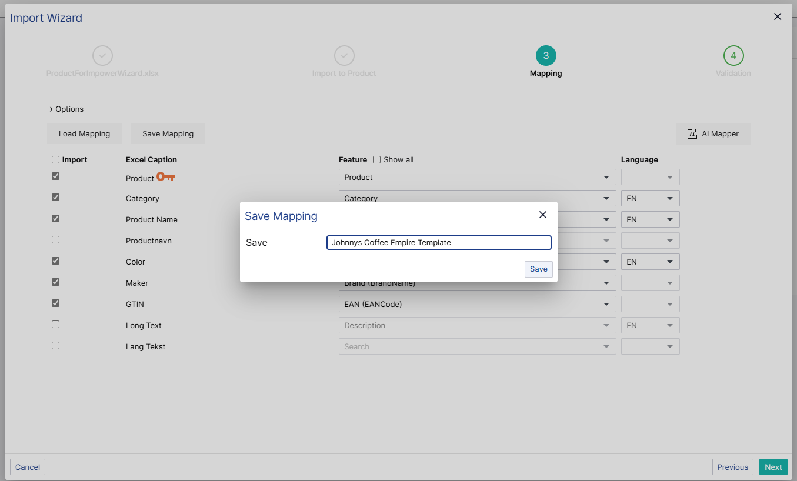
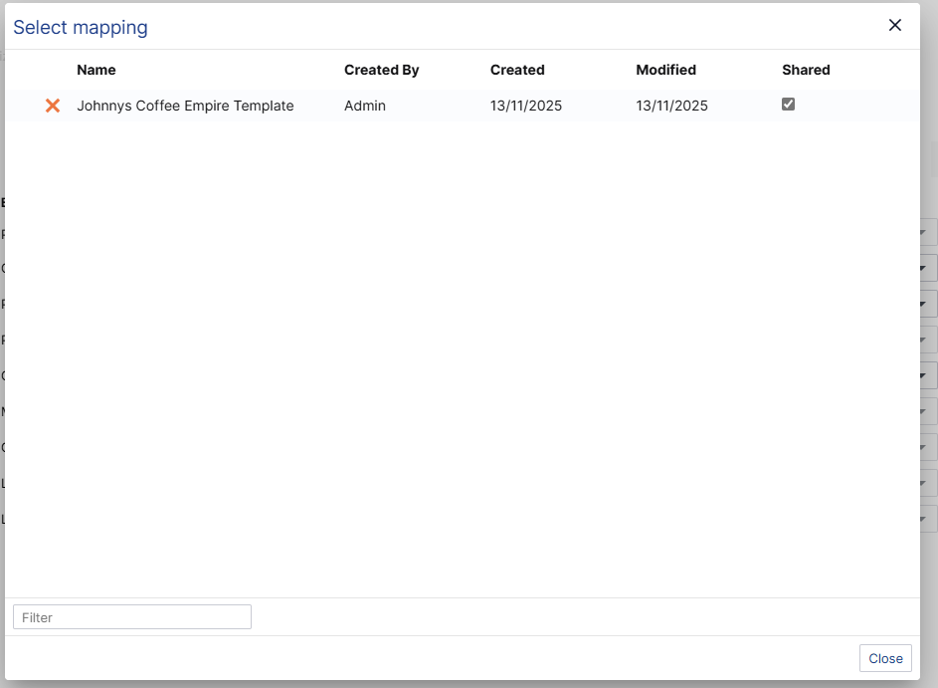
Import Wizard – Save & Load Mappings
Perfion 2025-R3
Save mappings and share them with others
Save mappings, so you don’t have to redo mappings every time
Also saves options
Choose which templates should be shared with other users

Slide 9
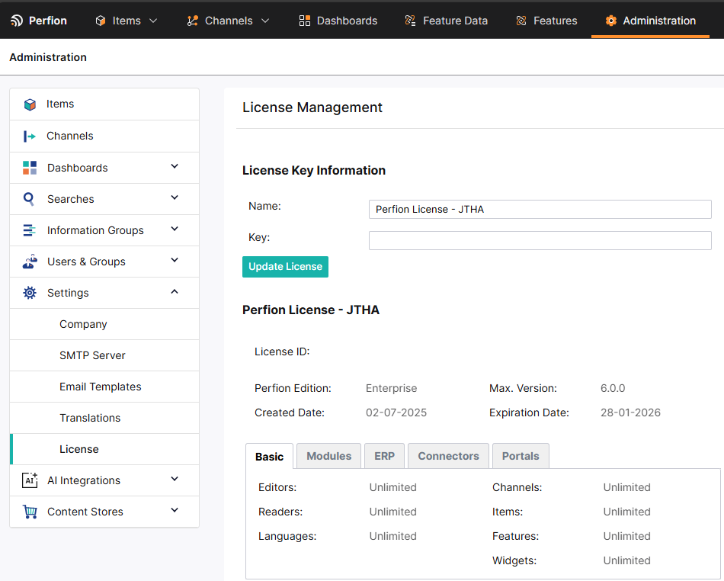
Administration in Web client
Perfion 2025-R3
Administer basic settings in the web client
Company Settings (mainly for supplier portal)
Setup and manage SMTP Servers
Customize email template
Manage translations & translation dictionaries (DeepL)
See and update license

Slide 10
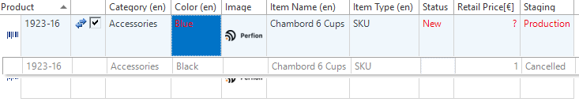
New Importer – Staging & Update Item Parent
Perfion 2025-R3
Import Products to Stages In New Importer
Import Stage by feature name or by _stage
Update Parents with _ToParentPath
Update the item hierarchy

Slide 11
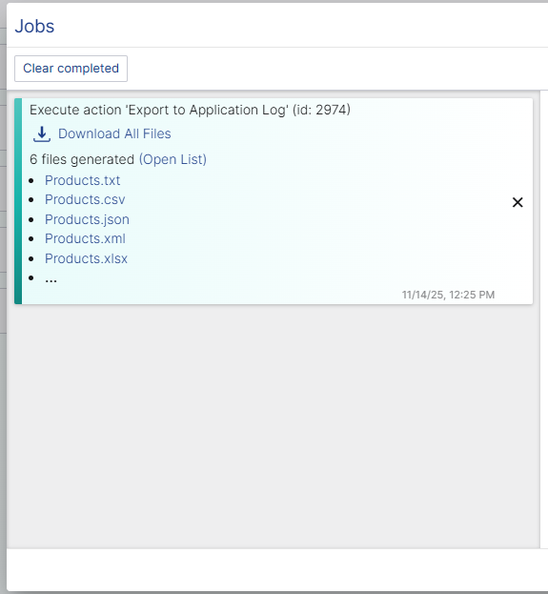
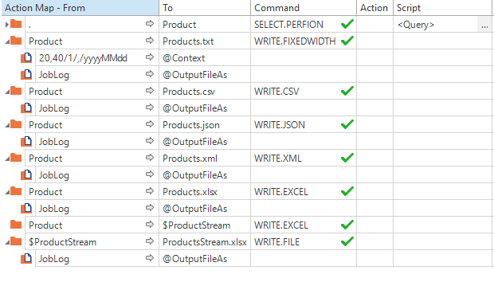
Actions Improvements – Write To Job Log
Perfion 2025-R3
Use Any WRITE.* command to write files to application server
Retrieve file outputs without a local drive
Export multiple files
Works with all existing commands

Slide 12

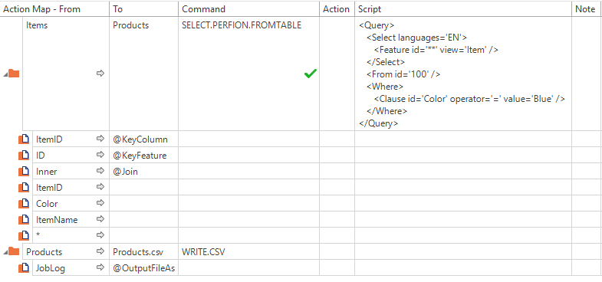
Actions Improvements SELECT.PERFION.FROMTABLE
Perfion 2025-R3
Query additional information directly on a datatable
Complicated scripts and loops are no longer needed to fetch additional information to a data table
Works well with triggers and context actions
Join options
  Left – Keep entire input table
  Inner – Only keep results that are found

Slide 13
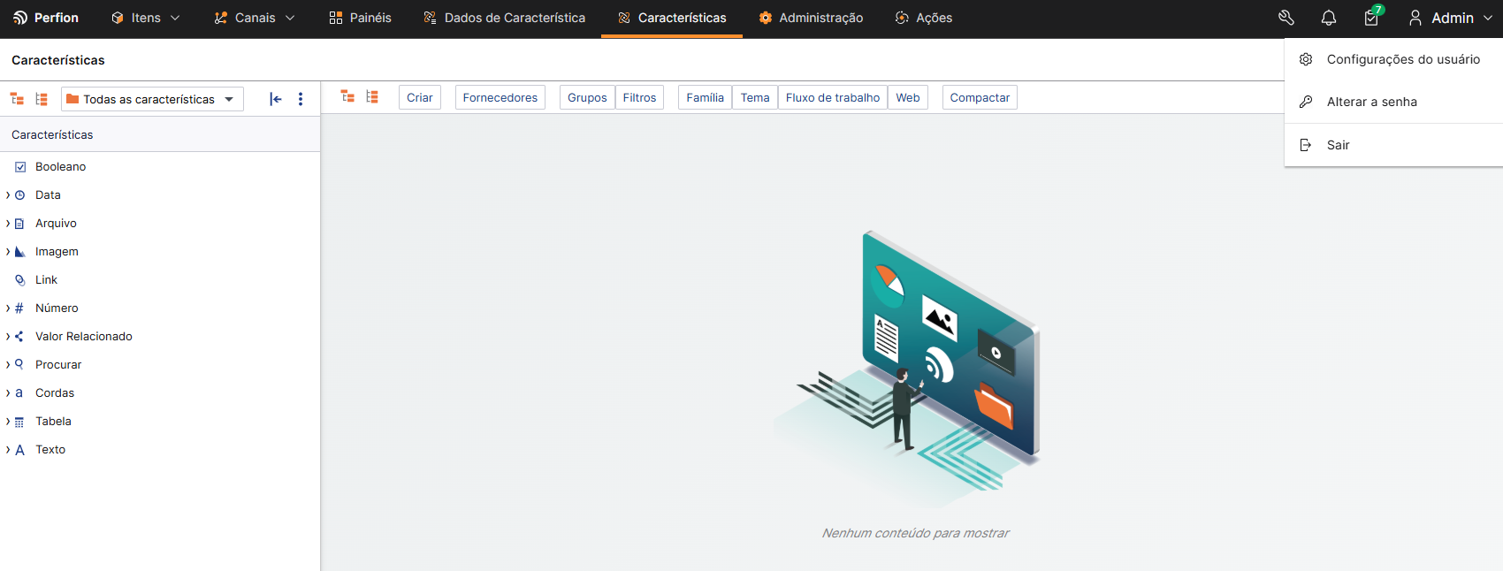
Portuguese (Brazil) User Interface
Perfion 2025-R3

Slide 14
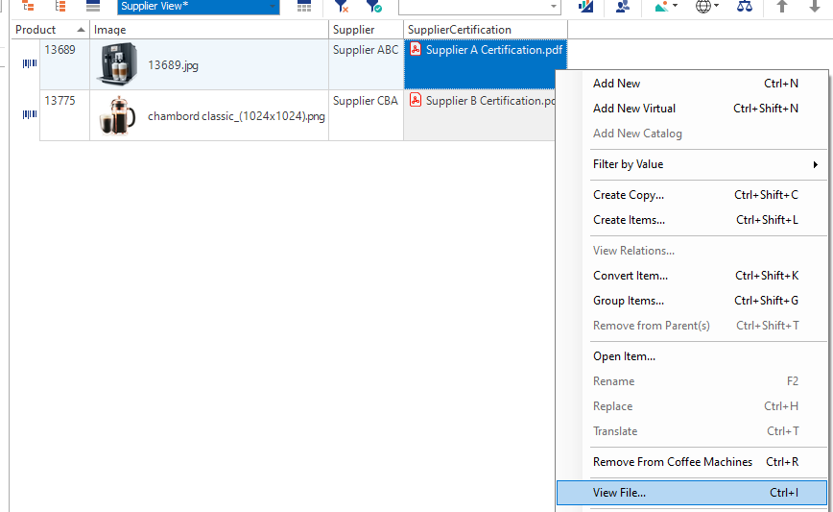
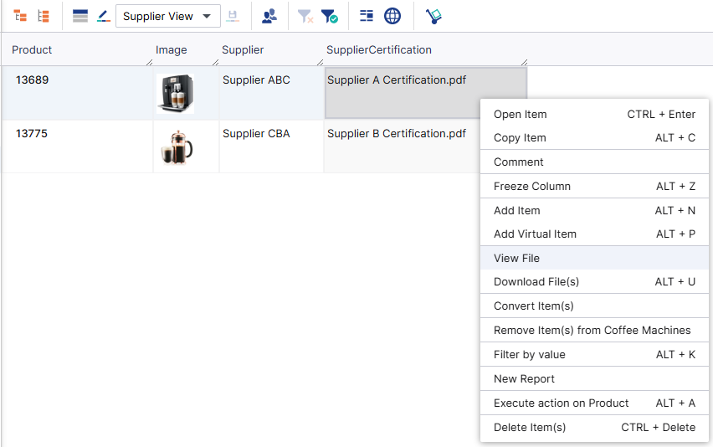
Files as Related Values
Perfion 2025-R3
Was never properly supported in either web or windows
Now fully supported in both
Works as you would expect a file feature to work

Slide 15
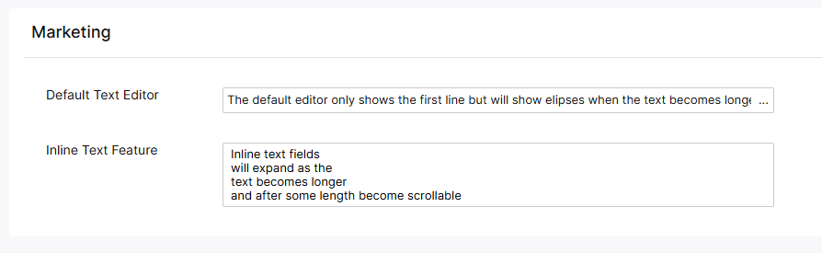
Inline Texts in Web Client
Perfion 2025-R3
Better overview when managing many Text feature
Respects Control Type

Slide 16
2025-R2
Build: 5.7.0
Released: Juli 2025

Slide 17
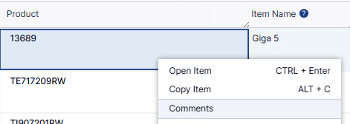
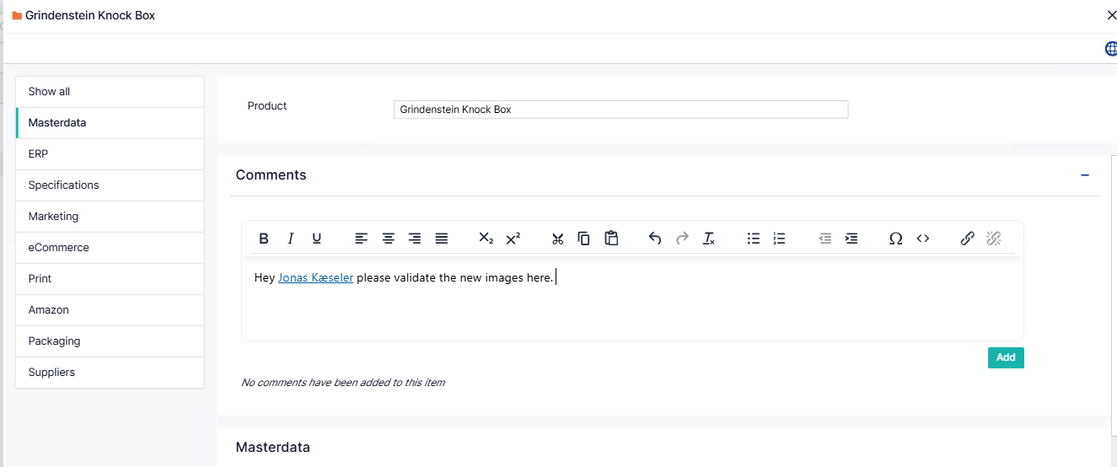
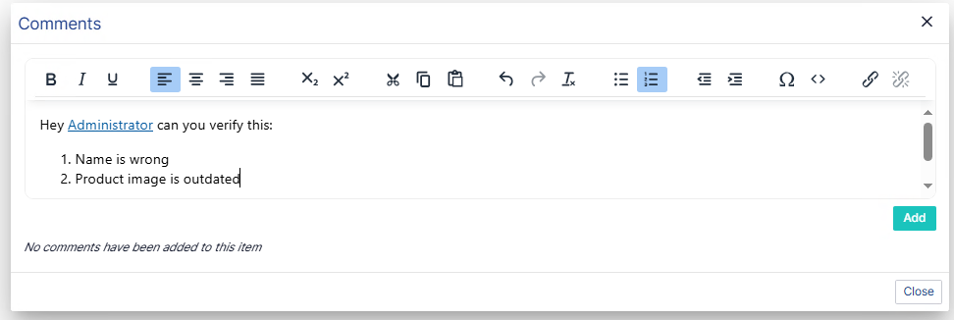
Comments
Add comments to any selectable item
Tag other users
Available in grid (right-click) and in Item Editor

Slide 18
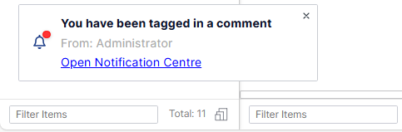
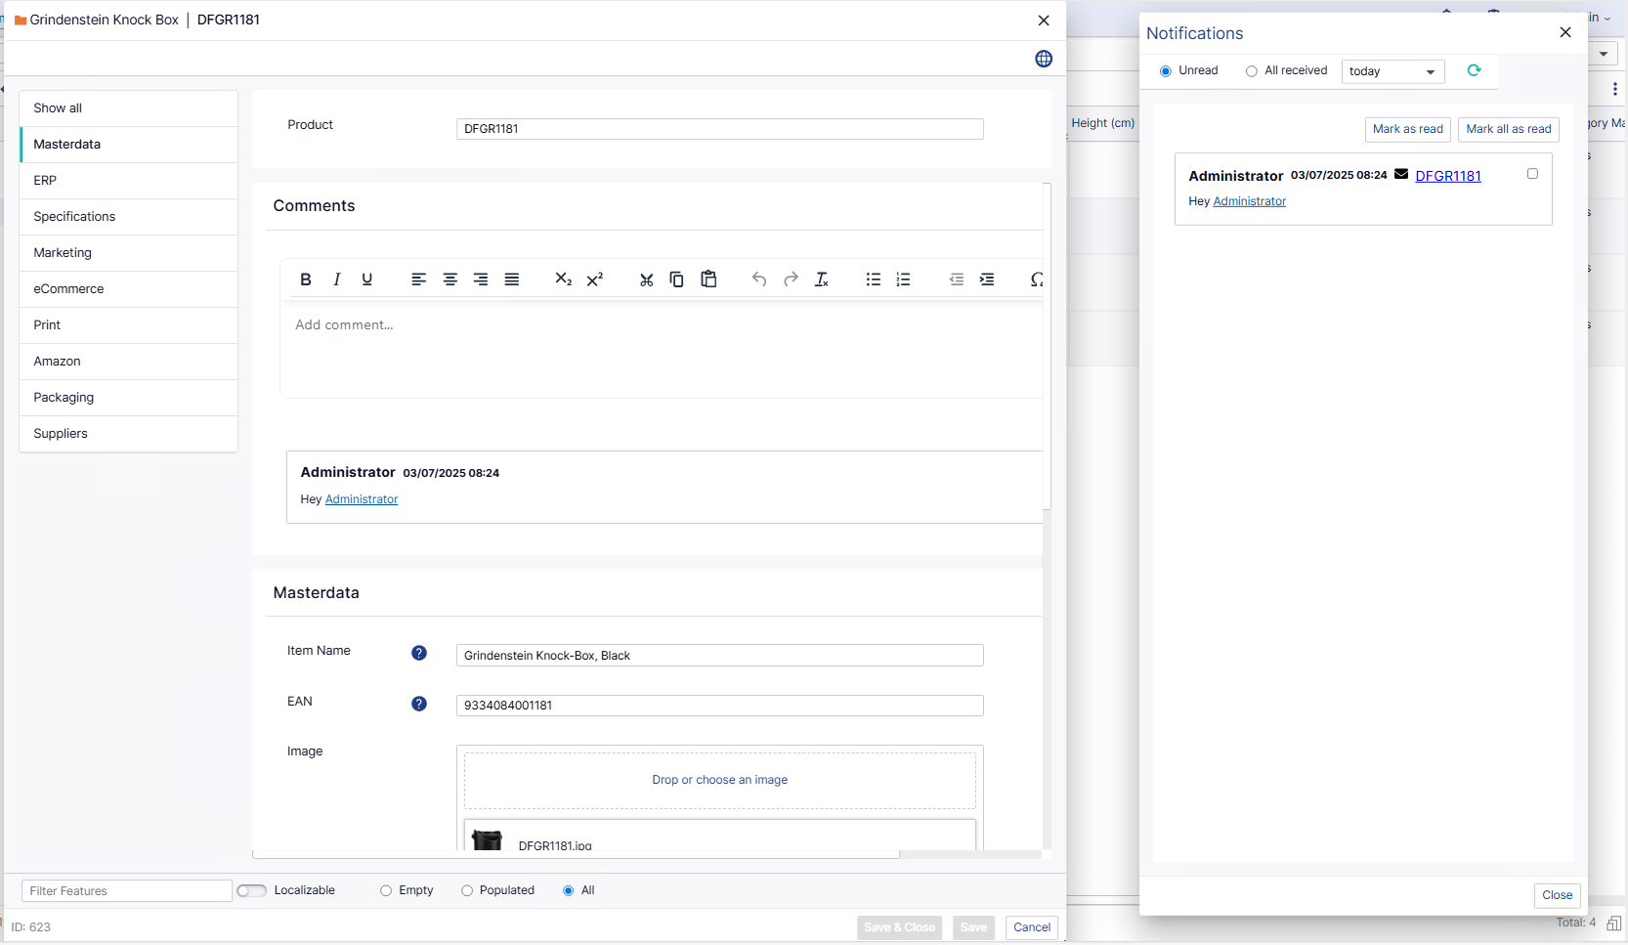
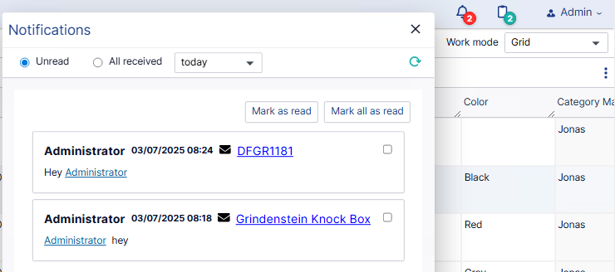
Notification Centre
When a user tags you in a comment, you get pop-up Notifcation
The new Notification icon shows how many unread comments you have
From the Notification Centre you open the item you’re tagged in

Slide 19
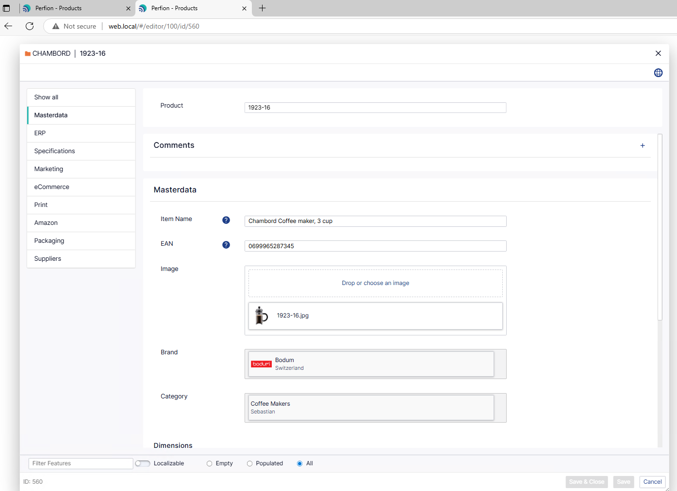
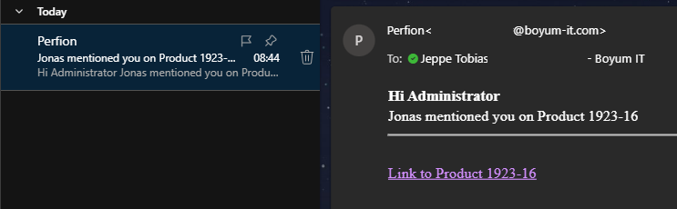
Notification Emails
When a user tags you in a comment, you get Notification email (can be disabled)
The link opens the Item Editor for that product

Slide 20
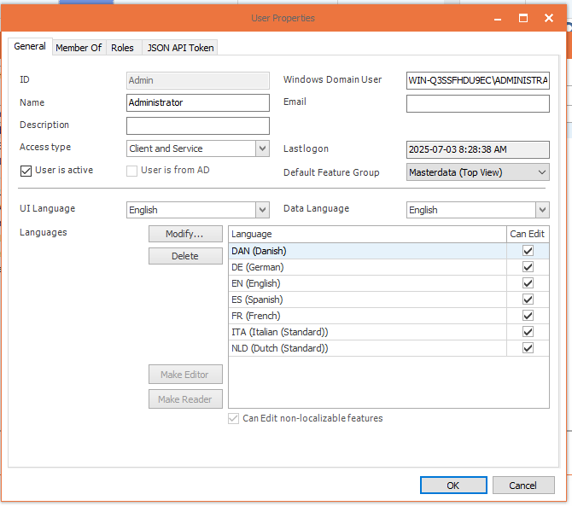
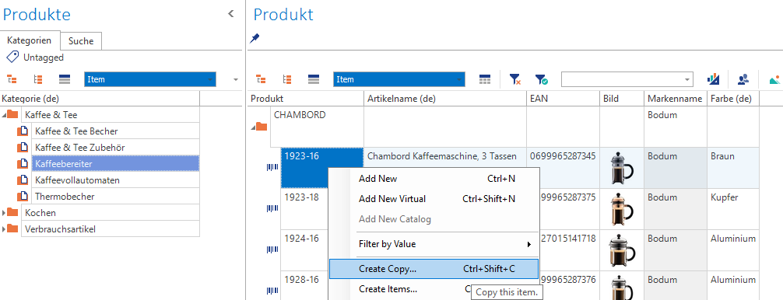
Split Data & UI Language – Windows Client
You can now have a different UI and data language in Windows
Ensures you have the UI you prefer, no matter what language you need to manage

Slide 21
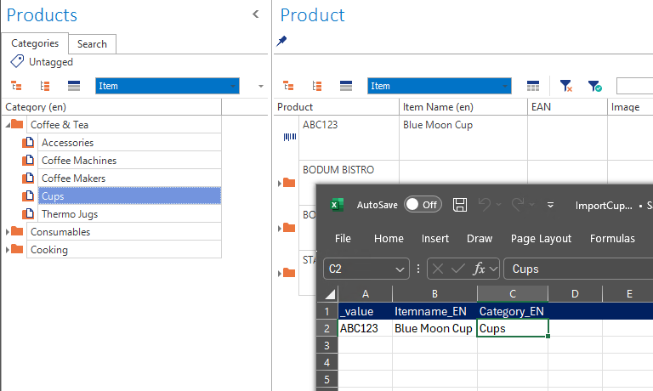
Split Data & UI Language – Windows Client
New Importer finds the item in the hierarchy if the item is unique
If the item (Cups) exist in root and other positions it will be added to root
If the item exists in multiple non-root positions, an error is thrown.

Slide 22
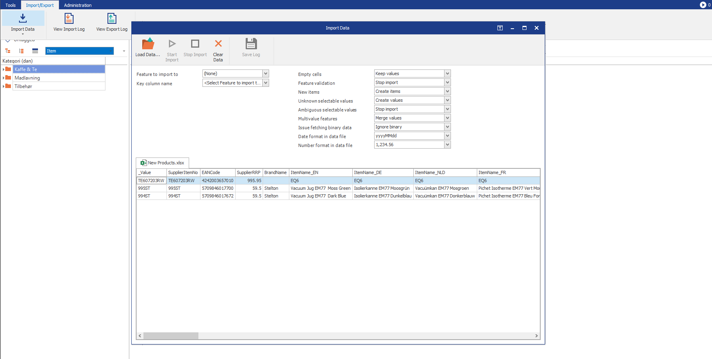
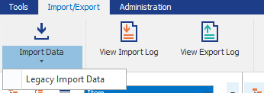
New Importer in Windows Client
Use the new importer directly in Windows client
New importer see vastly increased performance on large data set
Can run imports in parallel
Previously only in Actions & Import Wizard
The “legacy” importer is still available

Slide 23
Import without hierarchy path
New Importer finds the item in the hierarchy if the item is unique
If the item (Cups) exist in root and another position, it will be added to root
If the item exists in multiple non-root positions, an error is thrown.

Slide 24
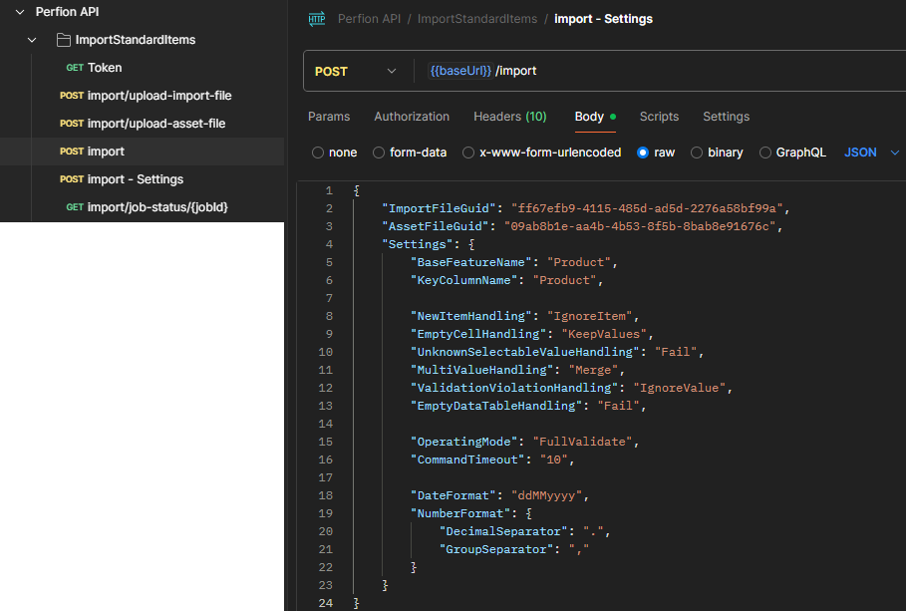
Import with API
You can now upload excel & asset zip files through API and start imports remotely
Authenticate
Upload import file
(option) upload asset file (.zip)
Start import
Check status
Documentation & Postman collection available on Knowledge Base (soon)

Slide 25
2025-R1
Build: 5.6.0
Released: May 2025

Slide 26
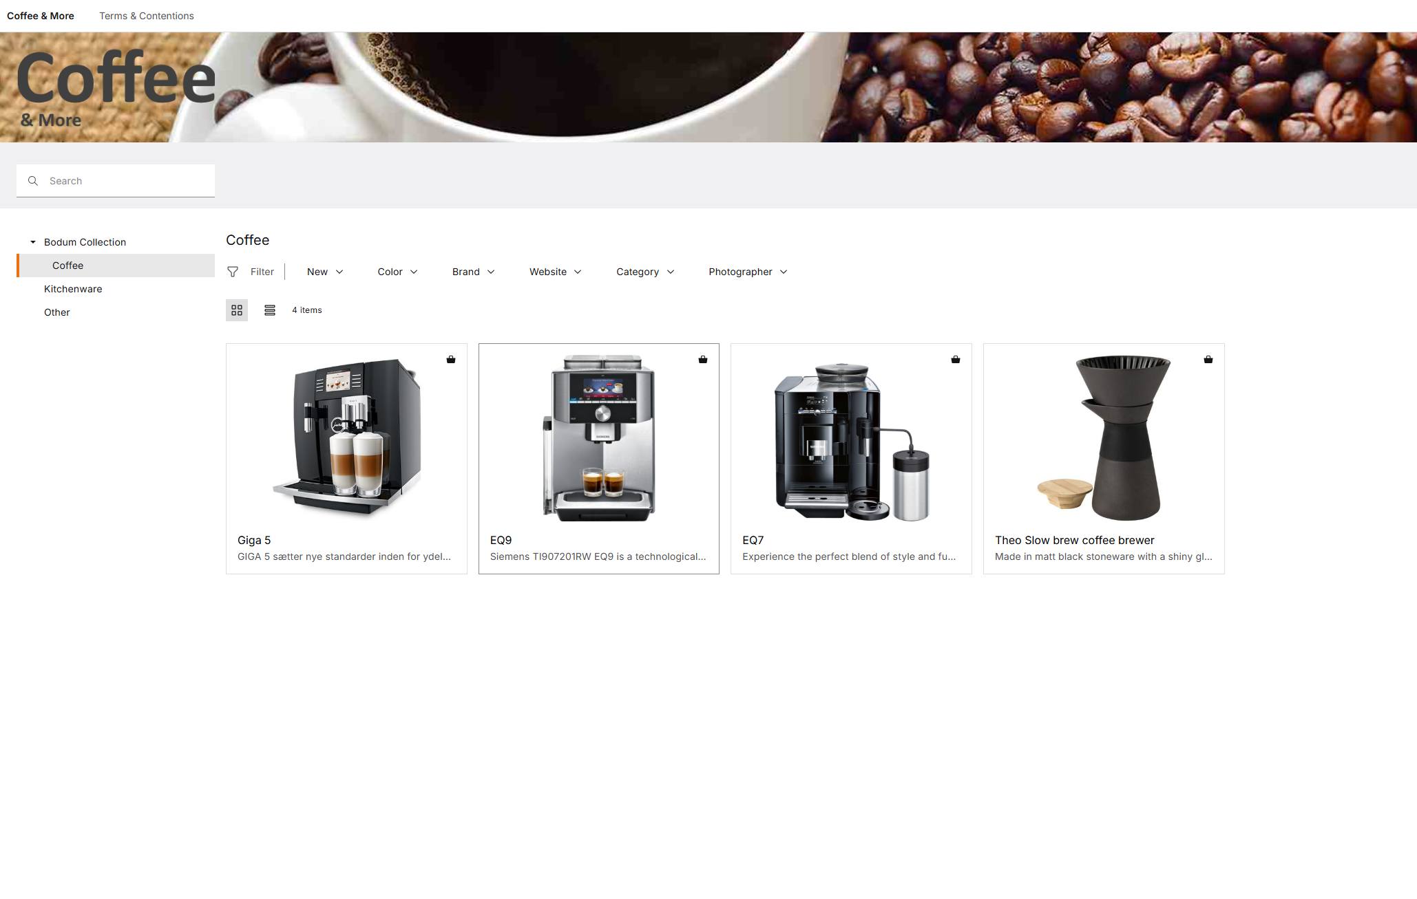
Content Store 1.0
Full Self-service content portal
Easy to configure
Find & download the content in the available languages

Slide 27
Content Store 1.0 - Administration
Content Store fully configurable from Perfion Webclient
Uses well-known Perfion principles

Slide 28
Content Store 1.0 - Administration
Content Store fully configurable from Perfion Webclient
Uses well-known Perfion principles

Slide 29
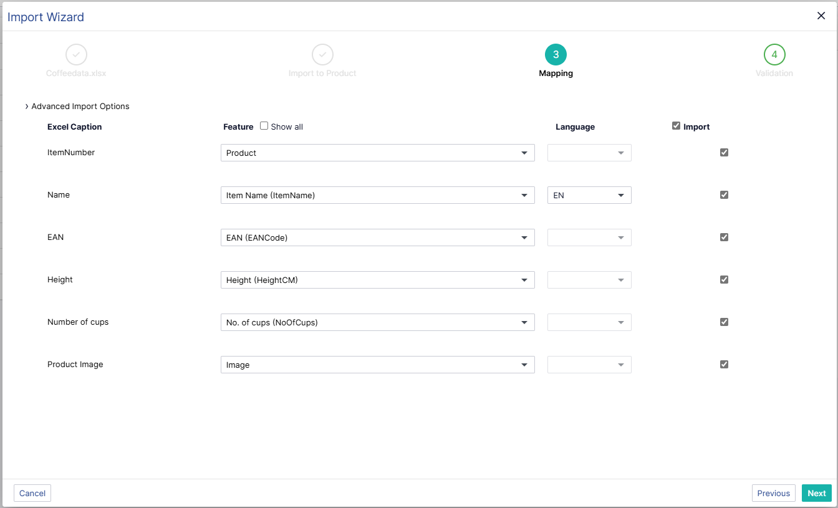
Import Wizard
Import any excel file, no need to preformat
Map columns to features
Uses the new importer

Slide 30
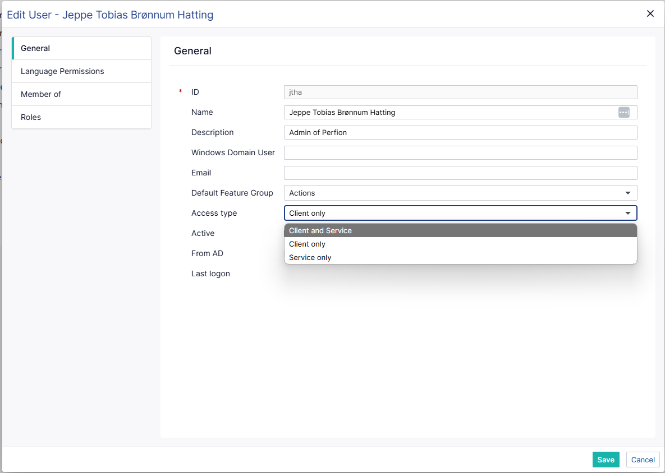
User Access Types
Control User Access
Made dedicated API Users

Slide 31
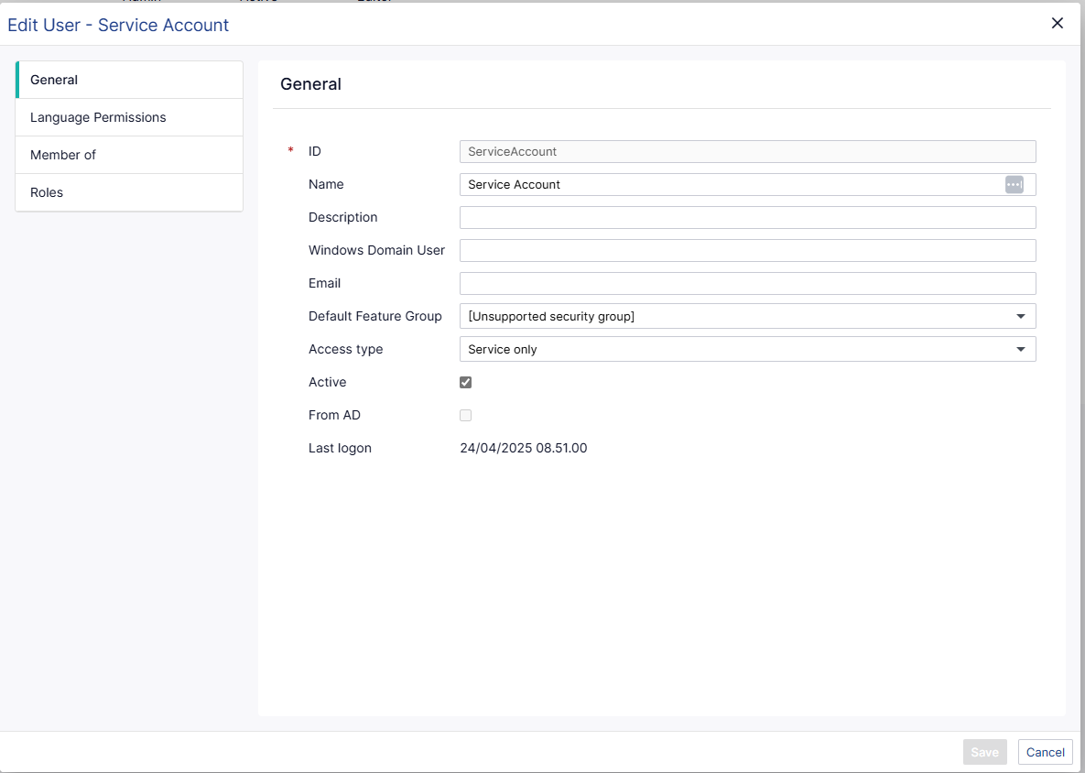
Free Service Account
Dedicated User for API & Application Server
Does not count against licensed Users

Slide 32
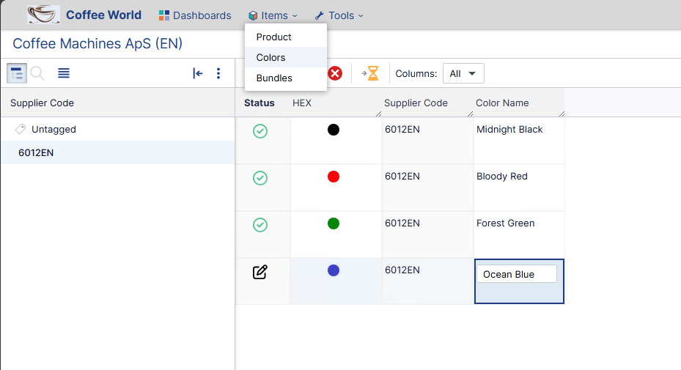
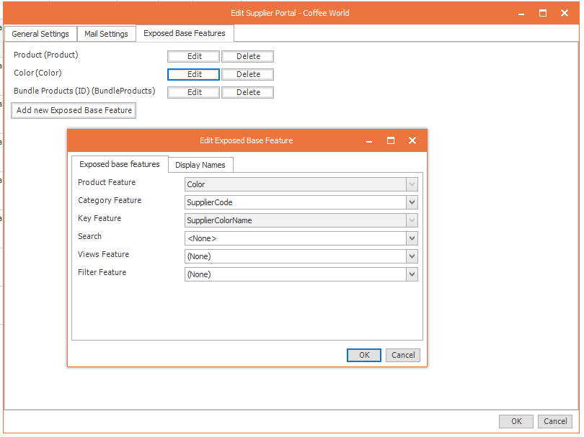
Exposes Multiple Base Features In Supplier Portal
Expose not only Products but also
Colors
Price lines
Complex data such as
  Bill of materials
  Ingredients

Slide 33
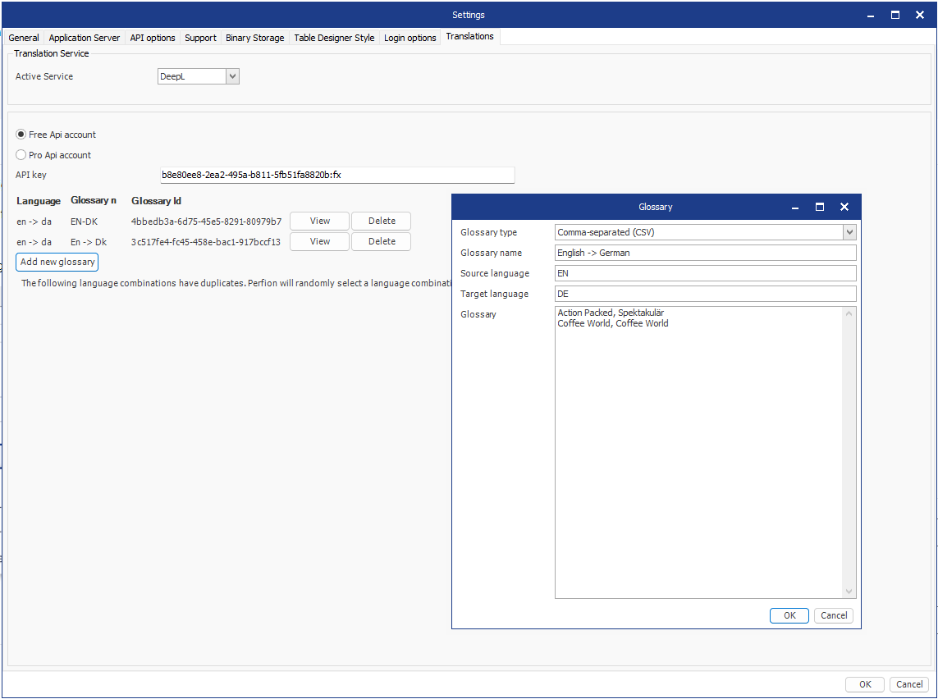
DeepL Glossary Translations
Create reserved tranlsations
Personalise translations
Ensure Company language is intact

Slide 34
Boyum IT Solutions
Headquarters (Denmark)
Boyum IT Solutions
Sintrupvej 7 1b, 1th
DK – 8220 Brandbrand
linkedin.com/company/boyumit
sales@boyum-it.com
youtube.com/user/boyumit
boyum-solutions.com
instagram.com/boyumit/

