Slide 1


Perfion Core Features
Highlights from 2018-2024 releases

Slide 2

2024-R2
Build: 5.5.0
Released: October 2024

Slide 3
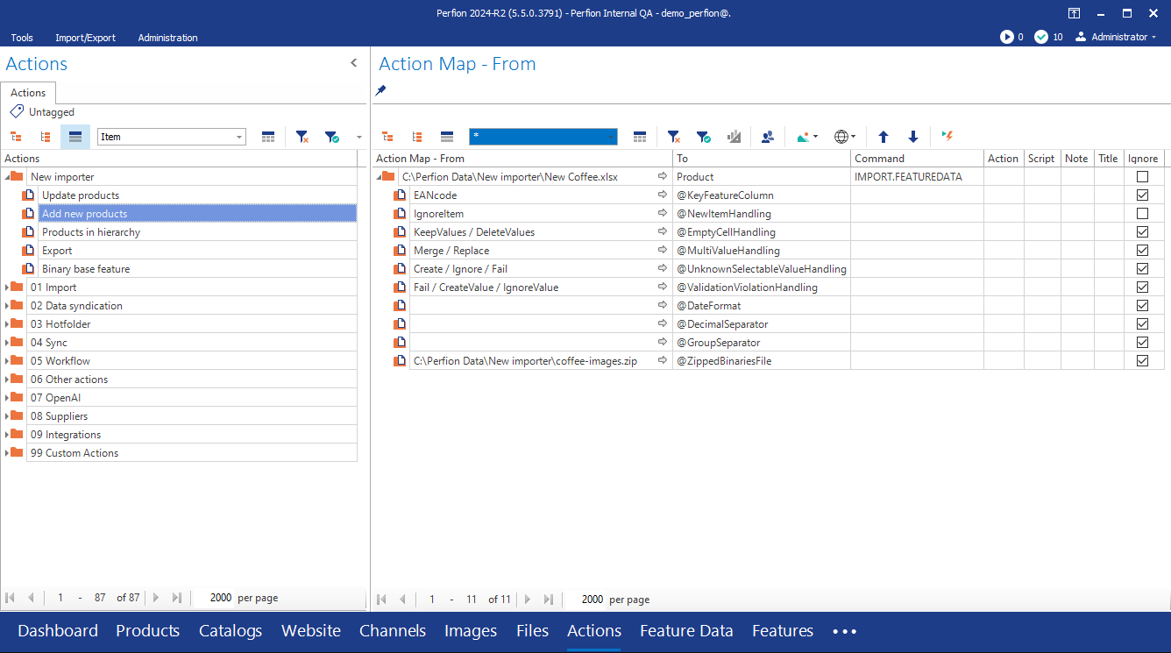
Perfion 2024-R2 (version 5.5)
New importer (Action command): IMPORT.FEATUREDATA
What’s new
  _ParentPath
  Binary base features
  Binary import from zip
  Case sensitive updates
  Delete values
  More parameters
New “Export” option
  SELECT.PERFION can output data in new import format

Slide 4
2024-R1
Build: 5.4.0
Released: April 2024

Slide 5
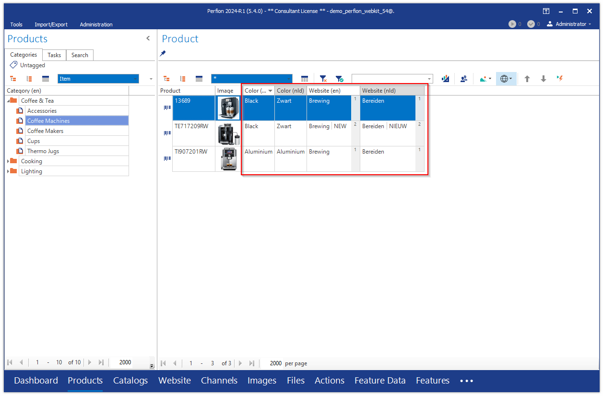
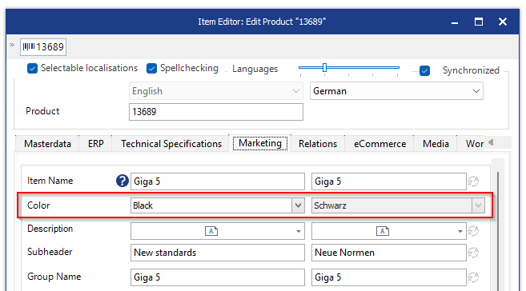
Perfion 2024-R1 (version 5.4)
Language variants on selectables
Validate selectable translations in grid and item editor
Edit translations via “Open selectable item”

Slide 6
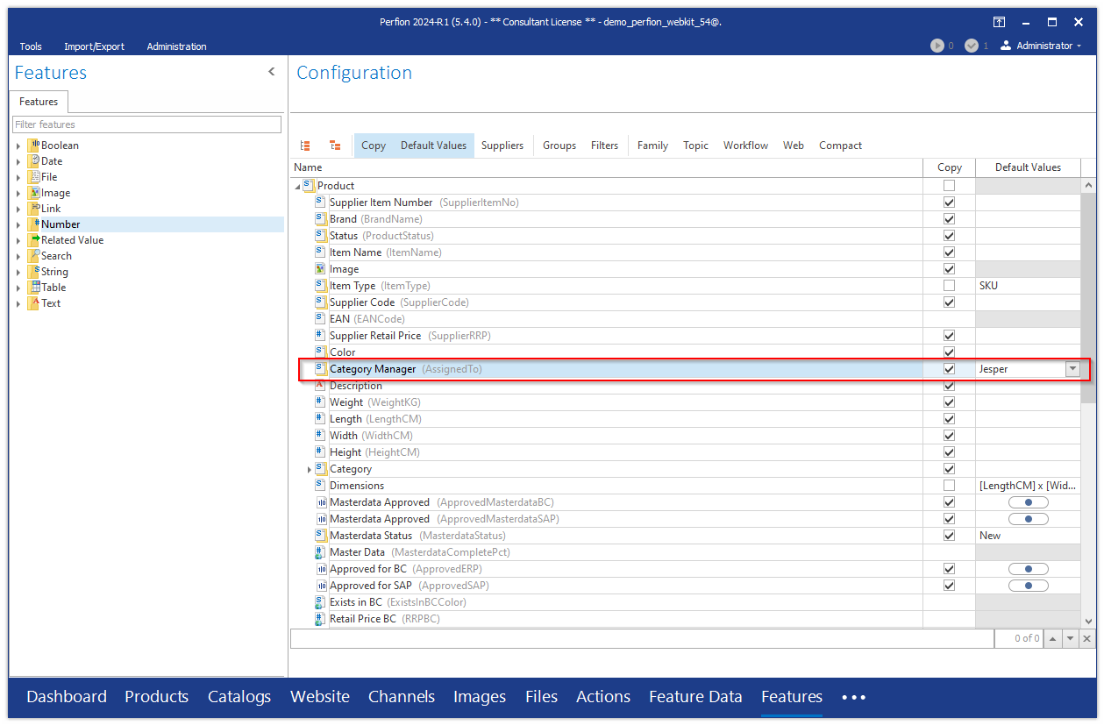
Perfion 2024-R1 (version 5.4)
Default values and Copy allowed together
Has effect when items are copied
Rules:
  Existing values are always copied
  When no value exists, default value is applied
  Parent values always win over child values

Slide 7
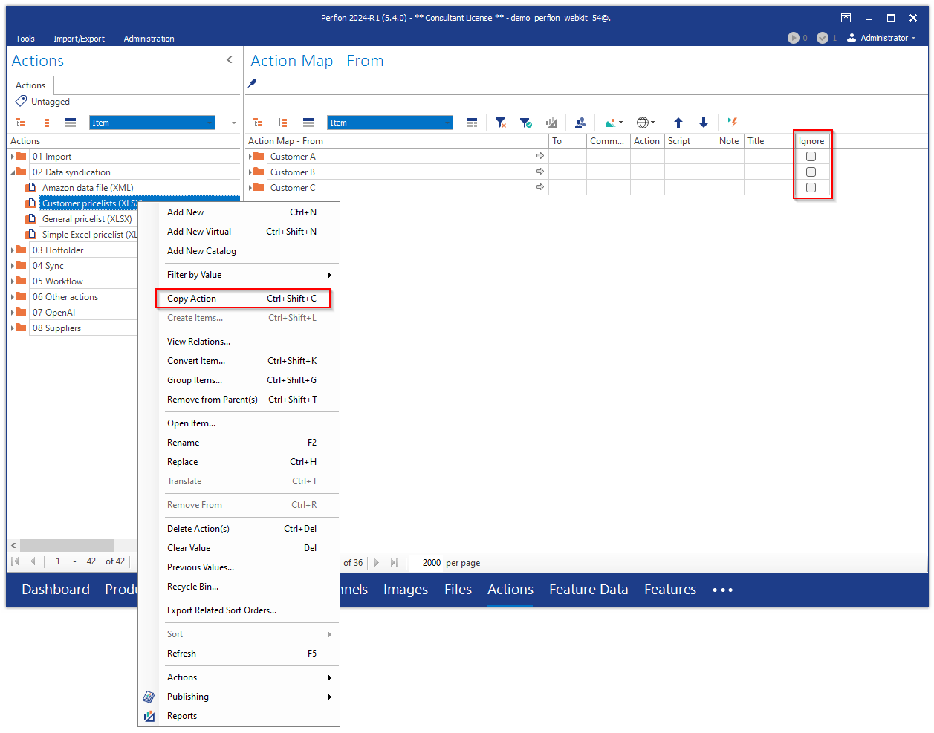
Perfion 2024-R1 (version 5.4)
Action management improvements
Ignore at group level (also in windows client)
Copy action

Slide 8
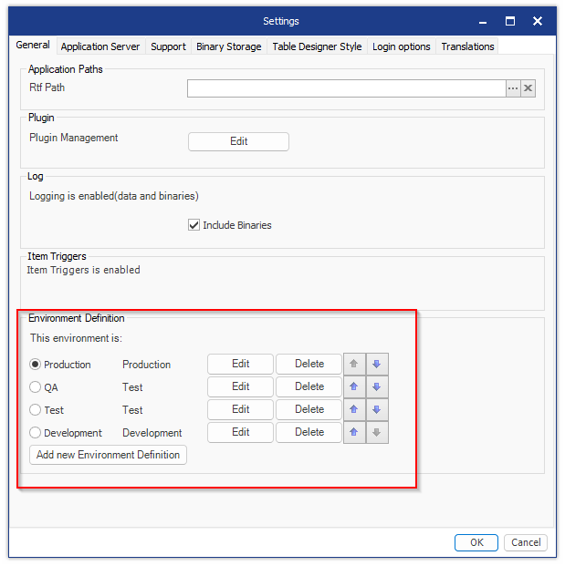
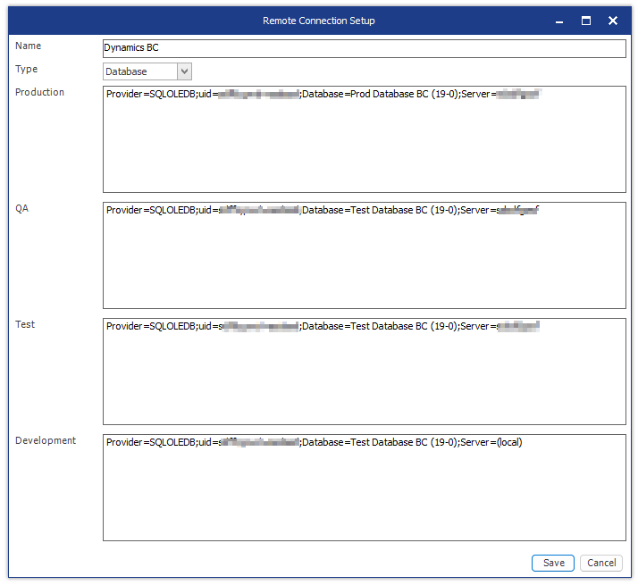
Perfion 2024-R1 (version 5.4)
Multiple environments
Manage environments
Individual connections for each environment

Slide 9
2023-R2
Build: 5.3.0
Released: October 2023

Slide 10
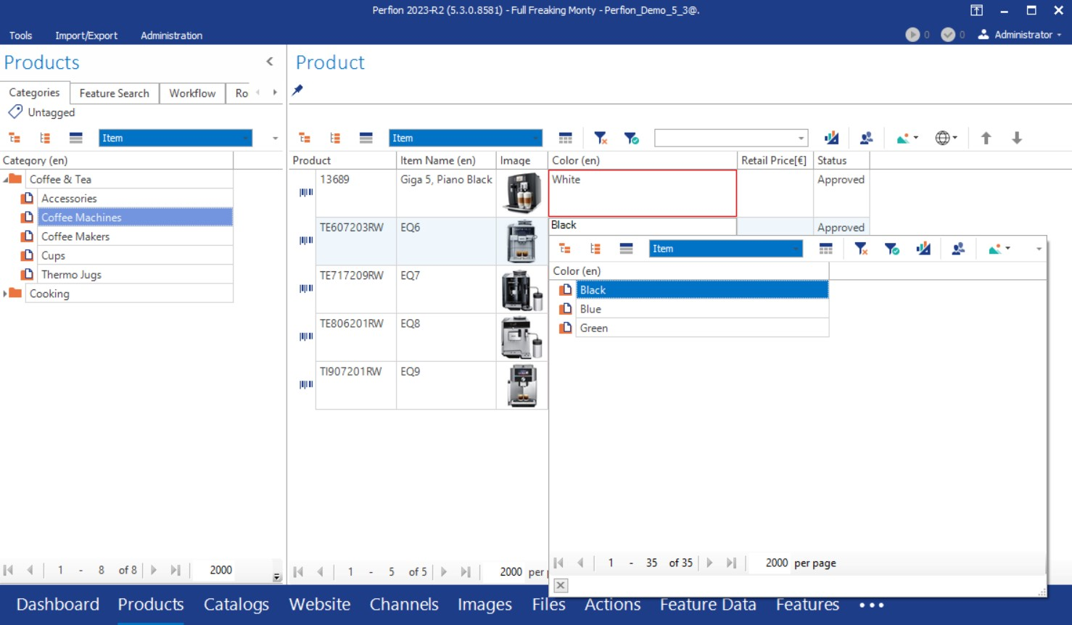
Perfion 2023-R2 (version 5.3)
Filtered Values
Filter available selectable values in any feature based on value in “controlling” feature
Highlight violations in grid and item editor
Examples:
  Allow specific Colors for each product category
  Allow specific materials for each supplier

Slide 11
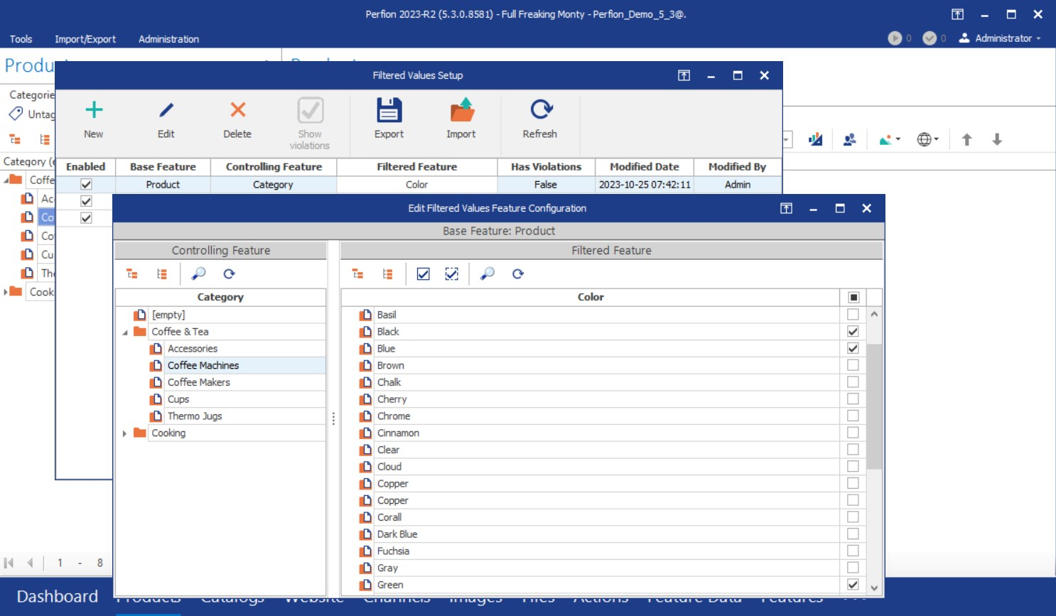
Perfion 2023-R2 (version 5.3)
Filtered Values Setup
Create, Edit and Delete Filtered Values configurations for a base feature where a controlling feature defines possible values for a filtered feature
Export configurations
Import configurations

Slide 12
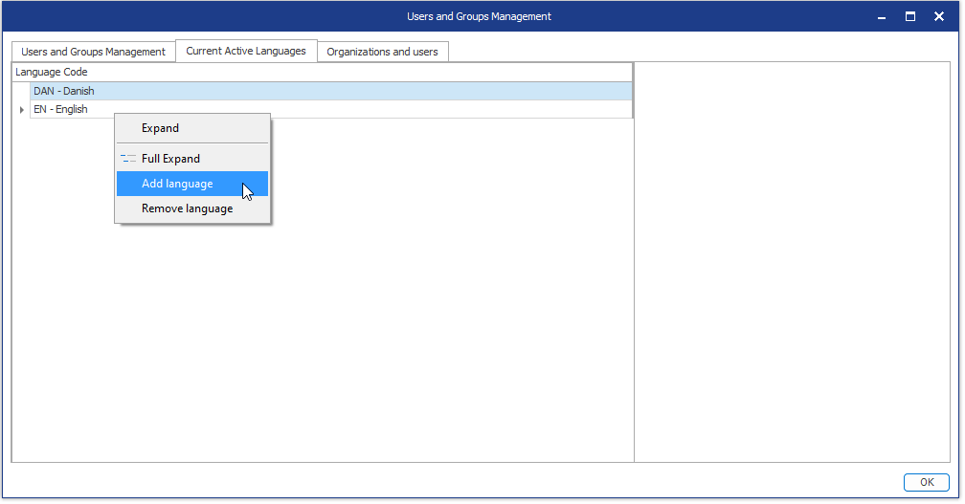
Perfion 2023-R2 (version 5.3)
Control Active Languages
Add/remove active languages
Explicit definition - no longer implicitly controlled by user assigned languages

Slide 13
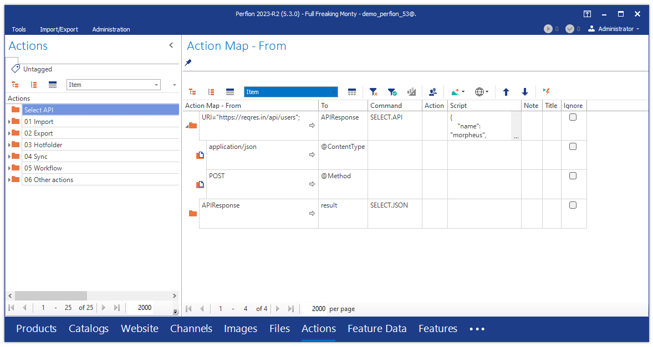
Perfion 2023-R2 (version 5.3)
Actions: SELECT.API command
Easy integration with other API-enabled systems
REST and SOAP Protocols
Supports several different authentication schemes e.g., Bearer Token and OAuth

Slide 14
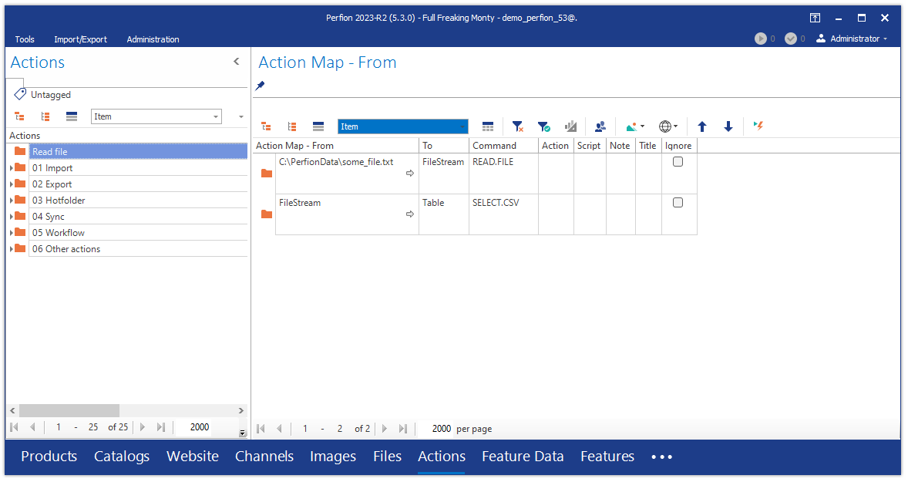
Perfion 2023-R2 (version 5.3)
Actions: READ.FILE command
Read any file type into a file stream
Use the stream to select data, upload to FTP or send as attachment in an email

Slide 15
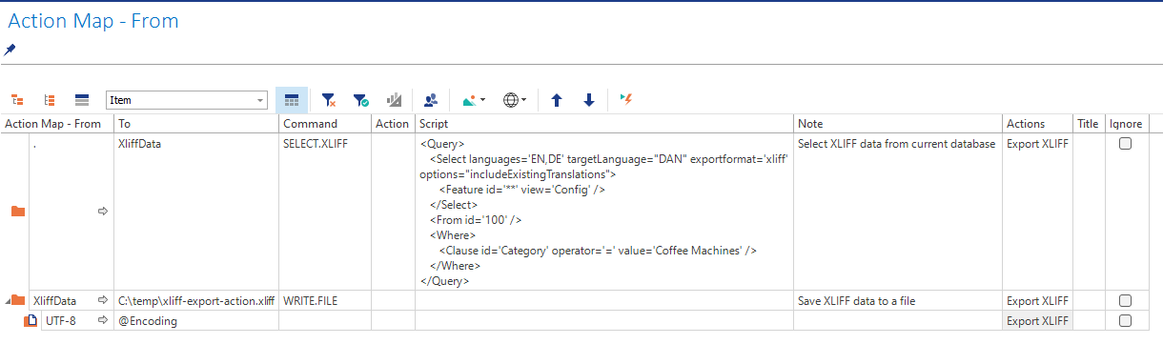
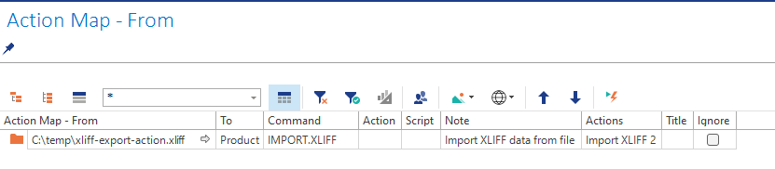
Perfion 2023-R2 (version 5.3)
Actions: import/export XLIFF
New command – SELECT.XLIFF
  Execute Perfion query and export to
  XLIFF (XML) format
New command – IMPORT.XLIFF
  Import translations from XLIFF file

Slide 16
2023-R1
Build: 5.2.0
Released: May 2nd, 2023
(requires database upgrade)

Slide 17
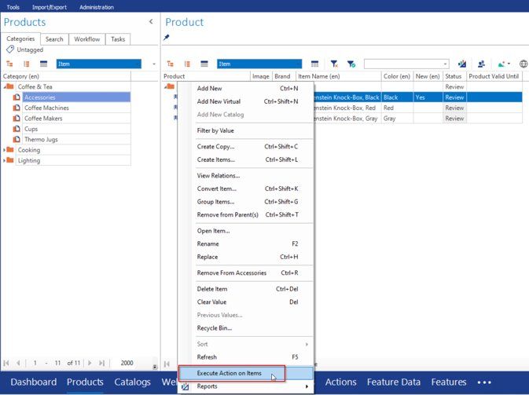
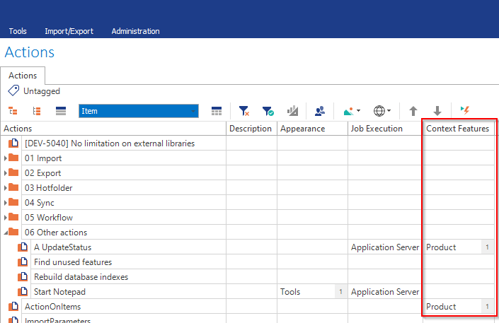
5.2 2023 R1
Actions: Execute in context
Execute action in context of item(s) in grid or categorizer
Item ID(s) are sent to action
Actions can work their magic as always on selected items
  Update values
  Export data
  Sync data from external source All or selected Items
Executed as logged in user

Slide 18
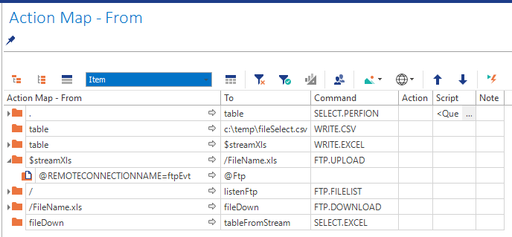
5.2 2023 R1
Actions: FTP
It is now possible to use Actions with different variations of FTP:
  File Transfer Protocol (FTP)
  File Transfer Protocol Secure (FTPS)
  Secure Shell File Transfer Protocol (SFTP)

Slide 19
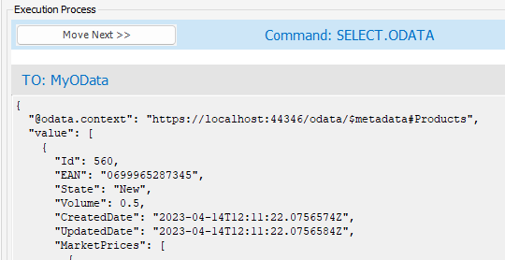
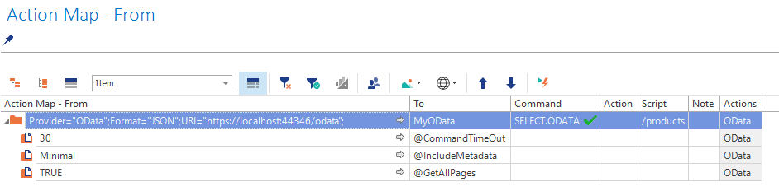
5.2 2023 R1
OData
OData remotes now supports services that only return minimal metadata.
Can be relevant for e.g., integrations with SAP Business One
In Actions, either full, minimal or no metadata can be requested

Slide 20
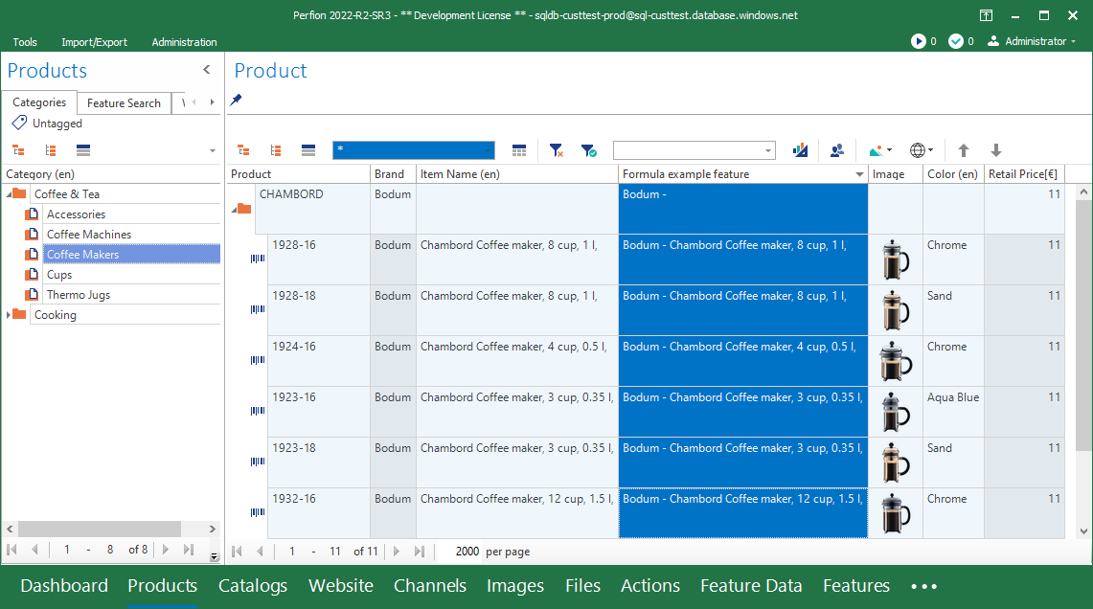
5.2 2023 R1
Formulas
Formula expression features no longer needs to be part of query
Formula expressions can contain remotes and related values

Slide 21
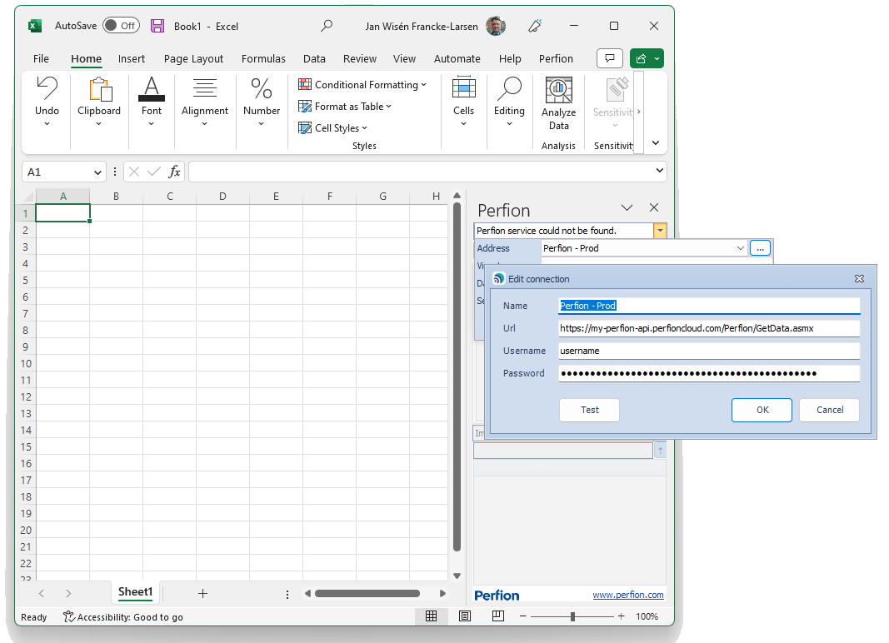
5.2 2023 R1
Office Add-in
It is now possible to use the Office Add-in, also when the Perfion API is secured with username/password

Slide 22



5.2 2023 R1
Watermarking
The Perfion Image Service has three endpoints
  Image
  ImageW
  ImageUncached
Previously, watermarks would only be applied to requests to the ImageW endpoint.
Now, all endpoints will apply watermarks according to configuration

Slide 23
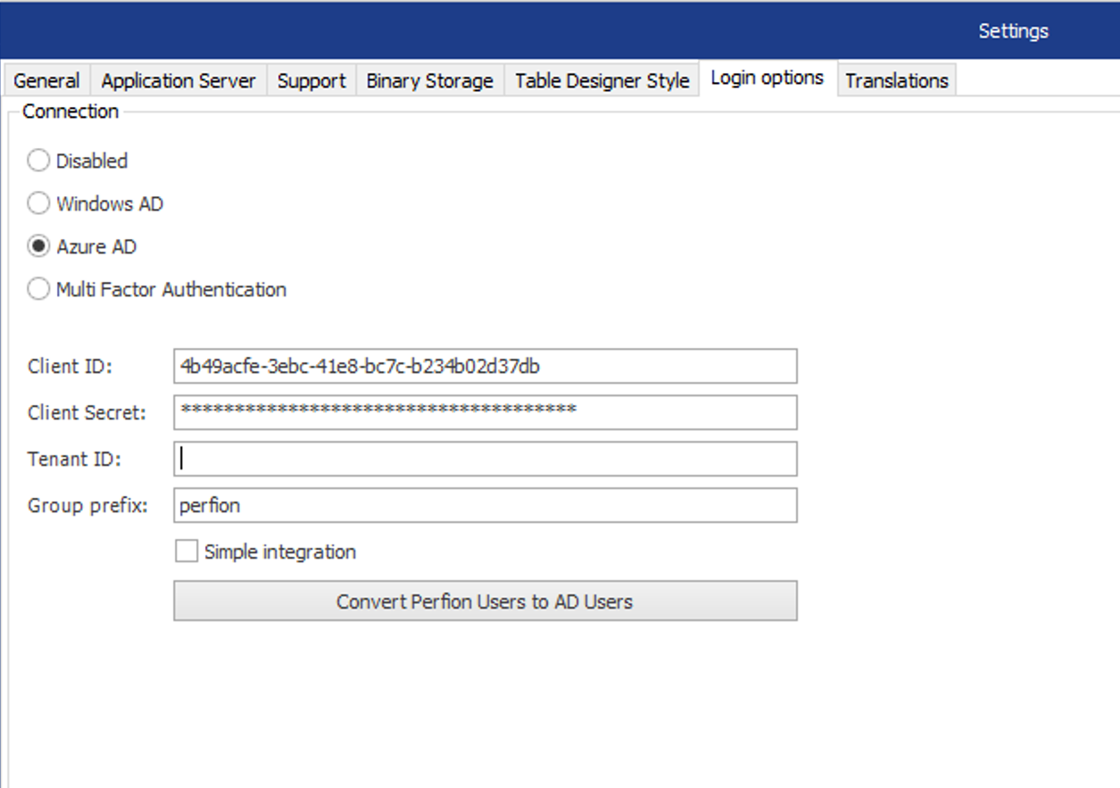
5.2 2023 R1
Active Directory Integration
Added “simple” integration option
  Groups and languages are controlled in Perfion and not in the AD
  One group is created in AD to control if a user is active or inactive in Perfion
Added Group prefix
  Great if you have multiple environments

Slide 24
2022-R2
Build: 5.1.0
Released: November 2022
(requires database upgrade)

Slide 25
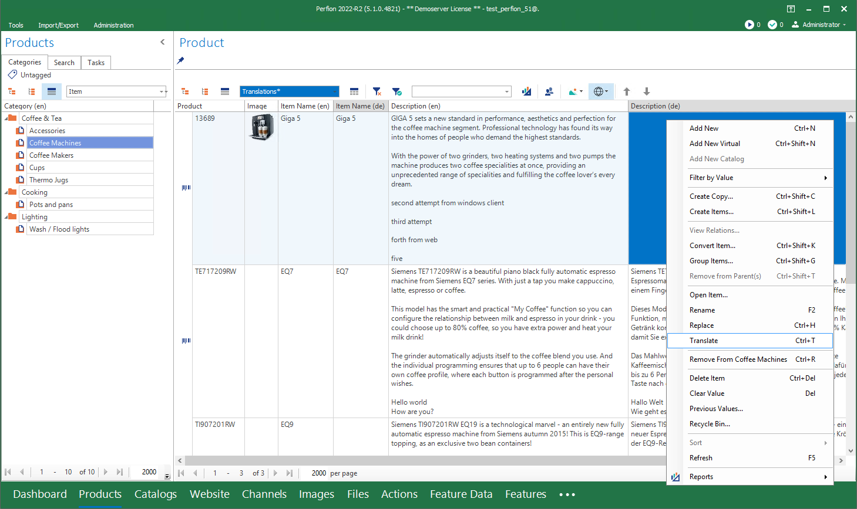
5.1 2022 R2
Translation Management
One-click translation from Item Editor
Multi-updates via grid
Choose your method:
  Google Translate
  DeepL
Use Actions to automate translations

Slide 26
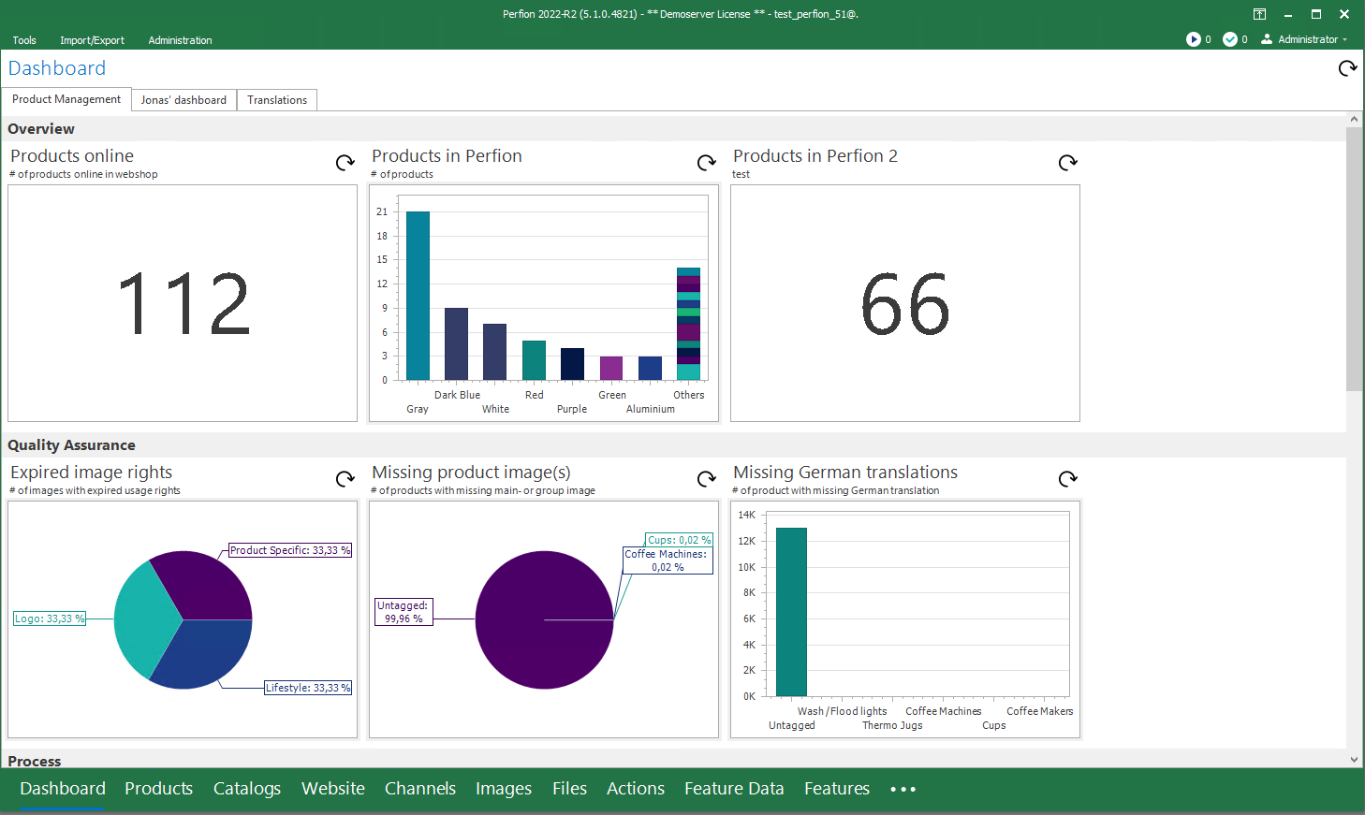
5.1 2022 R2
Dashboard Updates
Multiple and personalized dashboards
Optimized appearance
Choose between cached mode or live-updated widgets

Slide 27
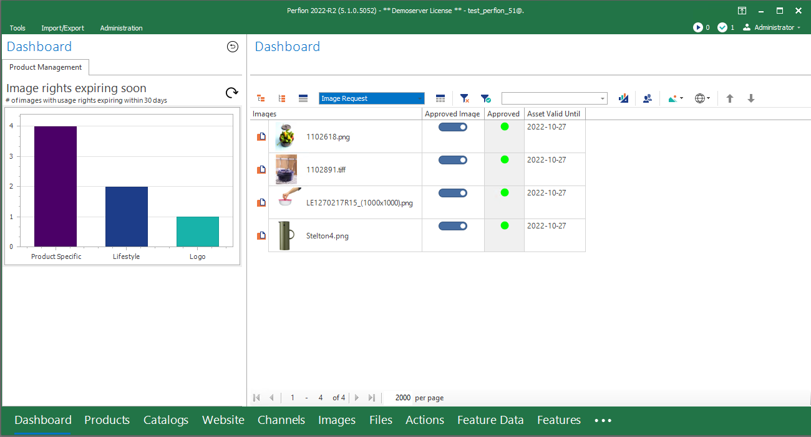
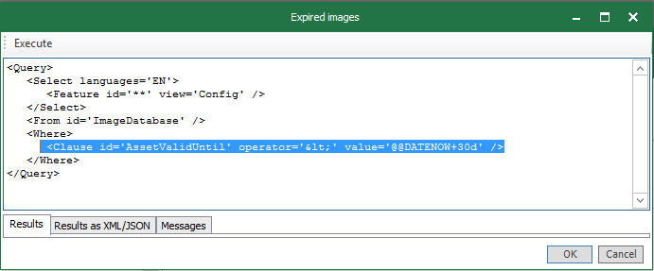
5.1 2022 R2
Date Operations in API
compare values in date features with today’s date +/- a range of days
compare system-managed createdDate and modifiedDate values on items and feature values with today’s date +/- a range of days.

Slide 28
5.0 2022 R1
Build: 5.0.0
Released: April 2022
(requires database upgrade)

Slide 29
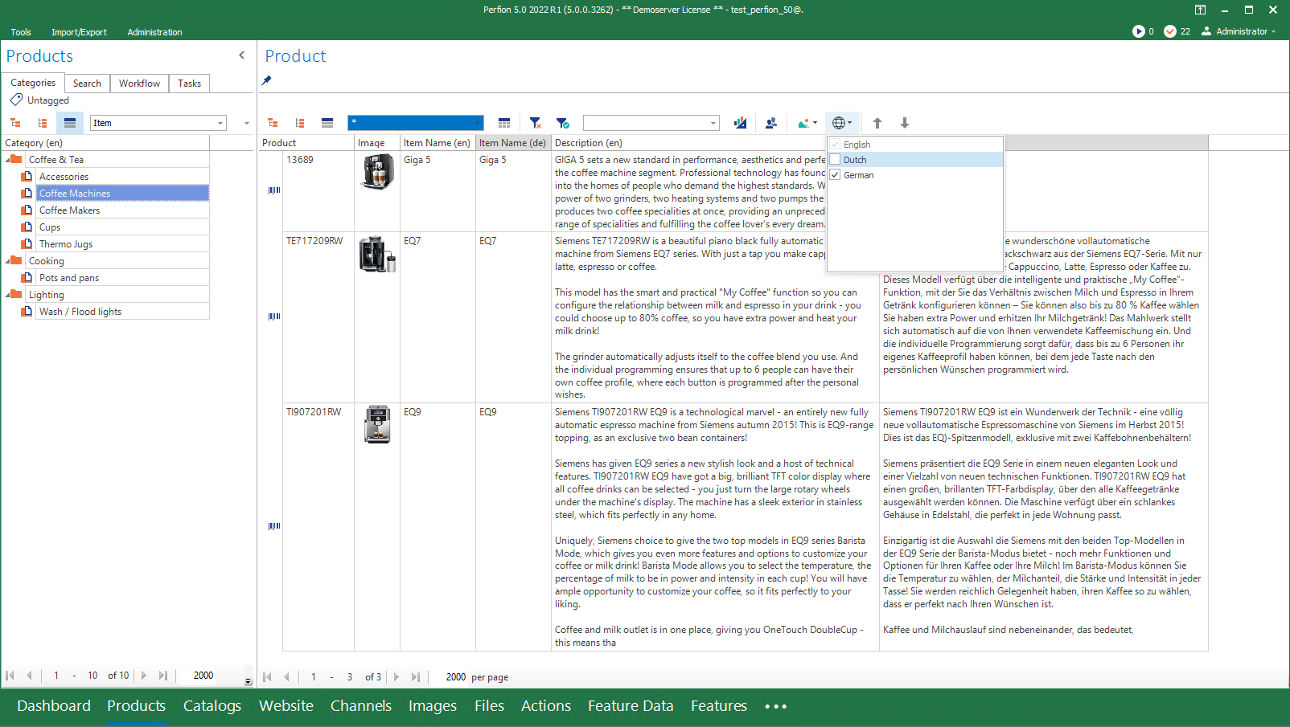
5.0 2022 R1
Multi-language grid
View and edit data in multiple languages simultaneously in the grid
Excellent overview of translations

Slide 30
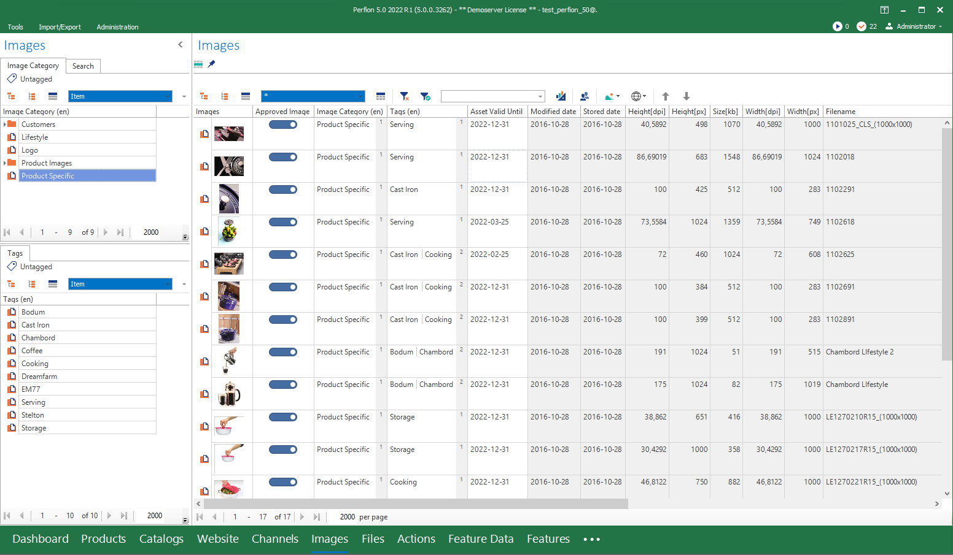
5.0 2022 R1
Read-only Features
Lock a feature for editing (even for admins)
Useful for data from external sources, or imported values
Editing only possible via e.g., API, Actions, Triggers

Slide 31
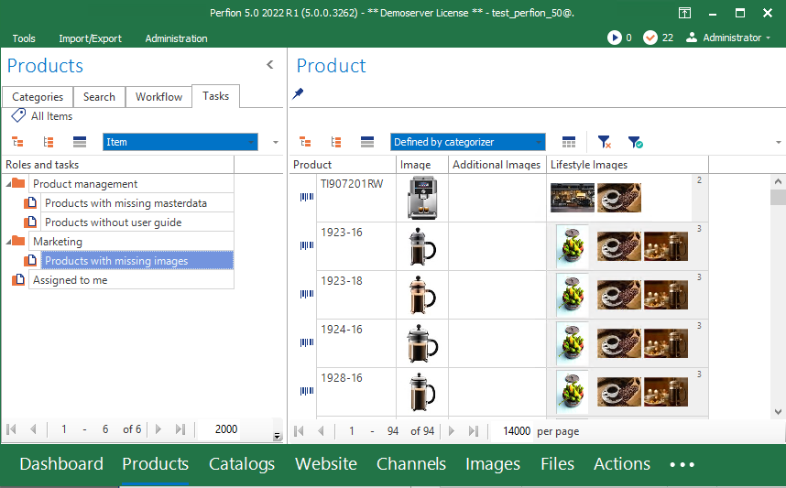
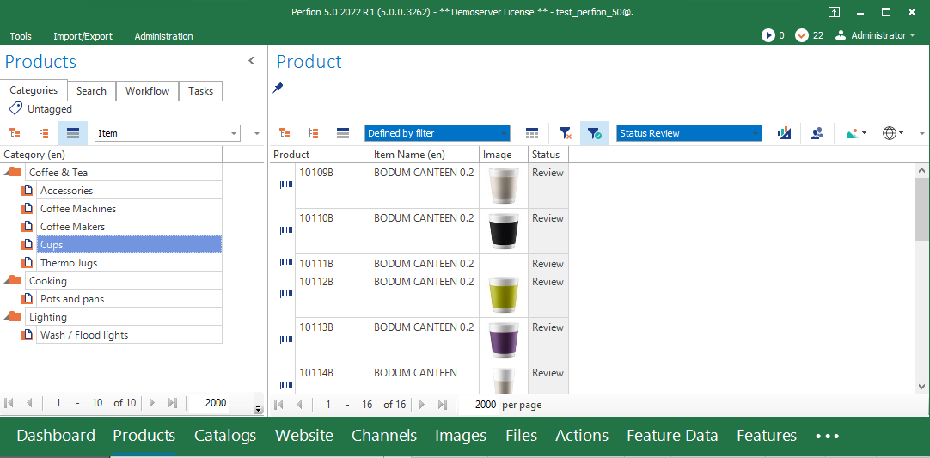
5.0 2022 R1
Views specified by context
Automatic determination of relevant view based on “left-side”.
Define view for
  Dashboard widgets
  Search categorizers
  Filters
View specified by left-side search categorizer
View defined by filter in grid

Slide 32
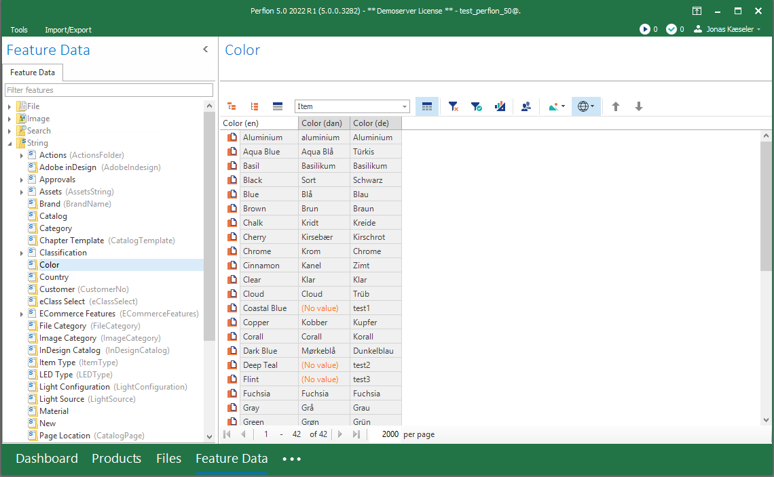
5.0 2022 R1
Access Feature Data as normal user
Non-administrators can access feature data to maintain lookup values
Permission can be granted at detailed level

Slide 33
Actions Package API Security
5.0 2022 R1
New commands:
  JOIN.INNER, JOIN.LEFT, JOIN.FULL
  WRITE.FILE
  SEND.MAIL
  REPORT
Include data from an Action in Perfion Reports
Use external dll/library in EXECUTE.SCRIPT
Filter and Order at Select commands
Execute action from the Perfion API
Possibility to execute queries in specific user context
Restrict third-party system to a limited set of data
Authentication via
  Basic authorization
  Bearer token
  Azure AD bearer token

Slide 34
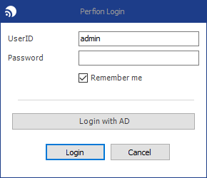
Active Directory Integration
5.0 2022 R1
Manage users from Microsoft AD
Achieve SSO via Microsoft login
Includes multi-factor authentication (if enabled in AD)

Slide 35
4.10 2021 R2
Build: 4.10.1
Released: October 2021
(requires database upgrade)

Slide 36
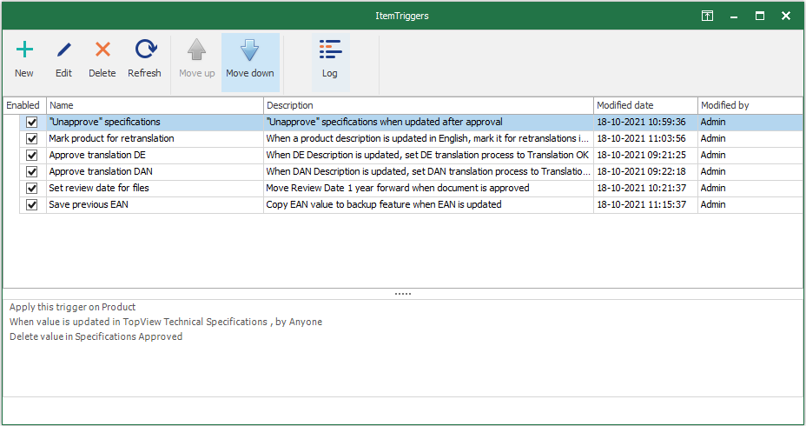
4.10 2021 R2
Item Triggers
  Changes on an item will trigger a given reaction from system
  Ex: Update of a product specification value will set status to Unapproved
  A trigger can update values on same item or execute an action
  Triggers work in all contexts (grid, item editor, API, import, web client, etc)

Slide 37
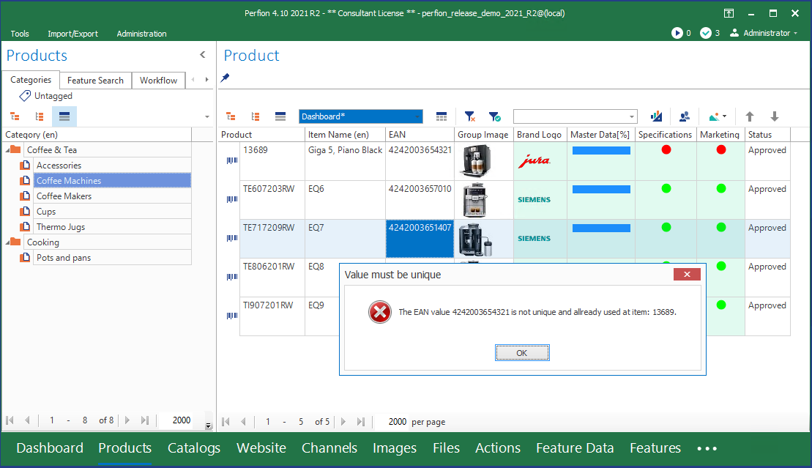
4.10 2021 R2
Unique values
  Ensure that key values are unique across all items
  Typically used for item numbers, EAN codes, etc
  Enforced at language level
    Same value is allowed in multiple languages on same item
  Also works with selectable features
    Two identical Color-items are not allowed, but same Color-value can be applied to multiple products
  Enforced in all contexts (grid, item editor, API, import, web client, etc)

Slide 38
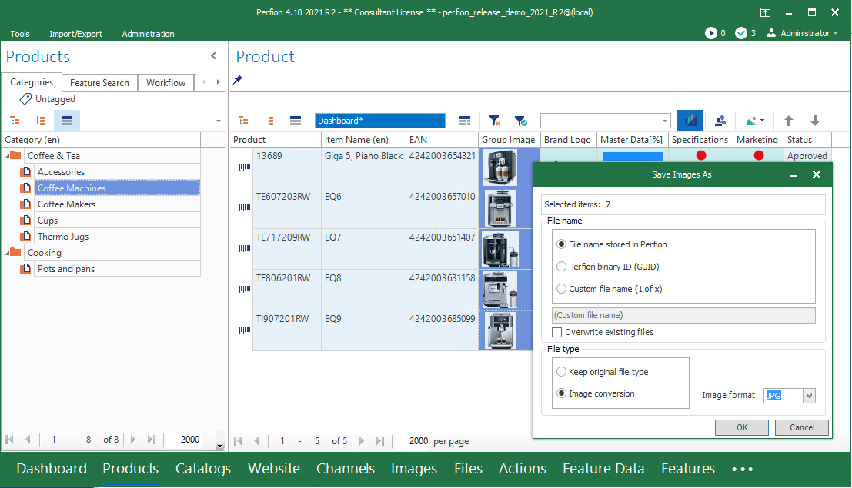
4.10 2021 R2
New DAM capabilities
  Export all files and images from grid in one go
    Convert images to other formats
    Resize images
    Canvas and aspect ratio
    Choose between different naming conventions
  Set point of Interest on images
  Access to image metadata

Slide 39
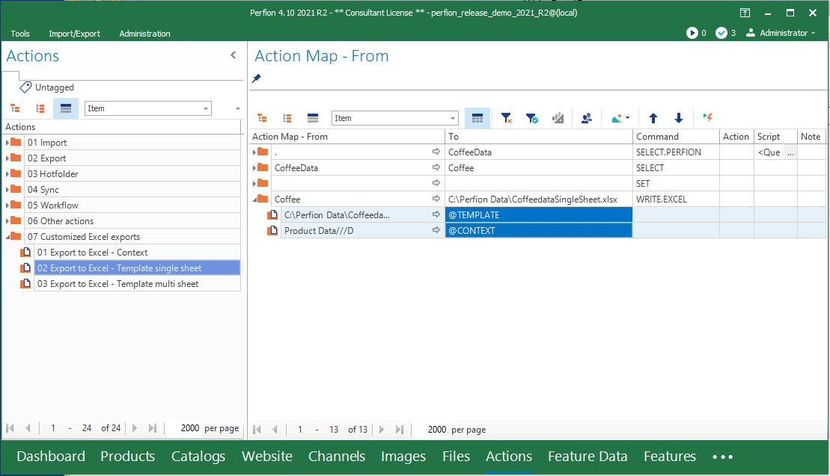
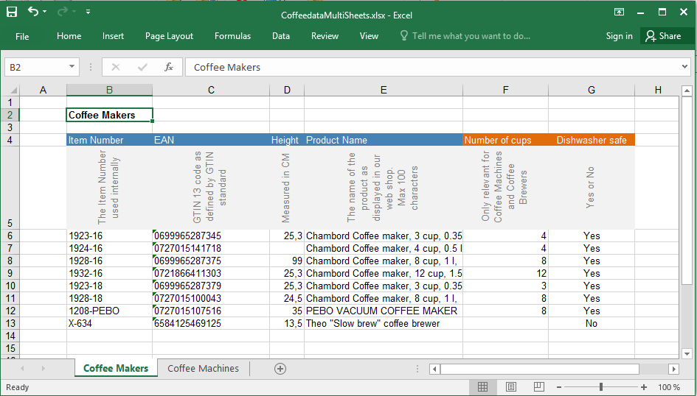
4.10 2021 R2
Custom Excel output
  Two new options with the action command Write.Excel:
    @CONTEXT
    @TEMPLATE
  Enables production of customized excel output:
    Styling (fonts, colors)
    Data directions
    Data insert points
    Multiple sheets
    Global parameters

Slide 40
4.9 2021 R1
Build: 4.9.0
Released: April 2021
(requires database upgrade)

Slide 41
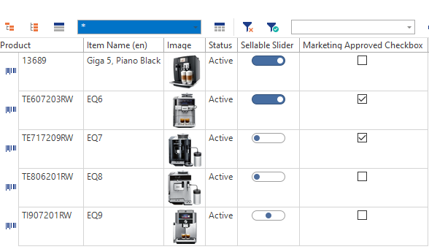
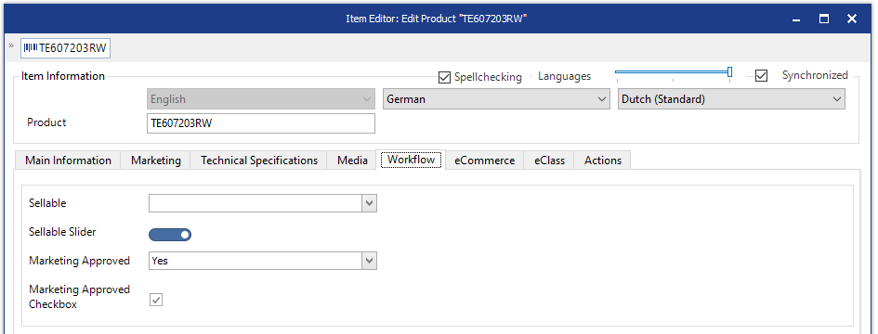
4.9 2021 R1
Boolean Feature Type
  Easy editing of yes/no values as checkboxes in the grid or item editor
  Supported in API, reports, etc.
  Supports 2-state (yes/no) or 3-state (yes/no/unknown)

Slide 42
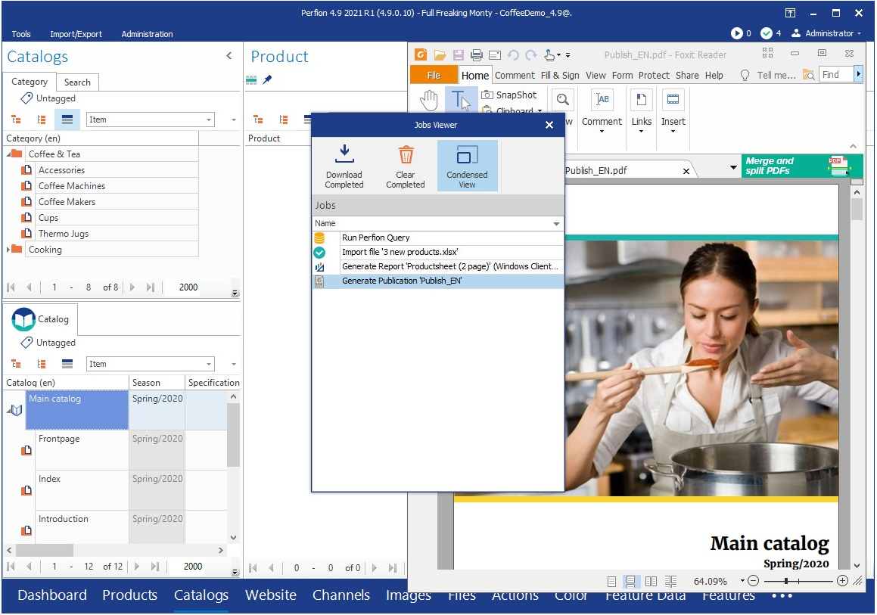
4.9 2021 R1
Application Server
  Offload time-consuming jobs for background processing
  View/save results when you need to
  Imports
  Reports
  Actions

Slide 43
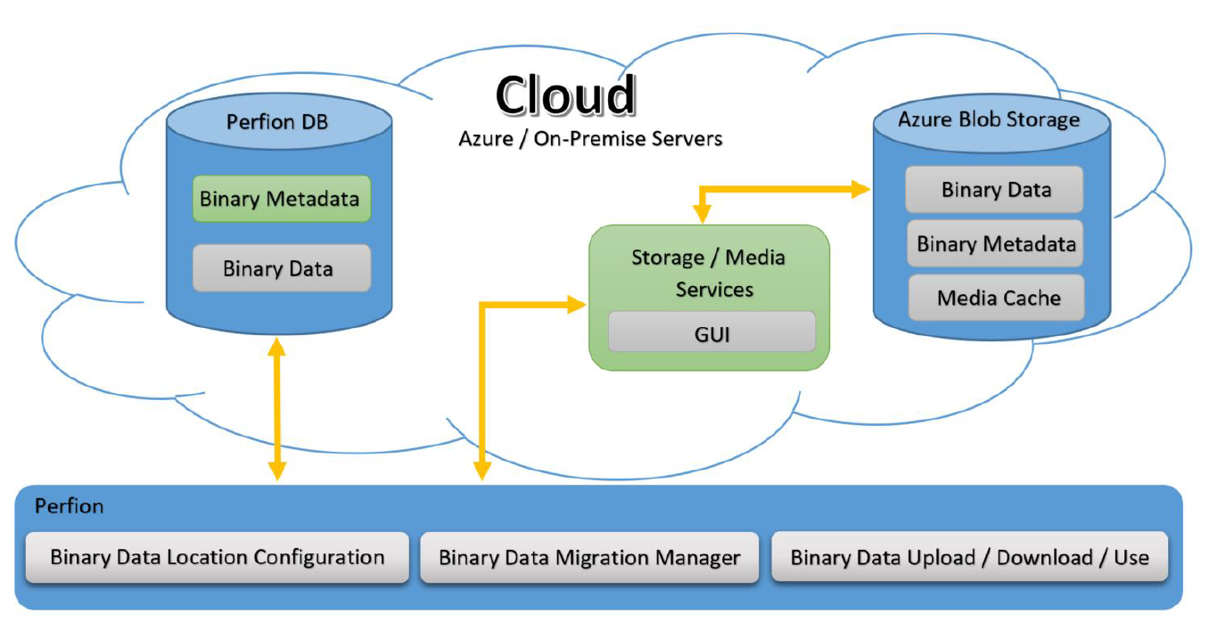
4.9 2021 R1
Binaries in Perfion Cloud
  Store all binary files in the cloud
  Minimize SQL server footprint
  Same Image Server functionality as for on-premise
  Transparent for users

Slide 44
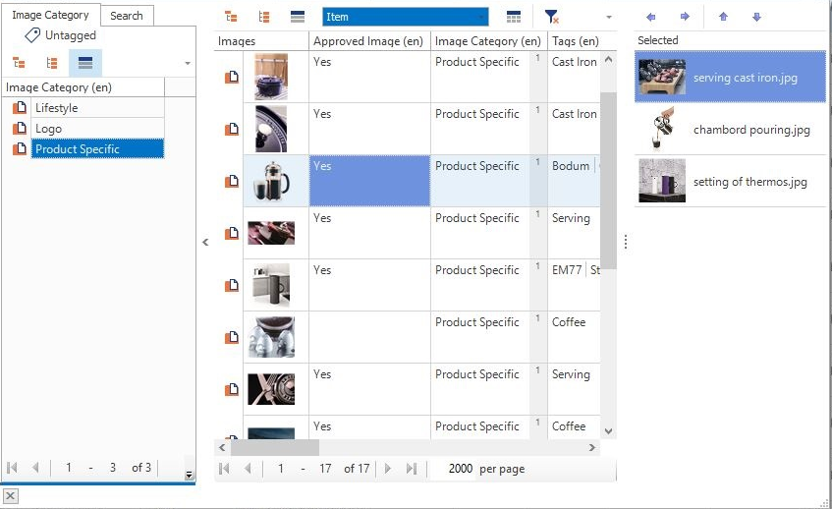
4.9 2021 R1
Improved Selector
  Easier search/selection of values
  Can be operated mouse-free

Slide 45
4.8 2020 R2
Build: 4.8.0
Released: October 2020
(requires database upgrade)

Slide 46

4.8 2020 R2
Dashboard
  Define custom widgets
  Easy overview of status of product data
  Follow up on KPI’s
  Identify areas that require an action
  Jump directly from Dashboard to relevant products

Slide 47
4.8 2020 R2
Async Remotes
  Remotes are now fetched in parallel.
  Continue work in the grid while remotes are fetched
  Significant performance increase when using many remotes

Slide 48
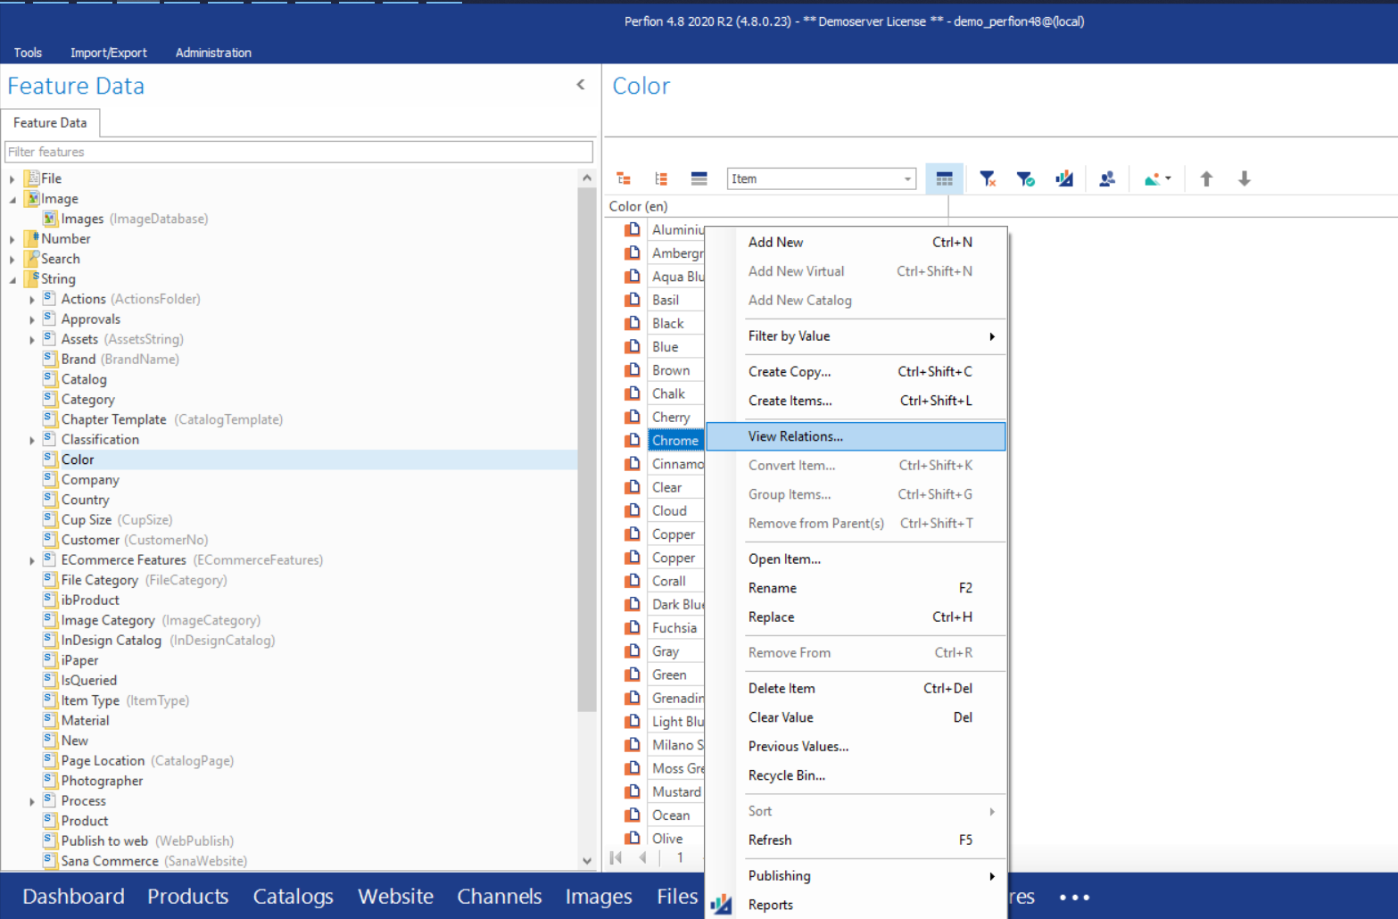
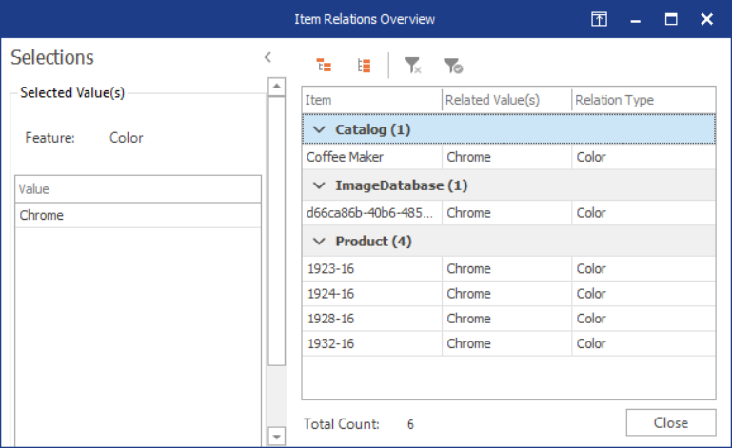
4.8 2020 R2
Item Relations
  Identify where features are used
  Find products deprecated values
  Find in which context the value is used

Slide 49
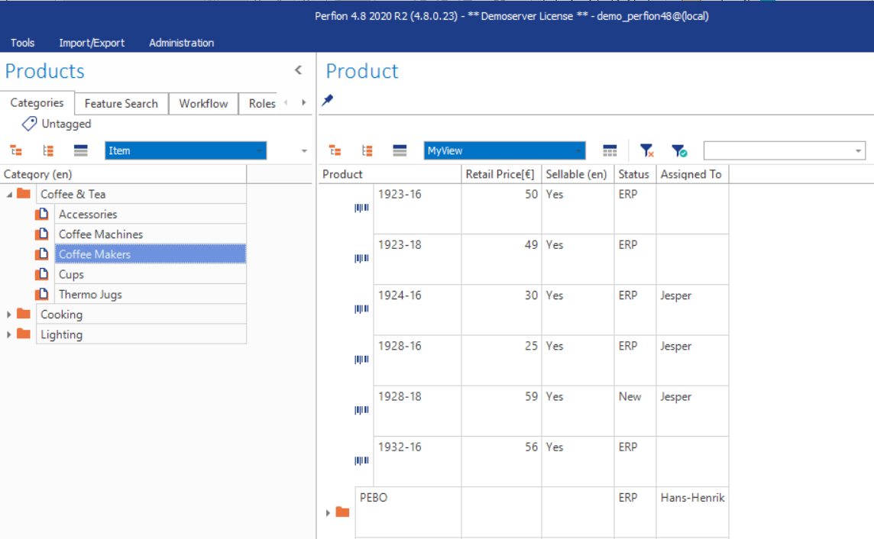
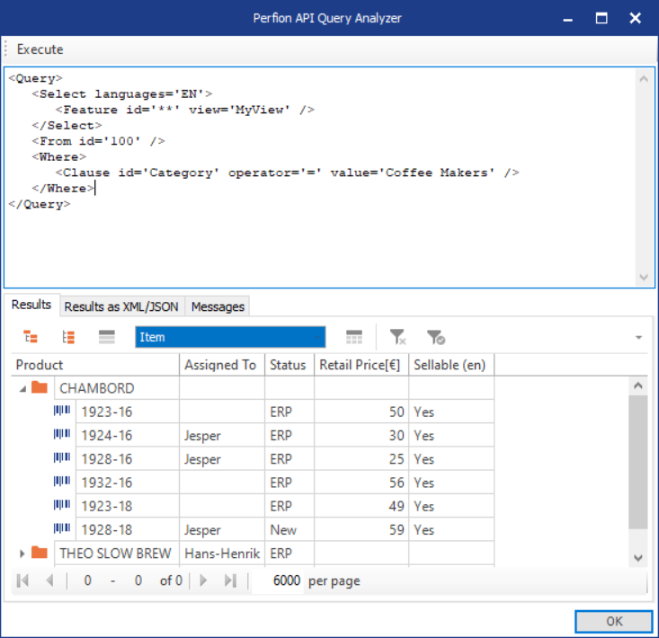
4.8 2020 R2
Custom Views in API
  Customized Grid Views can now be used in Perfion API queries.

Slide 50
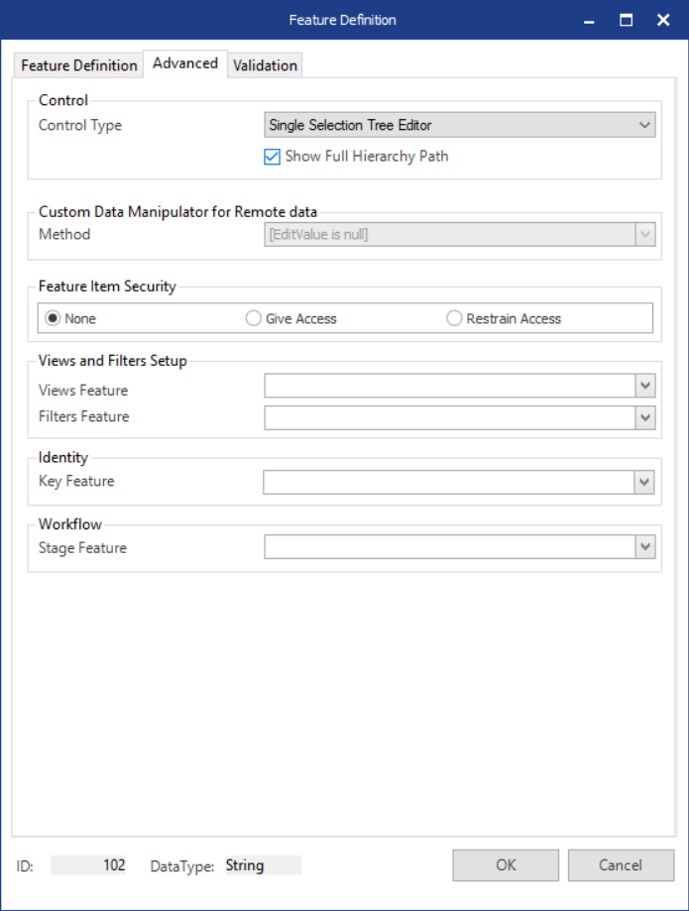
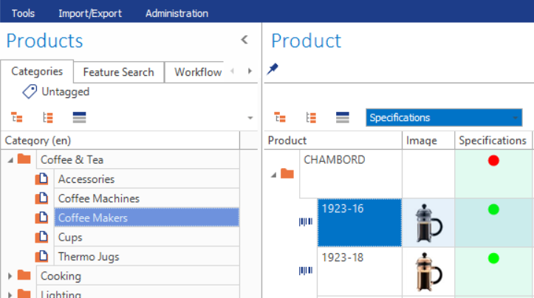
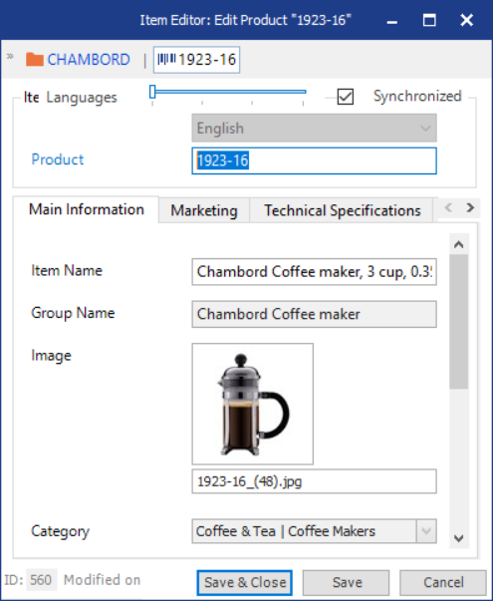
4.8 2020 R2
Show Full Hierarchy Path
  Enabled in Feature Definition
  Show full hierarchy path on values in Item Editor and Item Relation Overview

Slide 51
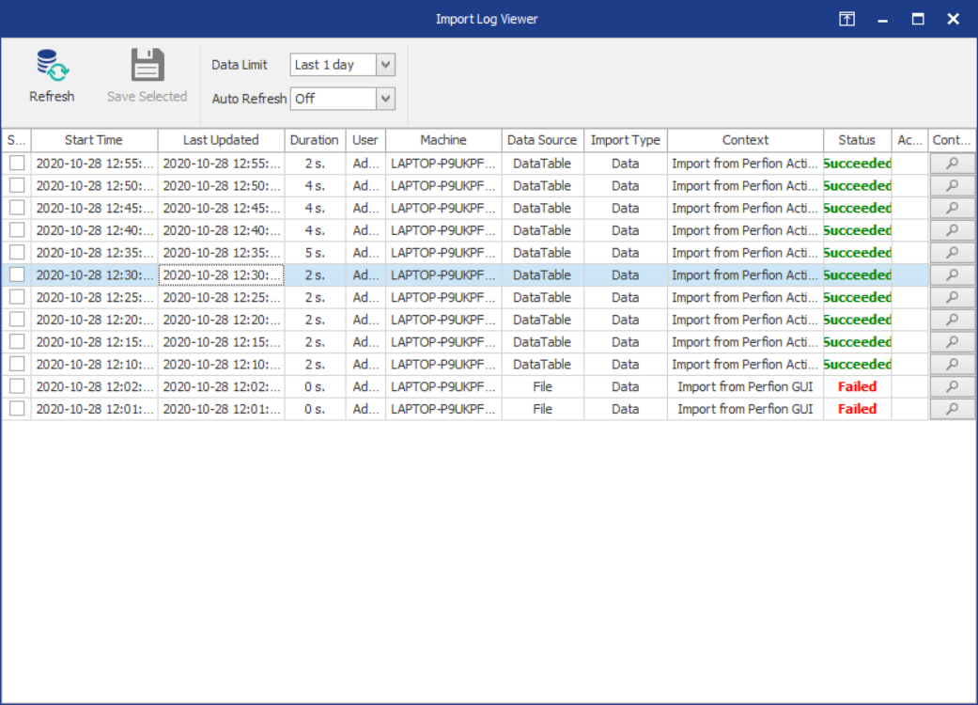
4.8 2020 R2
Import & Export Logs
  See logs of import and exports jobs
  Keep track of scheduled jobs
  Investigate why imports/exports fail
  Admin can stop currently running jobs and see jobs of all users

Slide 52
Various Improvements
4.8 2020 R2
Feature Definition Validations
  When creating a new feature it will now be validate to prevent data integrity issues
    Remote features can no longer be inheritable
    Search and Table features must be explicit
    Identity inherited features are now validated against their parent properties
Link features can now be longer than 255 characters.
Data Integrity Check
  Identify and automatically fix issues when you upgrade database
Also:
- Deprecation of MS SQL Server 2008, MS Windows Server 2008, MS Dynamics 2009

Slide 53
4.7 2020 R1
Build: 4.7.0
Released: May 2020

Slide 54

4.7 2020 R1
UI Update
  Layout and styling modernized
  Menus and icons updated
  Fonts usage harmonized
  Simplifications where possible
Various features, e.g.:
  Column chooser: Display only features in configuration
  Filters: Set search options for base feature

Slide 55

4.7 2020 R1
Dynamic Grid
  More options for showing images and content
  Indicators for more content / more images
  “Fit content” option
  Single-line for overview of many items, large column height/width for detailed inspection
  Preferences are saved as user settings

Slide 56

4.7 2020 R1
JSON API
  Choose between SOAP and Rest/JSON when communicating with Perfion
  Similar flexible syntax as the existing API
  Can be deployed separately or alongside SOAP API
  Use tokens for security
  Embedded API Query Analyzer support

Slide 57

4.7 2020 R1
Asset Portal
  Distribute media to partners or other third parties
  Configure assets and metadata to be shared on the portal directly in Perfion;
  Apply your own company branding and introductory pages
  Create PDF printouts of selected images
  Define user access on category-level and monitor activity
  Use anonymous viewing for selected assets
  Apply watermarks to copyrighted material
  Download assets in multiple formats and quality settings

Slide 58

4.7 2020 R1
Import/Export Actions
  Move Actions between dev/test and production systems
  Import Actions examples from Knowledge Base or provided by consultants
  Exchange Actions with other Perfion users

Slide 59

4.7 2020 R1
RTF Editor
  New Editor type for full RTF support
  Rich editor with many options
  Spellchecking
  Can be outputted via API in web-friendly format

Slide 60

4.7 2020 R1
Import/Export improvements
  Import split into different menu options for more direct access
  Menu displays only options relevant to the current section
  Import can “queue” up several files
  Four options available:
    Feature Definitions
    Feature Configurations
    Data
    Ordering

Slide 61
4.7 2020 R1
Actions Improvements
  Ability to import/export Actions
  New Command EXECUTE.ACTION.LOOP
  Ability to execute an action from the top menu
  Data analysis + Automatic configuration

Slide 62
Technical features
4.7 2020 R1
UTC:
  All operations now standardized to UTC time stamps.
  Time stamps can be viewed/queried in local time
Azure deployment
  Possibility to run API and web client as “Azure App Services” → lower cost, better scalability
  Reduction in client-to-database roundtrips/queries to improve performance
Developer Express v19
  Newest framework adds functionality and fixes issues in e.g. report designer
Integration.DLL
  Added options for interfacing external code to e.g. import commands via DLL

Slide 63
4.6 2019 R3
Build: 4.6.9
Released: October 2019

Slide 64

4.6 2019 R3
Related values
  Expose values from related configurations
  Example:
    Select a Color value on a Product
    Color feature has a configuration with RAL number set for each color
    With related values you can expose the RAL number on Product
  Related values works in grid, item editor, reports, exports, API, etc

Slide 65

4.6 2019 R3
Split-screen mode
  Multiple right-side grids
  Drag and drop items from one grid to another
  Place “dropped” items in correct order right away
  Makes it much easier to manage channel assortments

Slide 66


4.6 2019 R3
Import selectable binaries
  Now works like import of all other selectable values
  Import checks if selectable binary is duplicated in import file or exists in database in advance
  If yes, import does not create duplicated binaries in database. In stead, items are linked to same binary

Slide 67


4.6 2019 R3
Import related sort order
  Makes it possible to manage sort order in catalogs via import/export

Slide 68

4.6 2019 R3
Group items
  Selected items can be grouped under a new virtual item
  Works at any level in a hierarchy; new virtual is created at same level as selected items
  New virtual item is automatically enriched with default values
  Identical values on items are not consolidated on new virtual

Slide 69

4.6 2019 R3
Remove items from parent(s)
  Selected items can be removed from parent(s)
  Items will be placed at root level
  Items will loose their inherited values
  If done from categorizer view, items will be assigned the categorizer value (“Coffee Machines” in example)

Slide 70

4.6 2019 R3
Convert node type
  Items can be converted to/from Normal, Virtual and Catalog item type
  Conversion checks context and only allows “legal” conversions:
    Virtuals can only be converted to Normal if they have no children
    Normal can only be converted to Virtual if feature allows hierarchies

Slide 71


4.6 2019 R3
Copy SWAP data
  SWAP data on items can now be copied with items
  Administrator can decide if SWAP data should be copied or not (in configuration)

Slide 72

4.6 2019 R3
Action improvements
  Import options
    Keep first occurrence
    Delete existing values
    Validate values
  Join to empty tables
  Ignore SQL timeout
  Continue if export is empty
  Parameters in API and SQL queries
  Perfion API can be accessed in script code

Slide 73

4.6 2019 R3
Change ribbon color
  Ribbon can be set to six different colors
  Makes it possible to visually separate test from production environment

Slide 74
4.6 2019 R2
Build: 4.6.0
Released: July 2019
(requires database upgrade)

Slide 75


4.6 2019 R2
Scheduling
  Schedule background execution of actions
    Periodic import of data from files
    Periodic cleanup, or other data manipulation
    Periodic exports in specific formats
  Easy overview of all schedules
  Log with history of all executions

Slide 76

4.6 2019 R2
Deployment
  Administrators can deploy features and configuration from a development or QA database into the production system
  Allows you to implement and test changes in a safe environment and easily deploy changes to production

Slide 77

4.6 2019 R2
Import of Feature Definitions
  Use Excel import to quickly create large amounts of features
  Typical use cases:
    Integration with classification systems, where 1,000s of features with meta-information need to be created
    Create complete structure for image library et.al.

Slide 78

4.6 2019 R2
Default values
  Define default values for new items
  Default values added to new items created in client and via API inserts
  Default values can be set at item dependency level
  Typical default values:
    Status
    Assignee
    Formulas
    Tables
    Etc

Slide 79


4.6 2019 R2
Additional Action Mapping capabilities
  Includes:
    Export images and files
    Execute C# scripts
    Get filelist
    Send e-mails
    Additional scripting methods
    Direct reports to call actions
  Combined with scheduling you can now create hotfolder imports, workflows, email notifications and many, many other solution

Slide 80
4.5 2019 R1
Build: 4.5.60
Released: February 2019
(requires new license file)

Slide 81

4.5 2019 R1
Enforcement of license terms
  As of this release, the Perfion client will enforce terms of the loaded license
  This includes:
    Users (readers and editors)
    Languages
    Print publishing &
    Table designer
    SANA, Shopify and Ucommerce connectors
    Action mapping (included in all existing licenses)
    Logging (included in all existing licenses)

Slide 82


4.5 2019 R1
Improved user rights and language management
  One-click creation of editors (no edit-rights anywhere in client)
  Clear separation of languages access and rights to edit non-localizable features
  Overview of active languages
  Option to remove a language from all users

Slide 83
4.5 2019 R1
Data validation
  Create validation rules for numbers, strings and texts
  Rules are defined as number ranges or regular expressions (RegEx)
  Enforced throughout the client and in imports
  Enables you to enforce strict data policies and decrease the risk of invalid/erroneous data

Slide 84


4.5 2019 R1
Action Mapping: Export
  Extended Action Mapping with numerous export options
  Export data in formats tailored to specific purposes or third-party systems
  Merge different data sources into one export
  Define actions to dynamically convert/format/enrich data before saving to a file
  Perform simple operations on data, or use scripting for maximum control

Slide 85


4.5 2019 R1
Keyboard shortcuts
  In an effort towards mouse-free usage of Perfion, several additional shortcut keys have been added to the Windows Client
  Relevant shortcuts named in right-click menus
  All shortcuts explained in separate guide (can be downloaded from knowledge base)

Slide 86
4.5 2018 R3
Build: 4.5.51
Released: October 2018

Slide 87


4.5 2018 R3
Logging
  Full history of all value changes
  Previous values can be restored in grid via simple right-click menu
  Works for explicit and selectable values
  Also works for binaries (images and files)

Slide 88


4.5 2018 R3
Recycle bin
  Full history of all deleted items
  Deleted items can be restored in grid via simple right-click menu
  Items are restored with full data set including relations to output channels
  Works for all selectable features (products, image databases, color lists, materials, etc)

Slide 89

4.5 2018 R3
Copy only selected features
  You can now configure which features to copy when an item is copied
  Features are selected at configuration-level
  Typical features not to copy:
    Item Number
    EAN
    Approvals
    Etc

Slide 90


4.5 2018 R3
Information groups as views in grid (and API)
  Tabs and subgroups used in item editor are now also available as views in grid
  Eliminates need for many custom views
  Makes it easy to “zoom in” on relevant features in grid
  Information groups can also be used as views in API

Slide 91




4.5 2018 R3
Enhanced XLIFF support
  XLIFF format has been upgraded to XLIFF 2.0
  Export/import supports XLIFF format
  API can deliver data in XLIFF format
  All-in-all this enables automated translation processes with external translation agencies

Slide 92

4.5 2018 R3
Role based access to Perfion features
  Access to critical features can be managed for users and/or groups
  Typical examples:
    A normal user is grated access to import but only with validation enabled
    All normal user are restricted from editing report templates or using the API tool
  Access to Log and Recycle bin are also controlled via roles

Slide 93

4.5 2018 R3
Create new items in search result grids
  Previously new items could only be created in categorized grids
  Now you can create a new item or copy an existing item also in search result grids

Slide 94


4.5 2018 R3
Export/import configurations and item dependencies
  Configurations can be created and edited via export/import
  Excel and XML formats are supported
  Makes it easier to build large configurations with many item dependencies governed by external classifications

Slide 95
4.5 2018 R2
Build: 4.5.41
Released: June 2018

Slide 96


4.5 2018 R2
Item creator
  Allows you to create multiple new products/variants in one go
  Each new item will be assigned values as specified with the item creator
  The item creator can even create hierarchies (parent levels) for the new items.

Slide 97

4.5 2018 R2
Filtering on remote fields
  Remote features can now be included in left-side searches
  Grid results can also be filtered by remote values

Slide 98


4.5 2018 R2
Validate selectables during import
  When activated, it prevents importer from creating new selectable items (products, categories, colors, materials, etc)
  Allows for better data governance and ensures “clean” picklists in Perfion

Slide 99


4.5 2018 R2
Ecommerce API
  A new way of accessing Perfion data
  Focused on delivering data to e-commerce systems
  Mapping between systems is done in Perfion
  Remote system just asks for products, categories, etc

Slide 100



4.5 2018 R2
Action Mapping: Import
  Makes it easy to import data from suppliers in multiple formats and structures
  Mapping between external data formats and Perfion format is done in Perfion
  Import done in one click when mapping is set up

Slide 101
4.5 2018 R1
Build: 4.5.35
Released: February 2018

Slide 102

4.5 2018 R1
Edit multi-value features in grid
  Add, edit and delete multi-values in grid
  Copy/paste multi-values from cell to cell
  Mass-update multi-value cells across items

Slide 103

4.5 2018 R1
Search for multiple items
  Search for multiple specific items in one go
  Search field accepts semi-colon or new line as separator
  Limitation: search for multiple items does not work on base values

Slide 104
4.5 2018 R1
Spell check
  Based on Open Office Dictionaries
  Standard and custom dictionaries + grammar
  Active on text features and localized string features
  Works in grid and item editor

Slide 105

4.5 2018 R1
Show family
  Adds siblings and parents to search result and paged views
  Can be toggled on/off in grid
  Added items are greyed out
  Provides overview of inherited values and allow for updates

Slide 106

4.5 2018 R1
Easier import of data and assets
  Importer available from main menu (Tools -> Import Data)
  Data and assets can be combined in one file
  Simplifies product updates and enables you to create items with full set of data from one file

Slide 107

4.5 2018 R1
Search feature as categorizer
  Search features can be set up as a left-side categorizers
  Predefined searches become available with one click
  Very effective for workflows and tasks

