Slide 1
Perfion update Q2 2025
Webinar for Perfion clients:

Slide 2



Your Hosts
Jeppe Tobias Brønnum Hatting
Product Manager
Jan Wisén Francke-Larsen
Solution Architect
Stephen Rainbow
Advisor & Presales Consultant

Slide 3
Agenda
Perfion 5.6 2025-R1 release
  New Service Account
  DeepL Glossary
  Import Wizard
  Perfion Content Store
Perfion roadmap (2025-R2 + R3)
Deprecations

Slide 4
Small release of big features
Perfion 5.6 2025-R1
DeepL Glossary
Preferred translations
Supplier Portal
Expose multiple base features
Content Store 1.0
Full Self-service content portal
New Service Account
Dedicated user for API & ApplicationServer
New Access Types
Clients, API or Both
Import Wizard
Import any Excel, with modifying it
Does not replace importer
Boyum Framework
New look’n’feel for Perfion
Unreleased
Notifications
Tag other users on items

Slide 5
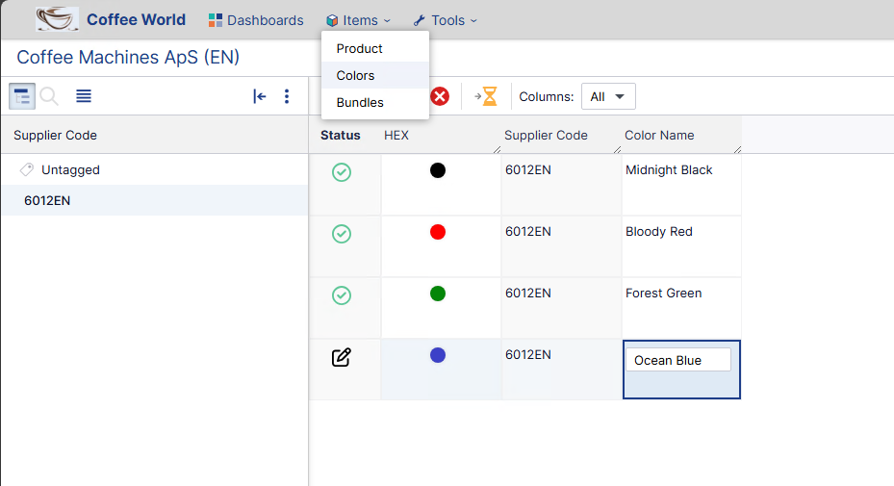
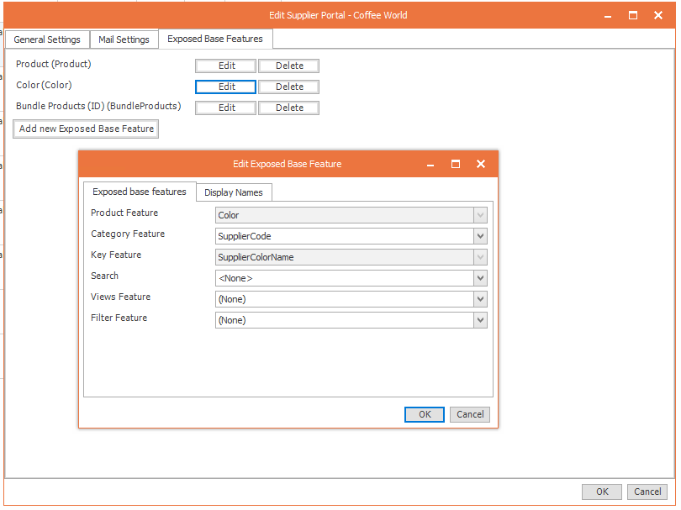
Supplier Portal – Multiple Base Features
Perfion 5.6 2025-R1
Expose not only Products
Different types of products
Supplier Colors, Materials, etc
Swapped data Bundles, Bill of Materials

Slide 6
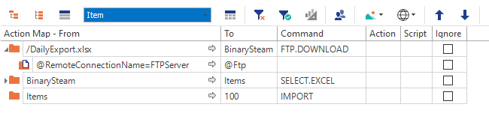
Actions: FTP Closing Connections
Perfion 5.6 2025-R1
Previously
FTP connection were opened, with each FTP command. Connections were also not closed after Action finished.
Now
The connection will remain open as long the Action is active and will be used for all FTP calls to the same server.
When the Action(s) are completed, all connections will be closed.

Slide 7
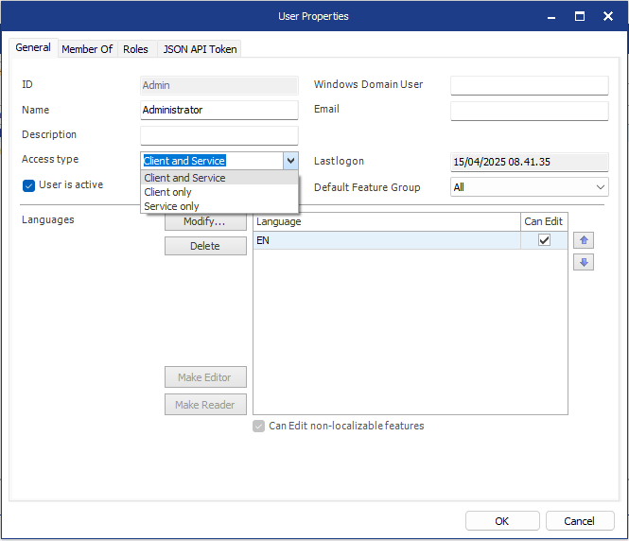
User Access Types – and new ServiceAccount user
Perfion 5.6 2025-R1
New Access Type option
  Client only - can only log in to Web or Windows Clients
  Service only - can only use the APIs & Application Server
  Client & Service - can use everything.
  Existing users will be migrated to “Client & Service” when upgrading
Last Logon
  Perfion will now log when an account was last successfully logged in.
New built-in ServiceAccount user
  All licenses will include a ServiceAccount user
  No longer need to reserve a user for API
  APIs and Application Server should be updated to run as the ServiceAccount user.

Slide 8

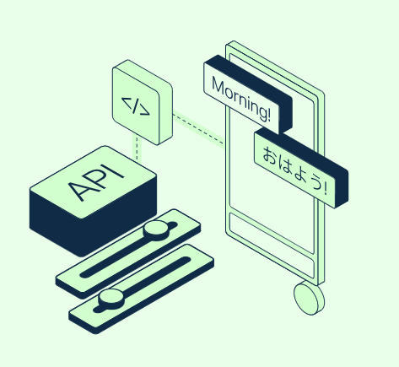
DeepL Glossary
Perfion 5.6 2025-R1
Brand-specific terms, such as company jargon or product and service names
Industry-specific terms
Audience-specific terms
Terms that should not be translated

Slide 9
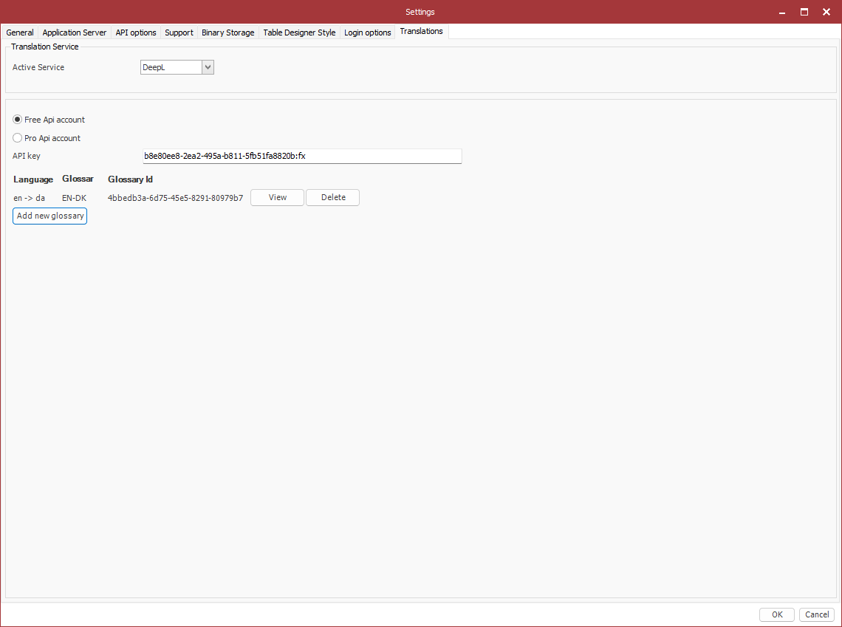
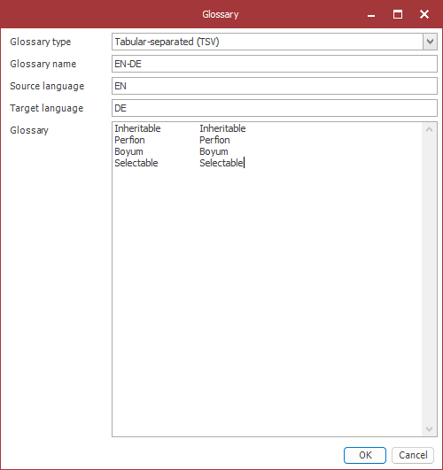
DeepL Glossary
Perfion 5.6 2025-R1
Glossaries are applied in Windows and Web clients
Administration in Windows client currently
One ‘Glossary’ per language
Format: tab or comma separated
Let’s take a look!

Slide 10
Agenda
Perfion 5.6 2025-R1 release
  New Service Account
  DeepL Glossary
  Import Wizard
  Perfion Content Store
Perfion roadmap (2025-R2 + R3)
Deprecations

Slide 11
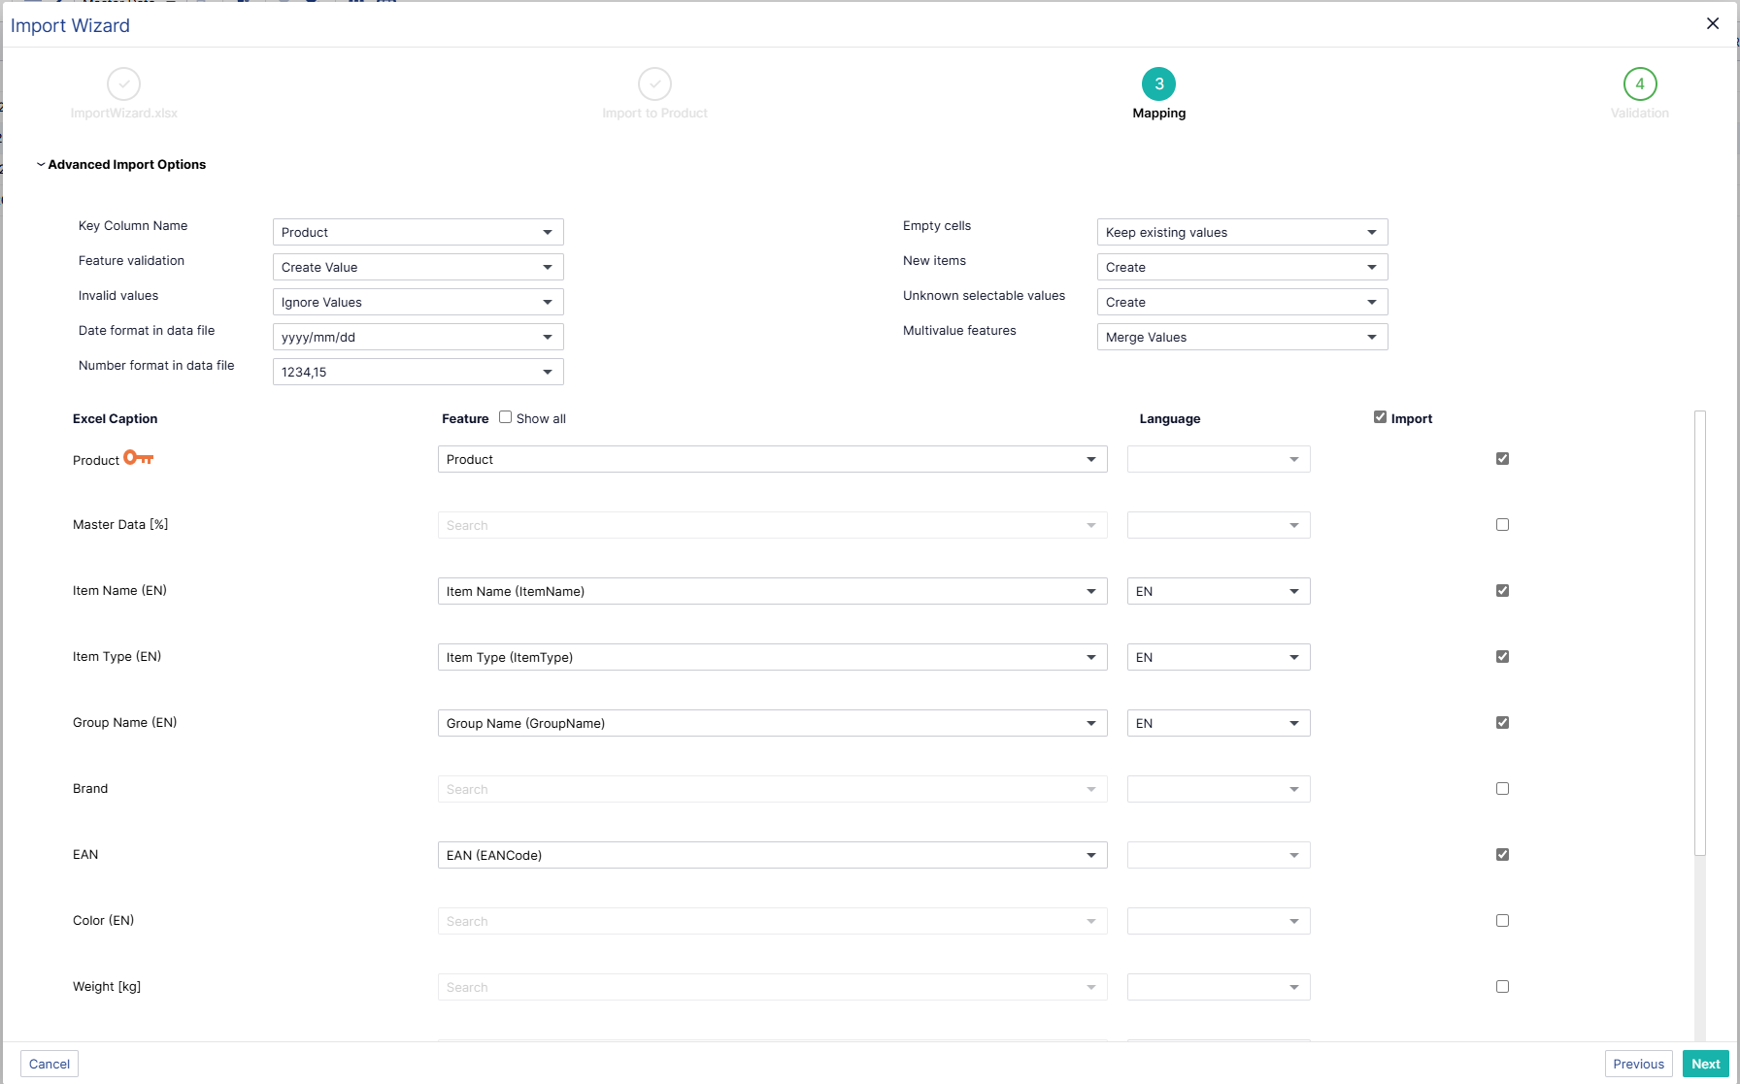
Import Wizard
Import Wizard
What & Why?
  Make imports more user friendly
  Streamlines process
  Automaps columns where feature name matches
  Uses new importer code base
  Next
  Save & Reuse Mappings

Slide 12
Agenda
Perfion 5.6 2025-R1 release
  New Service Account
  DeepL Glossary
  Import Wizard
  Perfion Content Store
Perfion roadmap (2025-R2 + R3)
Deprecations

Slide 13


















What is the Perfion Content Store?
Perfion Content Store (Q2 2025 release)
Content Store 3
Content Store
A ”channel” / self-service portal where Perfion clients can expose selected product information and/or digital assets for download by external and internal parties
Content Store 2
E-shop
ERP
Single source of truth
Print
Data

Slide 14
Real-World Applications
Perfion Content Store (Q2 2025 release)
Internal Content Store
Empower Your Team
Make life easier for your sales and support teams by giving them direct access to up-to-date product information without needing to navigate Perfion.
External Content Store
Boost B2B Partnerships
Provide your business partners with the latest product data and assets, so they can effectively market and sell your products.
Public Asset Portal
Create a Visual Experience for B2C
Offer an engaging portal where agencies, PR firms or consumers can download high-quality images, videos and other digital assets to showcase products.

Slide 15
Content Store
Demo

Slide 16

Standard pricing (12-month subscription)
Perfion Content Store (Q2 2025 release)
Base package €500/month
1 store
1 TB storage
1 TB download/month
Additional store €200/month
Additional storage (1 TB) €50/month
Additional download (1 TB/month) €150/month
Available to all Perfion Editions and deployment methods - Entry, Business & Enterprise – OnPremise & Cloud
Prices in other regions will be comparable, adjusted to the local currency
Always Saas, always hosted by us

Slide 17

Moving to Content Store: Steps for Asset Portal Customers
Perfion Content Store (Q2 2025 release)
2025 Maintenance: Customers must renew their 2025 Asset Portal maintenance to receive support and be eligible for migration.
Migration to Content Store: After renewing 2025 maintenance, customers can migrate to the Content Store at any time during 2025 without extra costs (except consulting services).
2026 and Beyond: From 2026, a new subscription will be required to use the Content Store.
Subscription Model: The Content Store will be subscription-only, with better pricing for longer commitments (e.g., 36 months)

Slide 18
Timeline
Perfion Content Store (Q2 2025 release)
Pilot kickoff
Launch Version 1.0
Release Version 1.1
Pilot Program
Service fixes
Perfion 2025-R1-SR1
Version 1.1 Development
April 2025
May 2025
June 2025
July 2025

Slide 19
Agenda
Perfion 5.6 2025-R1 release
  New Service Account
  DeepL Glossary
  Import Wizard
  Perfion Content Store
Perfion roadmap (2025-R2 + R3)
Deprecations

Slide 20
Demo Changes
Additional Validation – Action to convert Item Name to Title Case
Faster ERP Sync – new importer and late load images from hotfolder
Packaging structure to demonstrate swap tables
Features Feature for AI Descriptions, response in HTML
New Datasheet examples
AI SEO keywords and Amazon classification

Slide 21
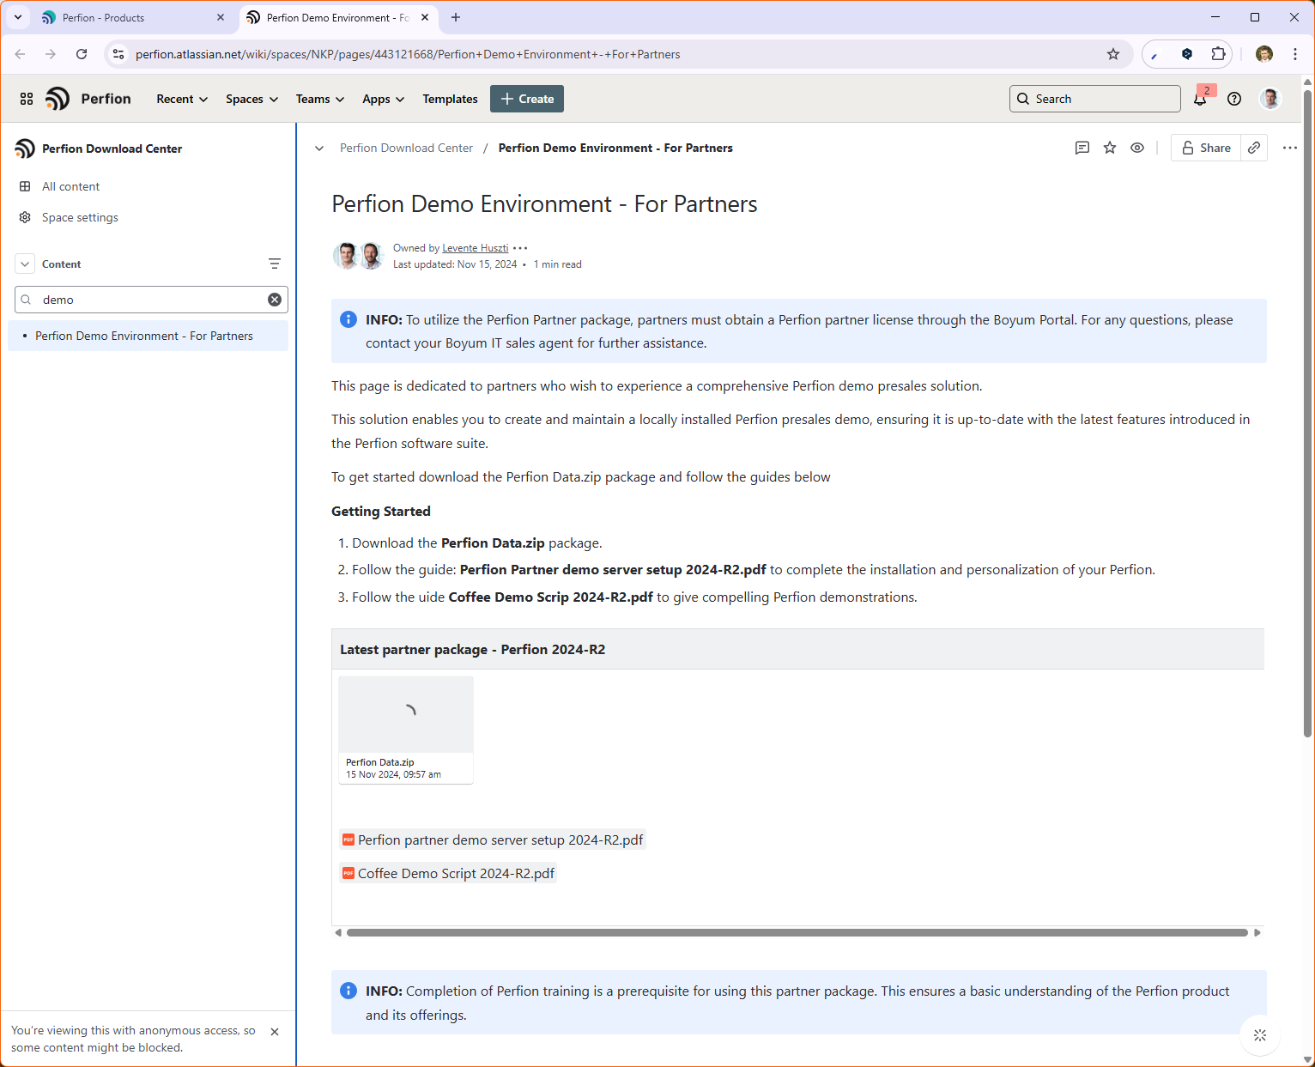

Demo Database Changes
How to access? Search for ‘Demo’ on the KB

Slide 22
Agenda
Perfion 5.6 2025-R1 release
  New Service Account
  DeepL Glossary
  Import Wizard
  Perfion Content Store
Perfion roadmap (2025-R2 + R3)
Deprecations

Slide 23
Roadmap 2025-R2 - Catch-up on R1
Perfion 5.6 2025-R1
Notifications
Preferred translations
Import Wizard
Save & load mappings
Roles based access
Validate Filtered Values
Content Store 1.1
Supplier Portal
Smaller Updates
Boyum framework
Administration menu
In Boyum dressing

Slide 24
Roadmap 2025-R3
Perfion 5.6 2025-R1
Content Store 1.2
Collections
Previous Check outs
Web Enablement
Administration
Triggers
License
AI
Built-in AI-powered functionality
Tasks
Create Tasks for users to complete
Boyum framework
More UI in Boyum dressing

Slide 25
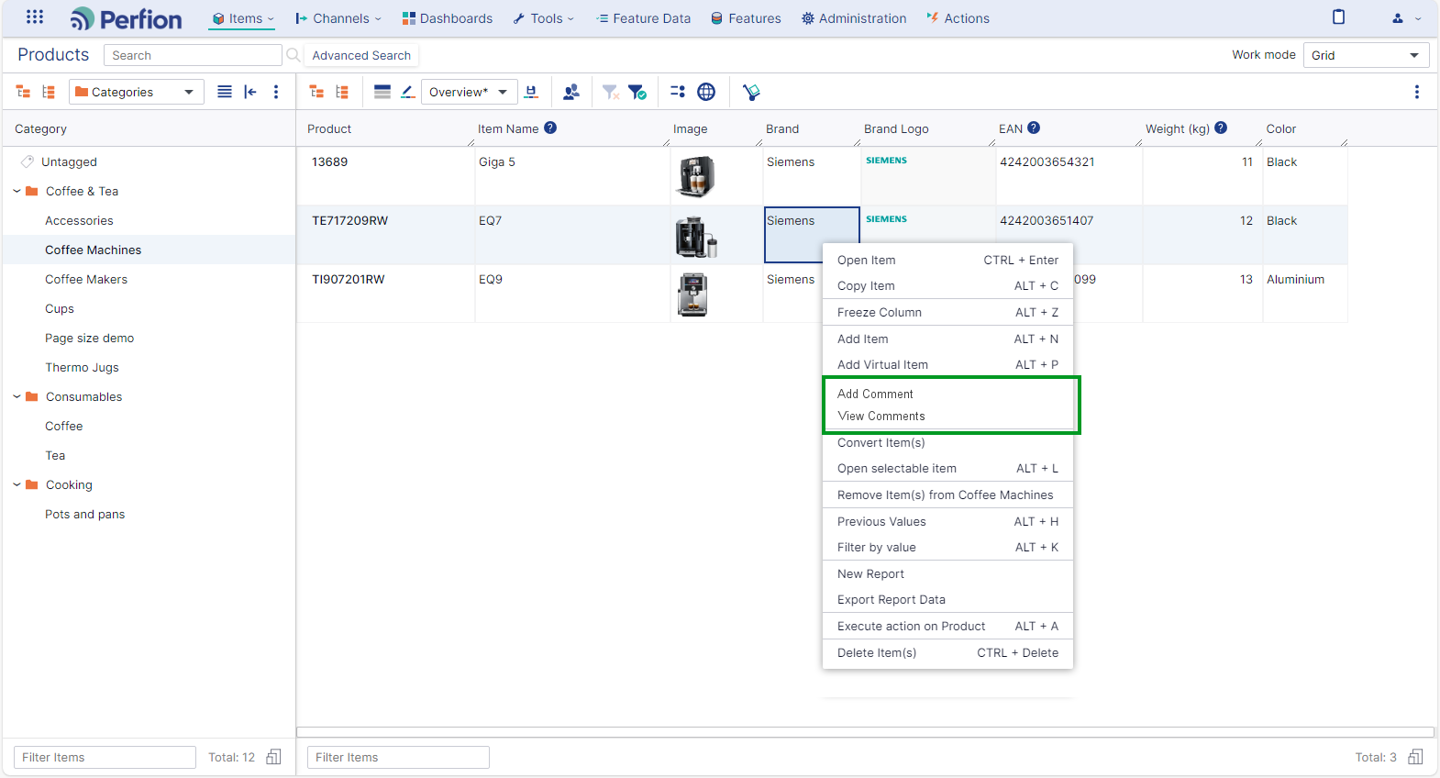
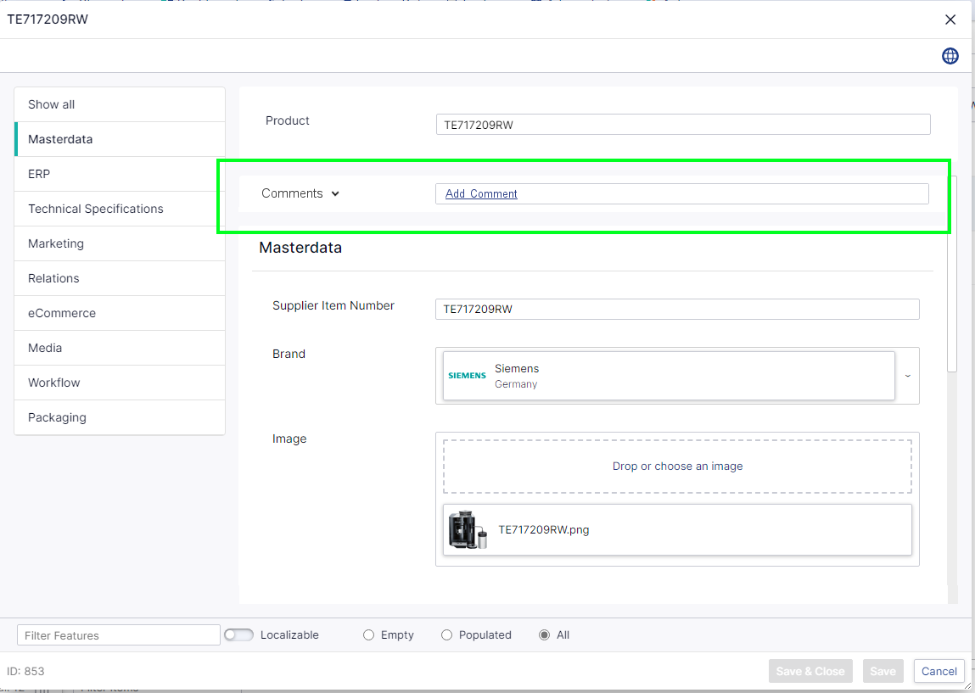
Notifications
Perfion 2025-R2 Preview
Add comments:
From grid
From editor

Slide 26
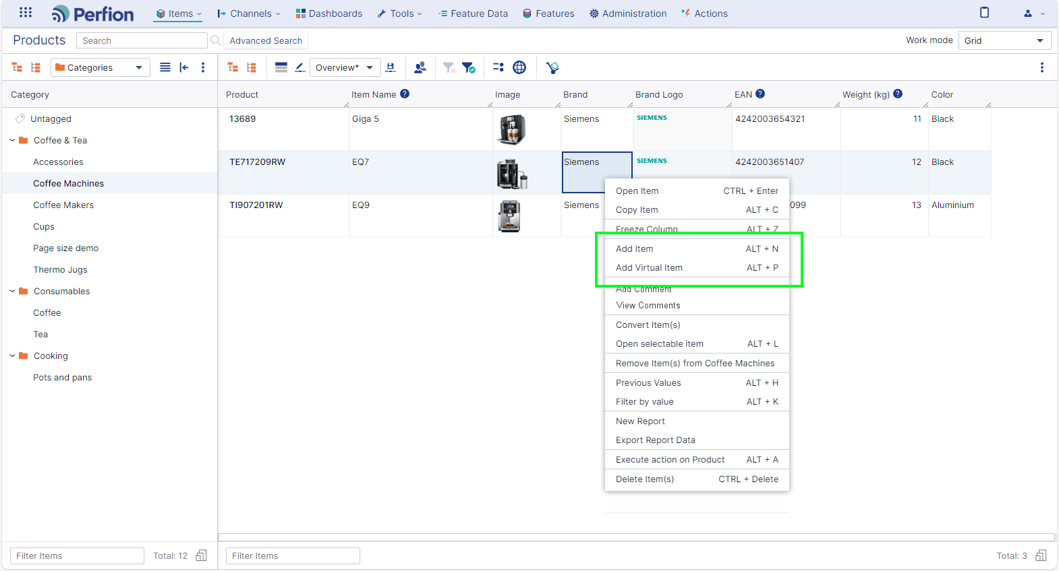
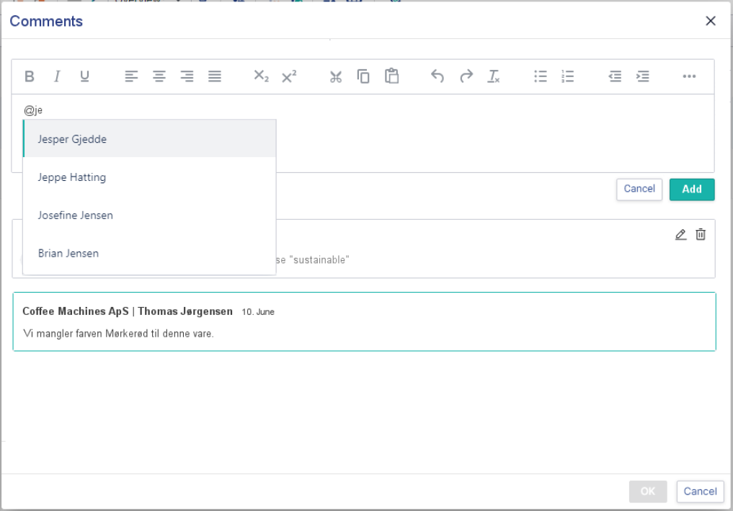
Notifications – write them
Perfion 2025-R2 Preview
Add comments:
From grid
From editor
Tag other users

Slide 27
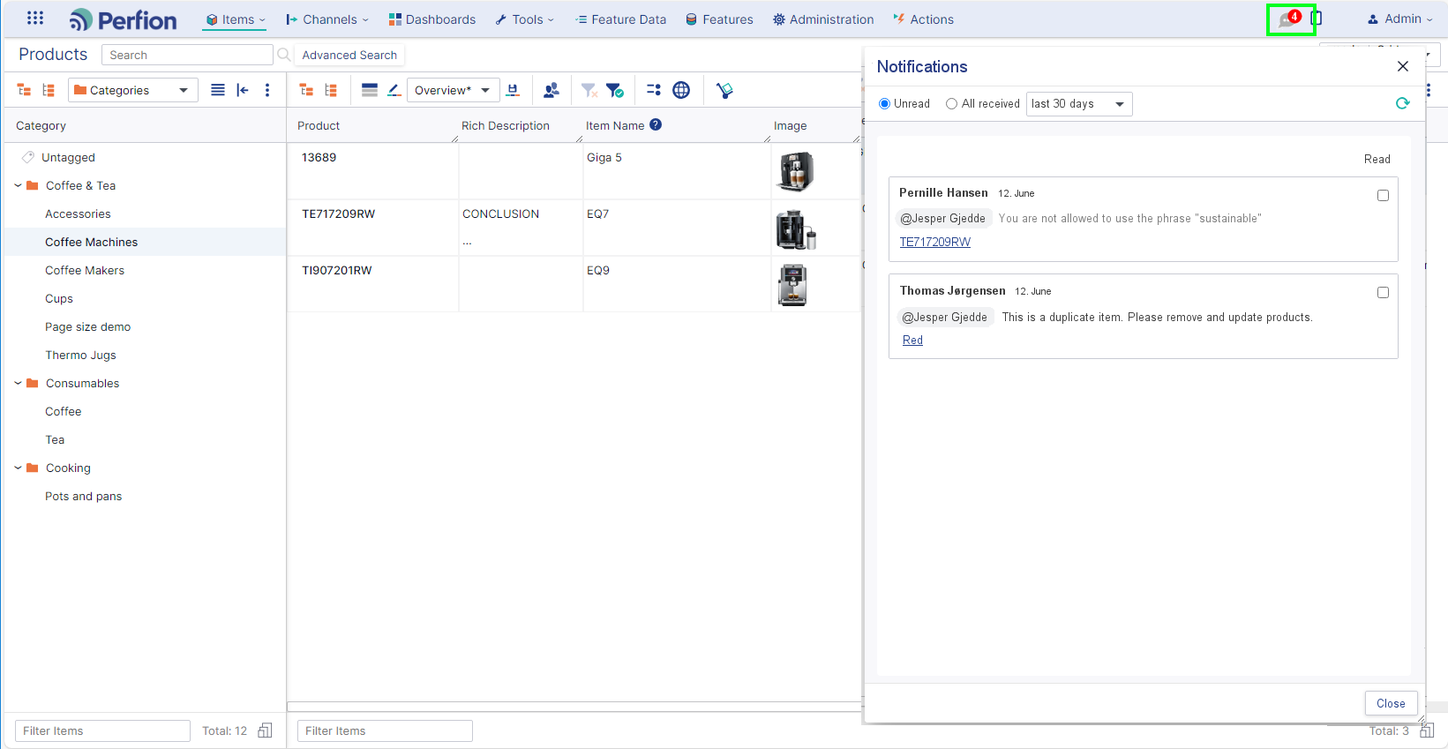
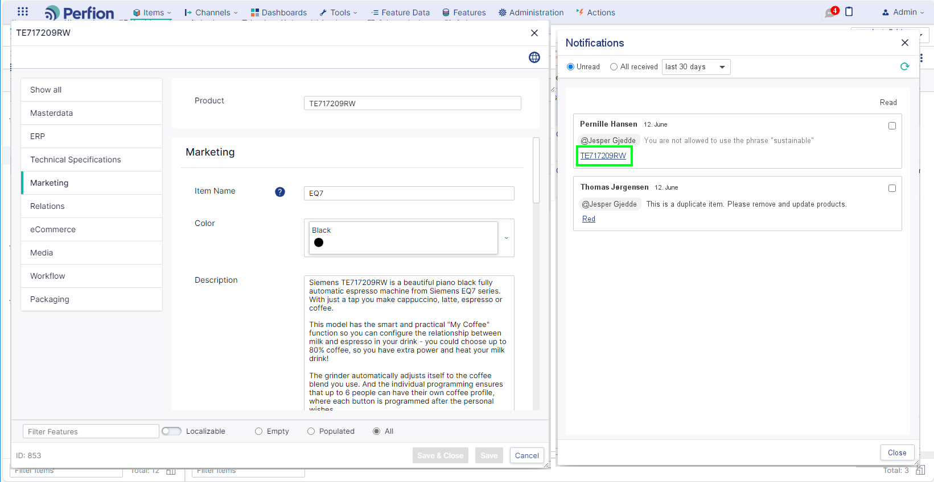
Notifications – read them
Perfion 2025-R2 Preview
Notifications Centre
Read all comments you have been notified in
Open the relevant item directly from comment

Slide 28
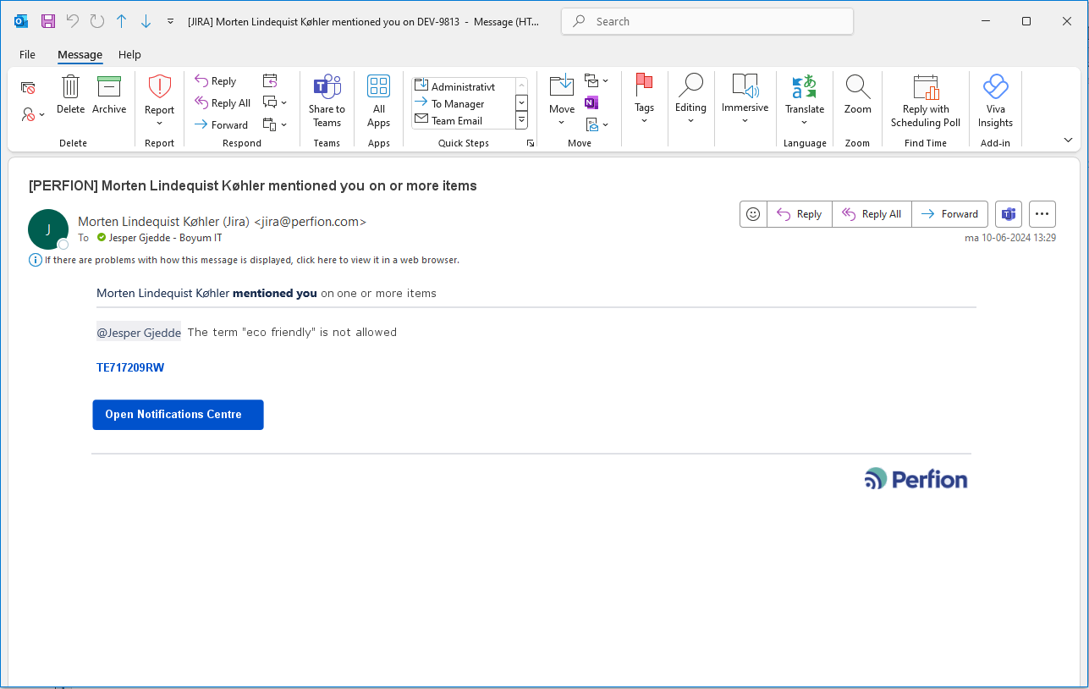
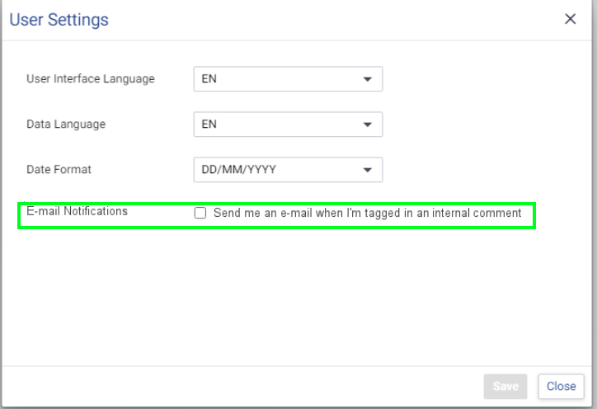
Notifications – emails
Perfion 2025-R2 Preview
Notifications Centre
User will receive an email if they are tagged
Can be enabled/disabled in User Settings

Slide 29
Agenda
Perfion 5.6 2025-R1 release
  New Service Account
  DeepL Glossary
  Import Wizard
  Perfion Content Store
Perfion roadmap (2025-R2 + R3)
Deprecations

Slide 30
Deprecations 2025-R1
Perfion roadmap (2025-R1)
SQL Server 2014
From 2025-R1, Perfion will require SQL Server 2016 or newer.
Shopify Connector v1.X
Customers should upgrade to version 2 instead.
Deprecations page on the Perfion Knowledge Base - https://perfion.atlassian.net/wiki/x/BwCAHw

Slide 31
Deprecations 2025-R2 + R3
Perfion roadmap (2025-R1)
Import/Export related sort order
Active Directory Federation Services (ADFS) support
Use direct integration with Microsoft Entra ID (formerly Azure Active Directory) instead.
Perfion API expressions such as Convert, Replace and CaseReplace.
FormatMultiValues will not be deprecated
FilterOn/FilterOff
Use Filtered Values instead.
Perfion Remote Web Service Interface
Use an OData remote instead
Deprecations page on the Perfion Knowledge Base - https://perfion.atlassian.net/wiki/x/BwCAHw

Slide 32
Questions?

