Slide 1
Perfion update Q3 2025
Webinar for Perfion customers

Slide 2



Hosts
Jeppe Brønnum Hatting
Stephen Rainbow
Product Manager
Advisor & Presales Consultant
Linkedin.com/in/jeppetobiashatting/
Linkedin.com/in/stephen-rainbow
jtha@boyum-it.com
stra@boyum-it.com

Slide 3
Agenda
Perfion 5.7 2025-R2 release
  Notifications & Comments
  Split user language & Data language in windows client
  New Importer: Smart hierarchy match
  Import through API
Release Demo
Perfion roadmap
2025-R3 Preview

Slide 4
Release Update
Perfion 2025-R2 - 5.7

Slide 5
Release Highlights
Comments
Add comments on items
Notifications
Tag users
E-mail notifications
Notification centre
Split Data & UI Language
Now in the windows client
Import Through API
Improve bulk integrations
Import: Smart hierarchy match
Import to hierarchy without full path
New import: Windows GUI
Use the new importer directly in Windows client

Slide 6
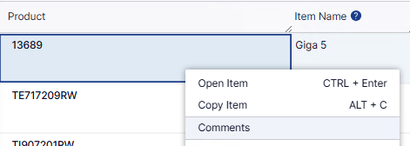
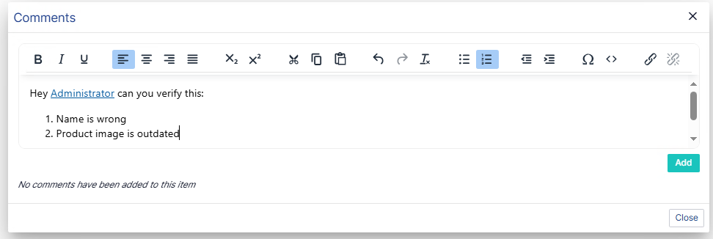
Comments
Enhanced Collaboration
Add comments to items
  Any selectable item
  Simple formatting
  Tag users
Screenshots e.g.

Slide 7
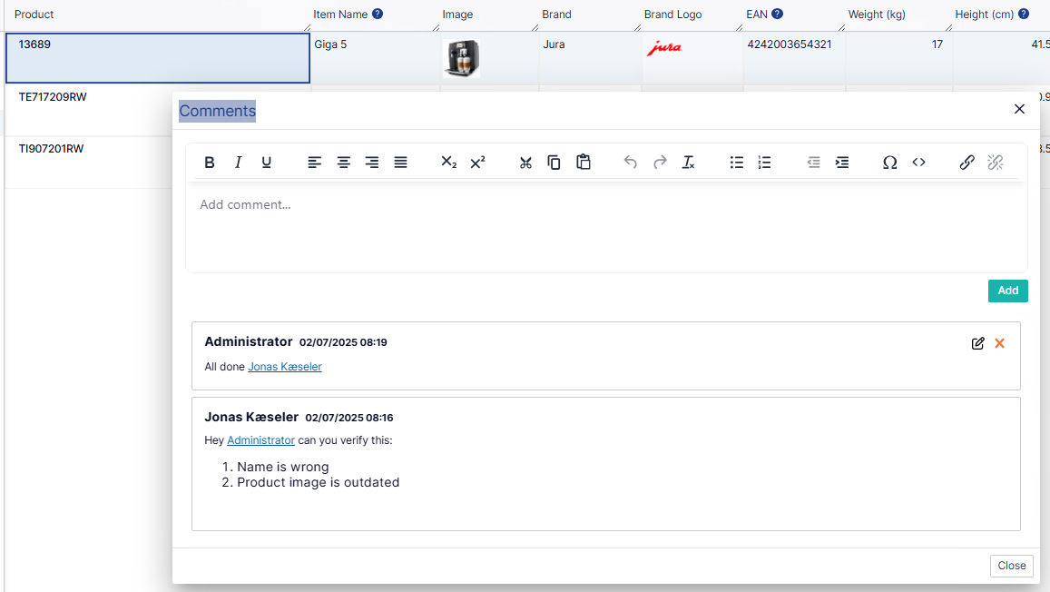
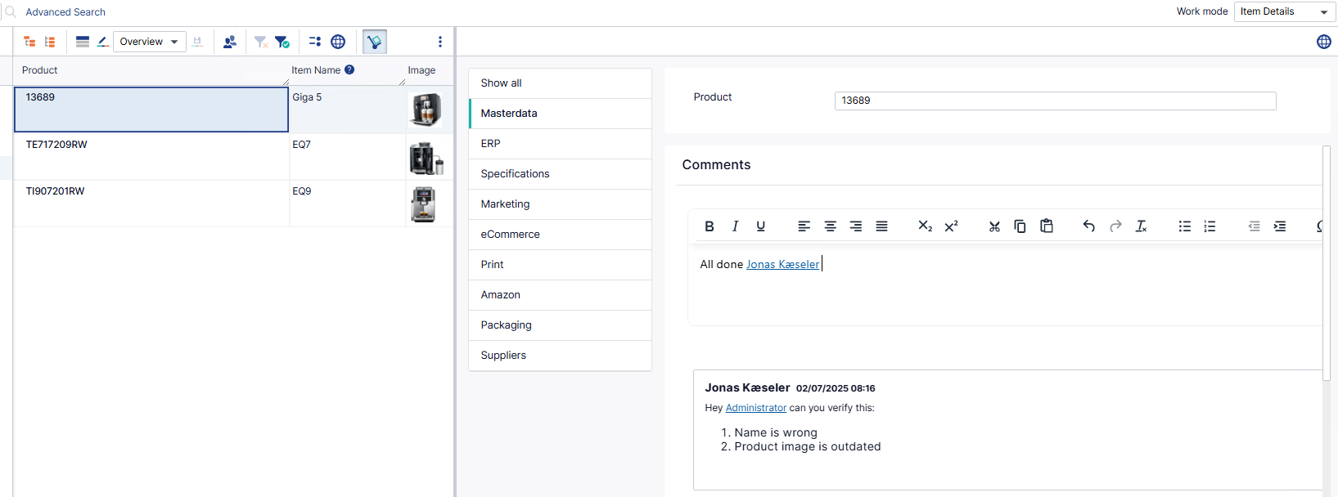
Comments
Enhanced Collaboration
Available both in Grid
  And Item Details

Slide 8
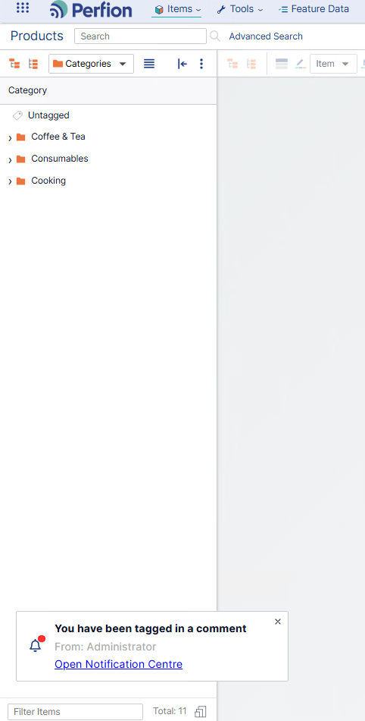
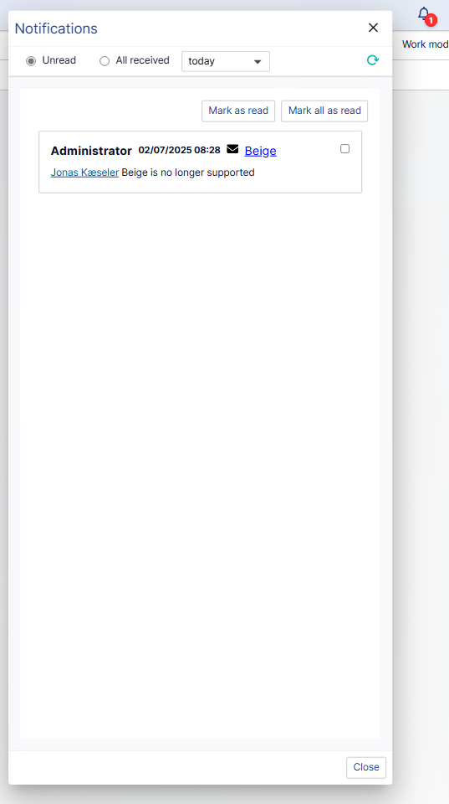
Notifications & Notification Centre
Enhanced Collaboration
When tagged in a comment, you get notified,
In the Notification Centre you can see all comments you have been tagged in.

Slide 9
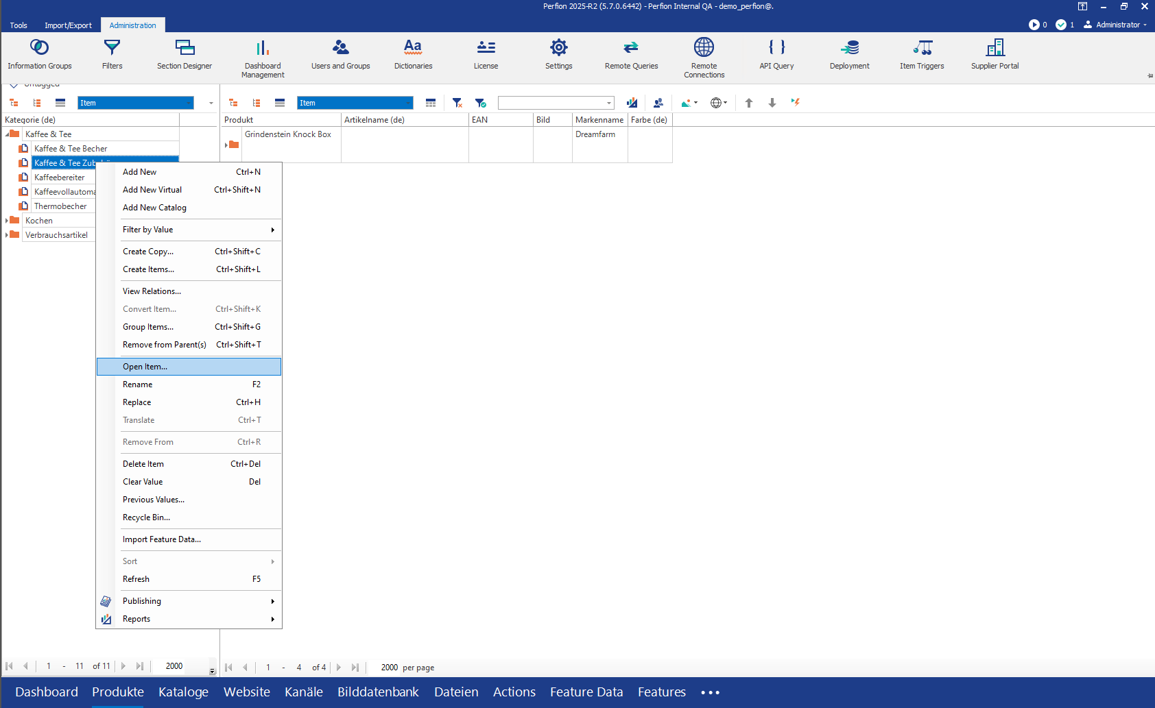
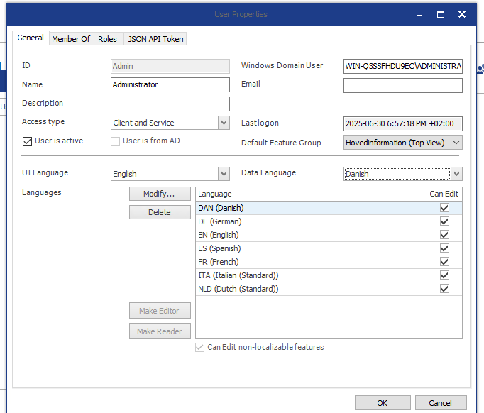
Split Data & UI Language
Better User Experience
Keep UI in main language but data language in locale you need to manage

Slide 10
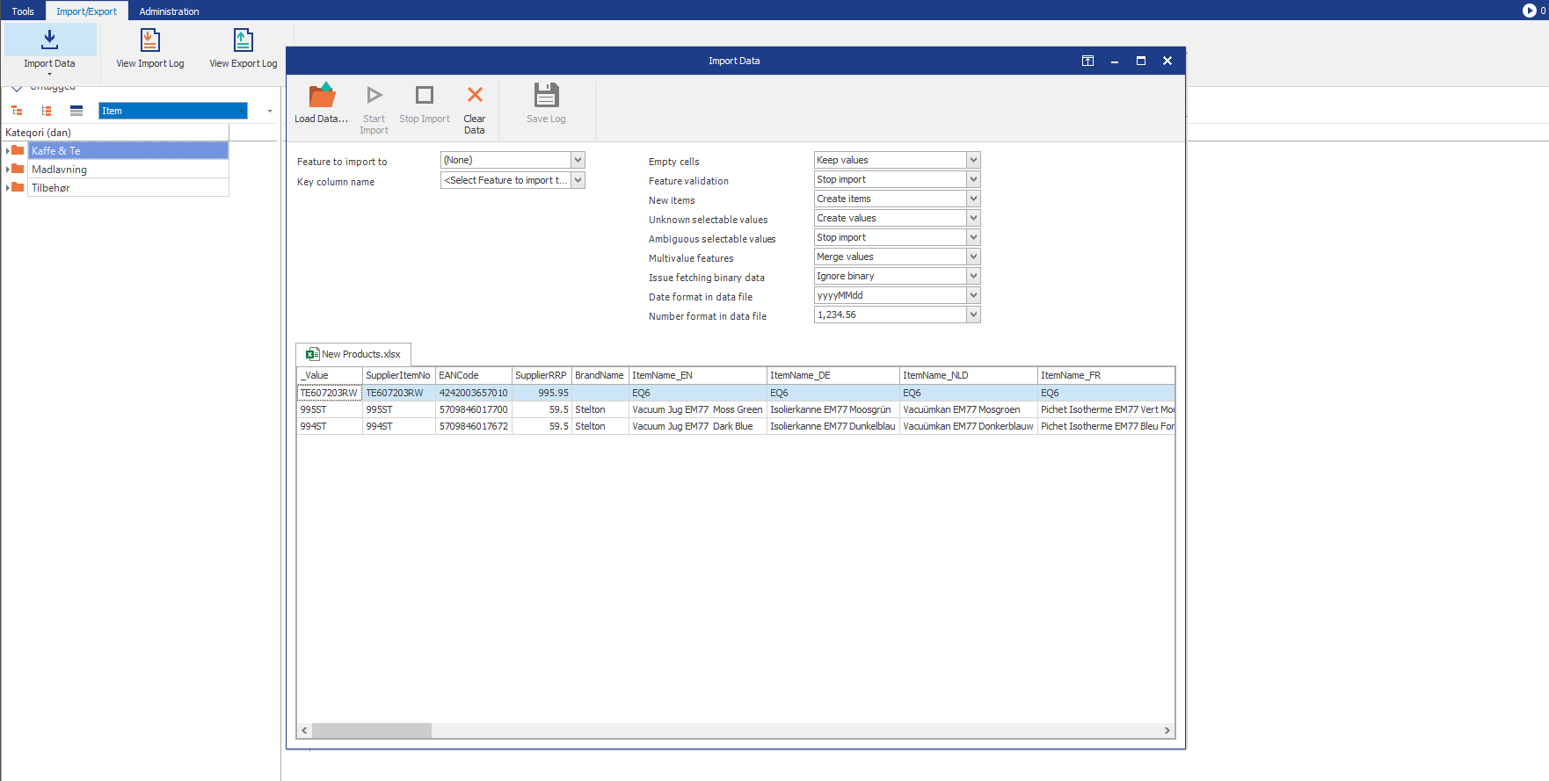
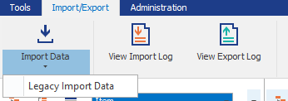
New Import – Windows GUI
Better Performance
Use the new importer directly in Windows client
New importer see vastly increased performance on large data set
Can run imports in parallel
Previously only in Actions & Import Wizard
The “legacy” importer is still available

Slide 11
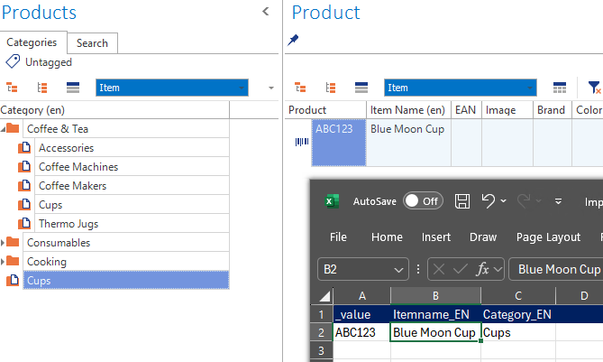

New Import – Import Without Entire Hierarchy
Better Performance
Have you ever done this?
You want to import a new series of product into a category but forget to specify the entire path in the import file.
Result: New Wrong category in the root of the tree ☹
NO MORE!

Slide 12
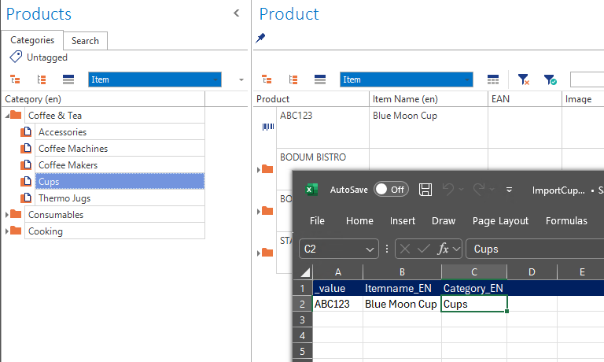

New Import – Import Without Entire Hierarchy
Better Performance
New Importer finds the item in the hierarchy if the item is unique
If the item (Cups) exist in root and other positions it will be added to root
If the item exists in multiple non-root positions, an error is thrown.

Slide 13
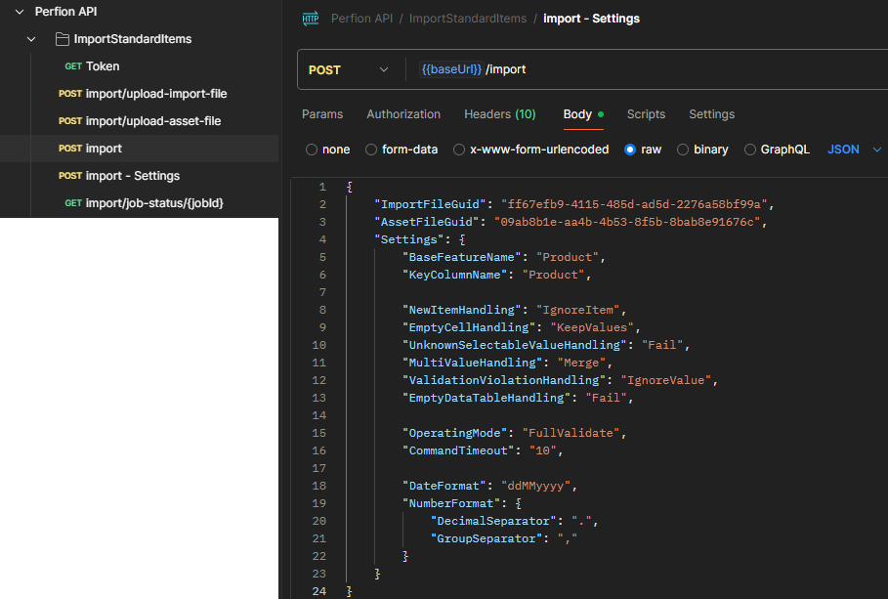
New Import – Import Through API Service
Better Performance
You can now upload excel & asset zip files through API and start imports remotely
Authenticate
Upload import file
(option) upload asset file (.zip)
Start import
Check status
Documentation & Postman collection available on Knowledge Base (soon)

Slide 14
Release Demo
Notifications

Slide 15
What’s next?
Release 2025-R3 and on

Slide 16
Roadmap Perfion
AI Functionality
Automapping in Wizard
Prompt based values
Enrichment Workmode
Web catch up
Administration & Settings in webclient
Boyum Look’n’feel
Imp. Wizard – Save mappings
Reuse mappings
Portuguese UI
Action Improvements
Query against data table
Write to job log
Better variable support
New Importer: Staging

Slide 17
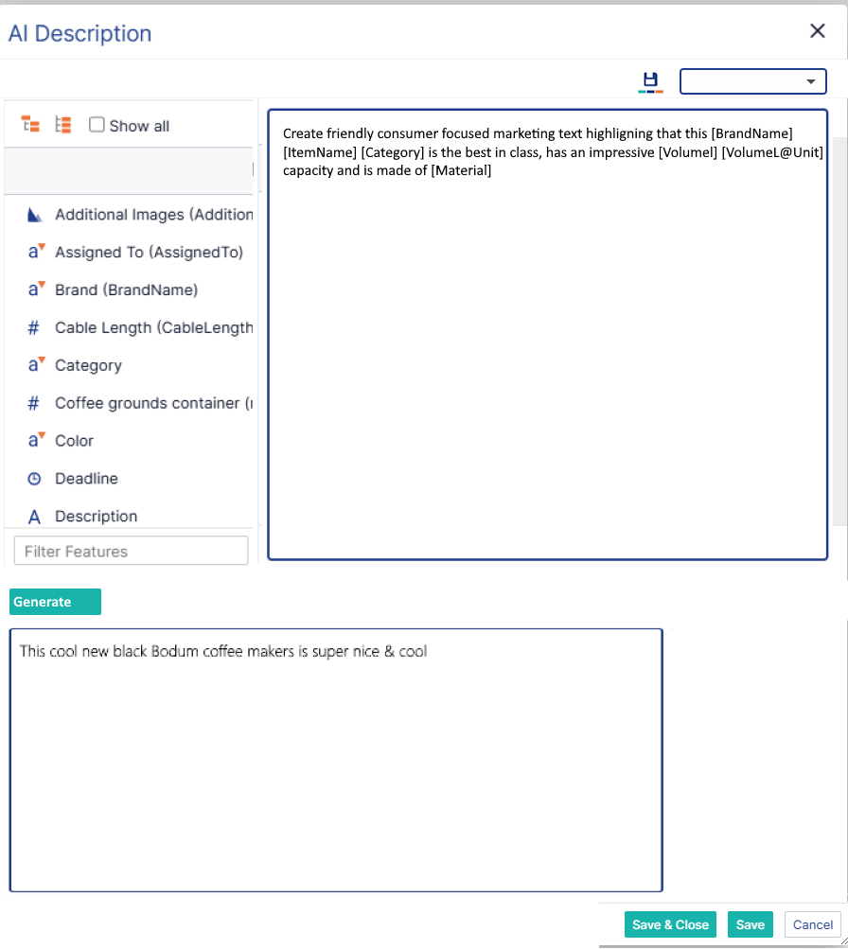
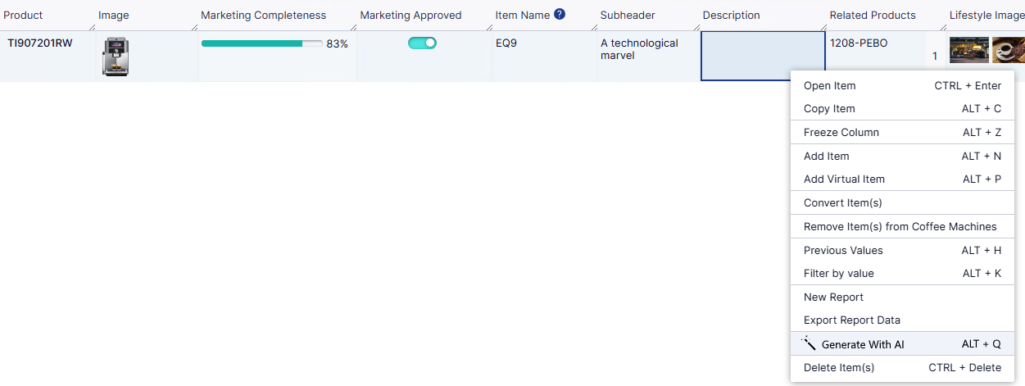
AI Preview
2025-R3 Preview
Prompt based values
Descriptions, Text and Titles with AI
Save and reuse templates
Based on Formula editor

Slide 18
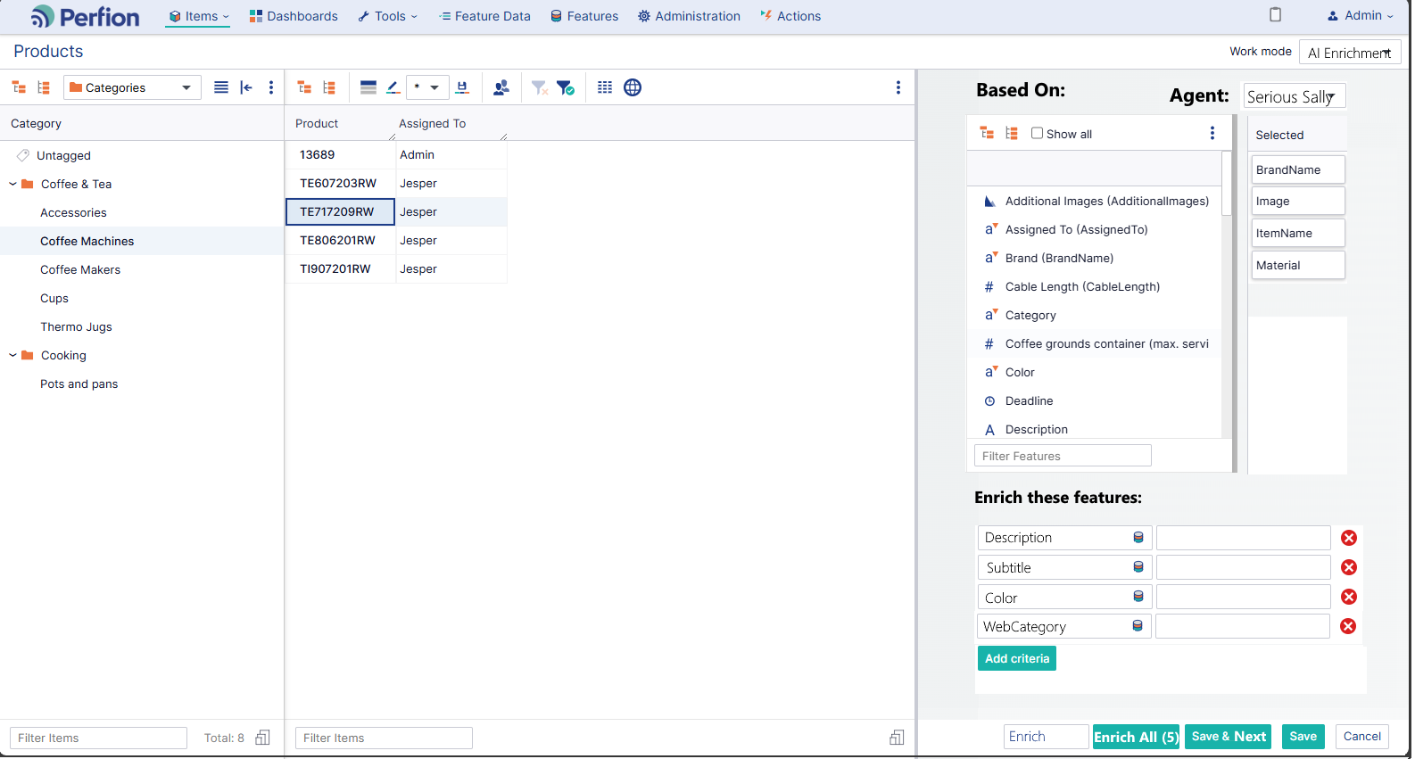
AI Preview
2025-R3 Preview
AI Enrichment Workmode
Extract additional information from existing data
”Hi AI Agent, based on this image, itemname, and user guide, please fill out the Decription, Color, Material and Website category for this product”

Slide 19
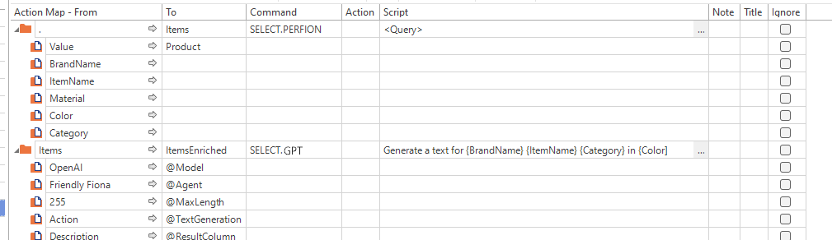
AI Preview
2025-R3 Preview
Dedicated GPT Action Command
Make it easier to work with LLMs in Actions

Slide 20
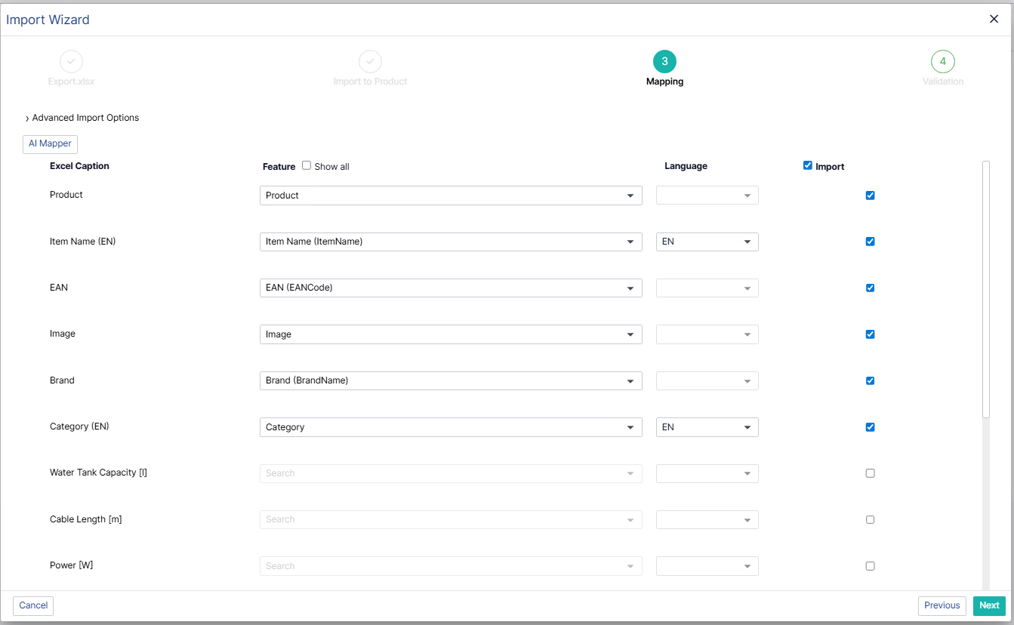
AI Preview
2025-R3 Preview
AI Assisted Mapping in Import Wizard
Speed up the mapping of large data sets
Also comming: Saving and reusing mappings
Let’s see!

Slide 21
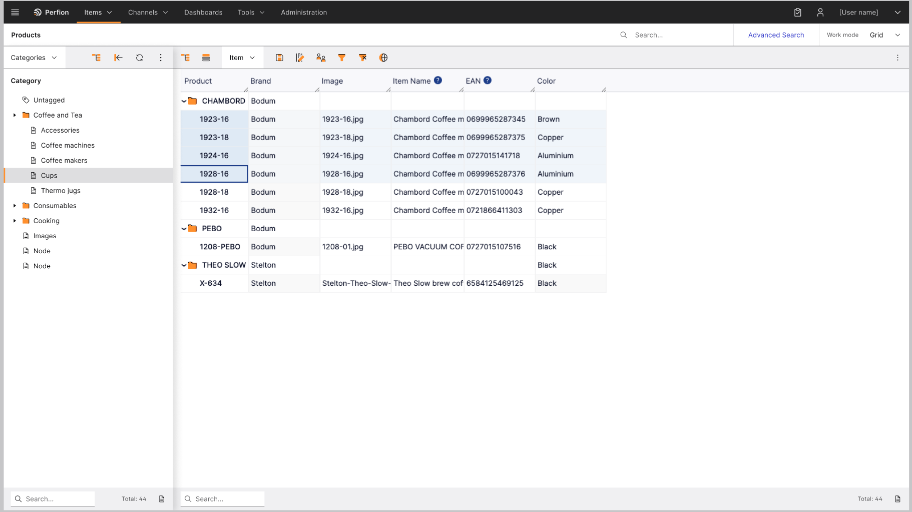
New Look’n’feel
2025-R3 Preview
Perfion in Boyum Clothing
Make Perfion consistent with other Boyum products
Short term benefit:
Minor clean up of UI
Better consistency
Long term benefit:
More flexible foundation for customization
  Light mode?
  Customer branding?
Ensure consistency, usability and keyboard navigation in new functionality

Slide 22
Roadmap Portals & Connectors
Content Store 1.1
Bug fixes
Minor improvements & usability
Content Store 1.2
Collections
Download & access options
Video Player
Supplier Portal
Lock Items
Automate User Management
Shopify Connector
Shopify market prices
Better error messages
Go-live date for categories
Magento Connector
Better error handling on mandatory values
Support for decimal values
Release2ERP SAP B1
Conversion of values
Deleting empty value

Slide 23
linkedin.com/company/boyumit
sales@boyum-it.com
youtube.com/user/boyumit
boyum-solutions.com
instagram.com/boyumit/

