Slide 1

Perfion Features
Highlights from 2025 and onwards

Slide 2
2026-R1
Build: 5.8.09
Released: June 2026

Slide 3
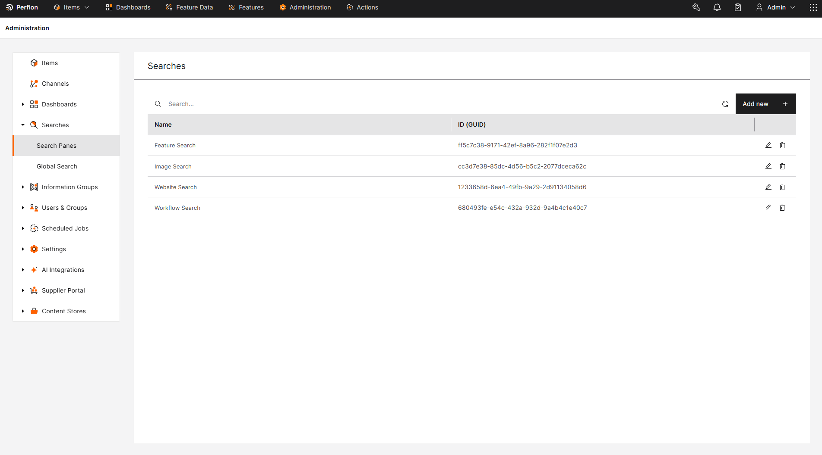
Boyum Makeover Part II
Perfion 2026-R1
Administration section is now converted
Exact same functionality, different look
Final Administration section conversion will come in 2026-R1 SR1

Slide 4
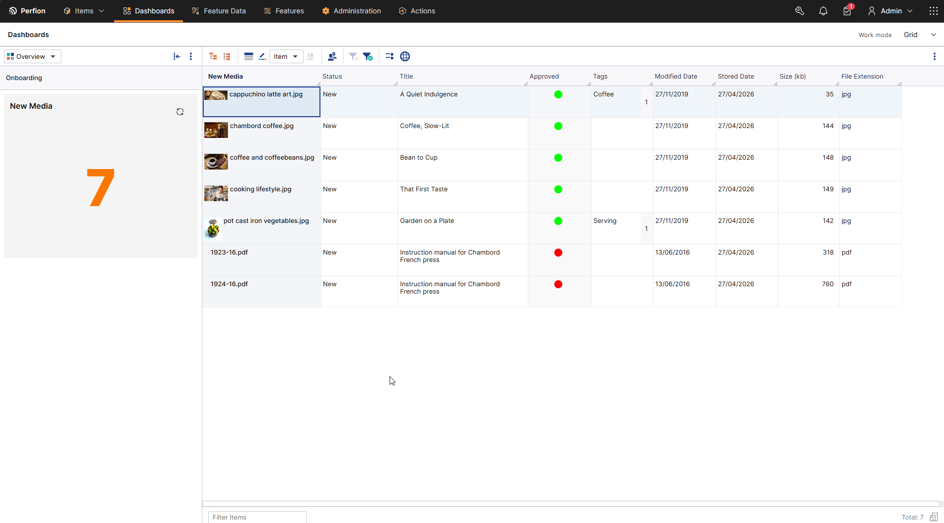
Mixed Item Widgets & Channels
Perfion 2026-R1
Channels & Widgets now supports multiple base features at the same time.
Often, items with different base features would still need to be in the same channel or workflow.
This is now supported without having to resort to multiple ‘copies’ of each per base feature
Particularly beneficial for asset channels like Content Store

Slide 5
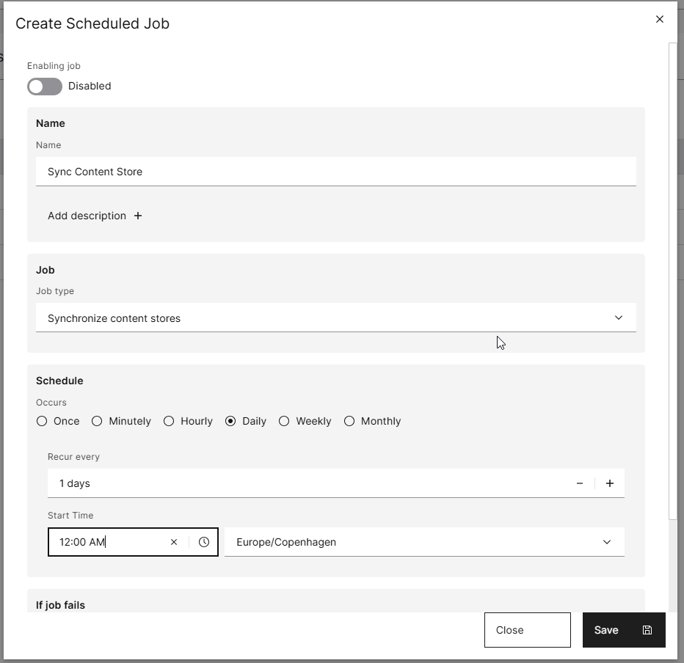
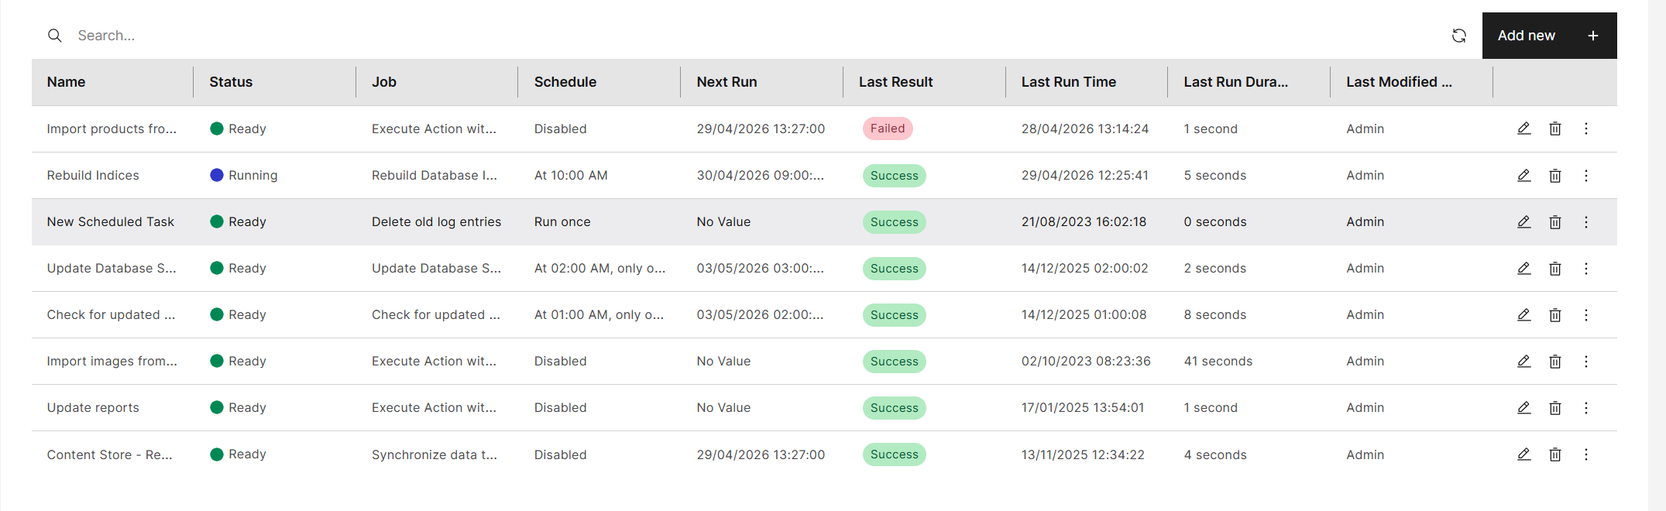
Web Client Enablement - Scheduling
Perfion 2026-R1
Scheduler now available in the web client
Schedule, execute and overview jobs
Switched from proprietary solution to CRON jobs

Slide 6
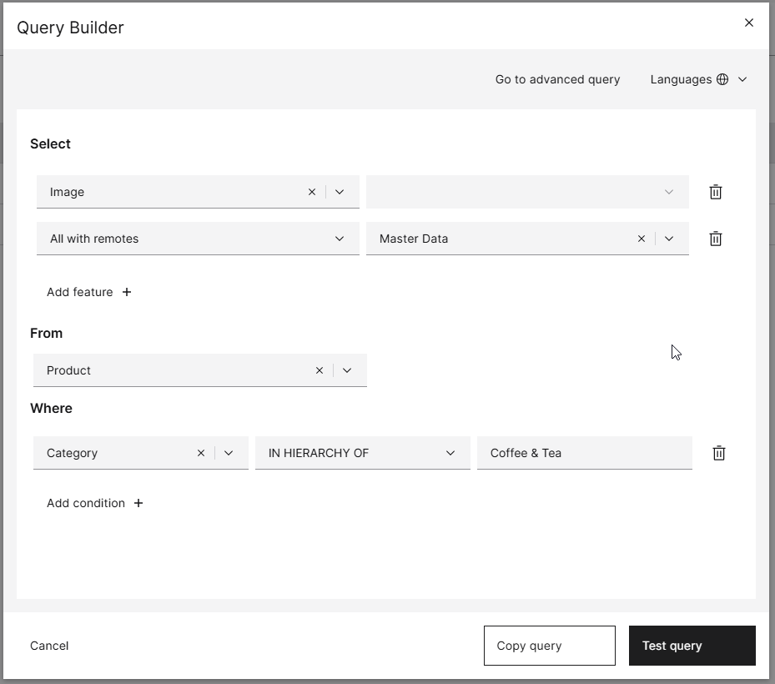
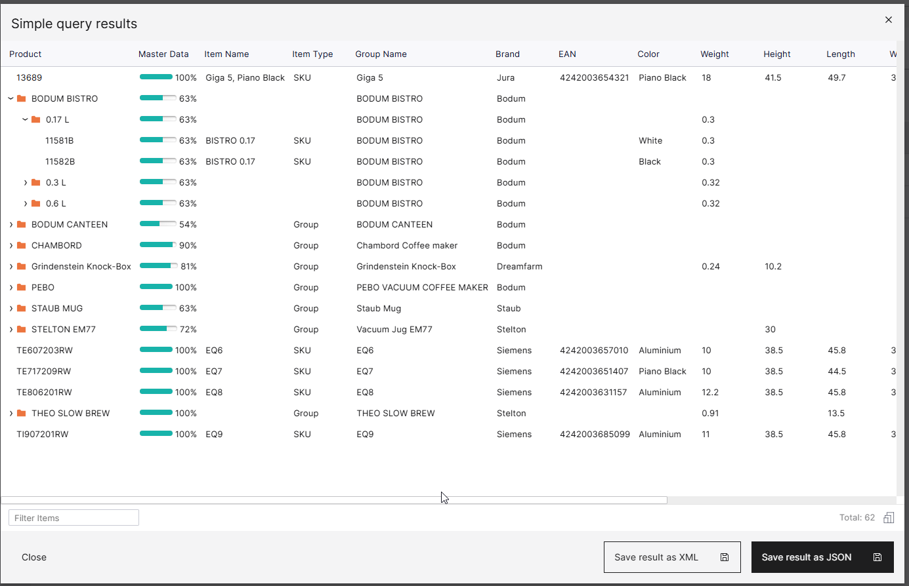
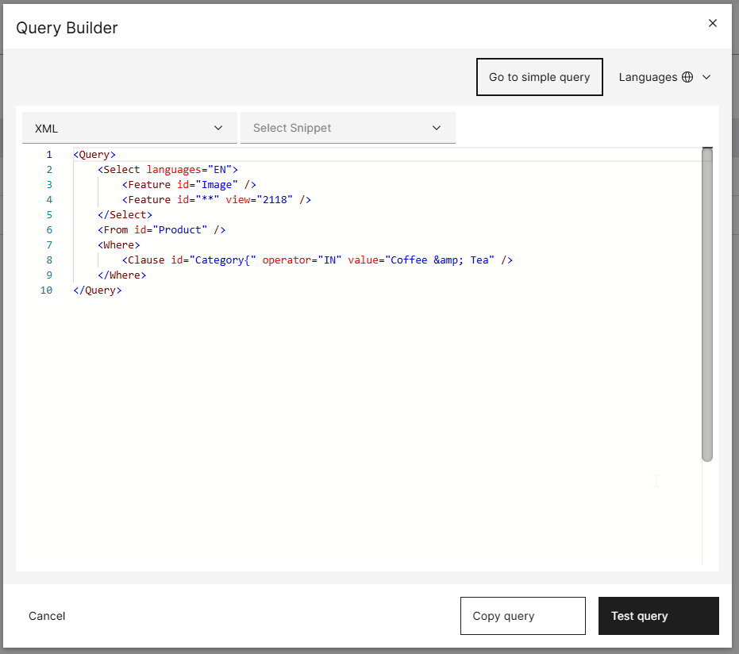
Perfion 2026-R1
Perfion 2026-R1
Query Builder for web client
Build and test queries in the web client
Simple mode with guided UI
Advanced mode with syntax highlight

Slide 7
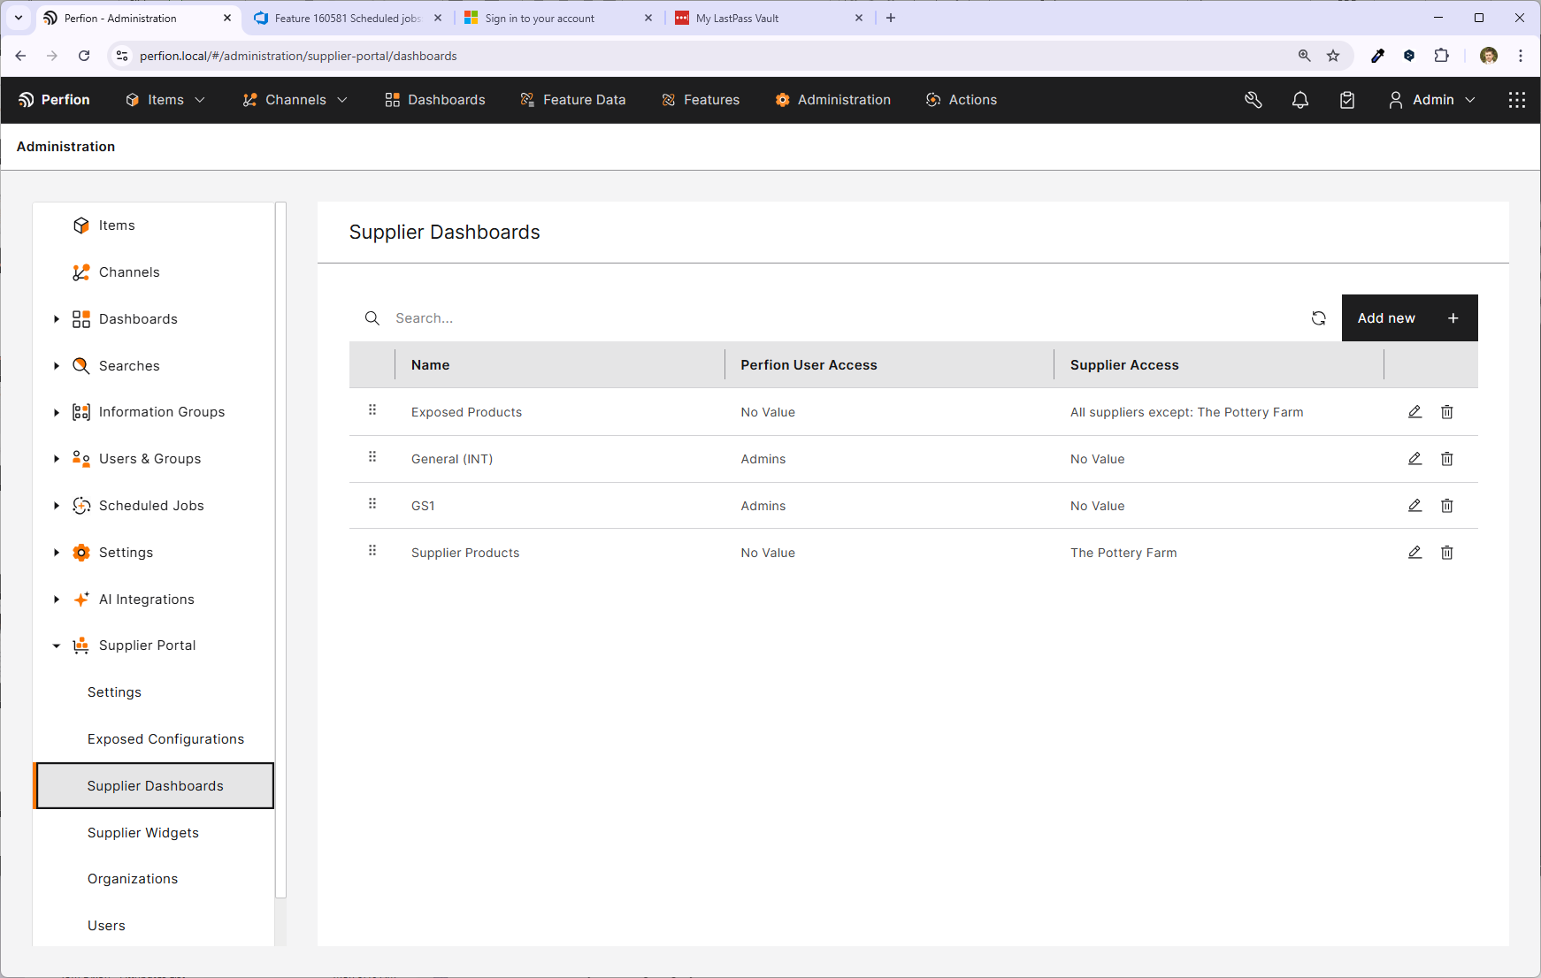
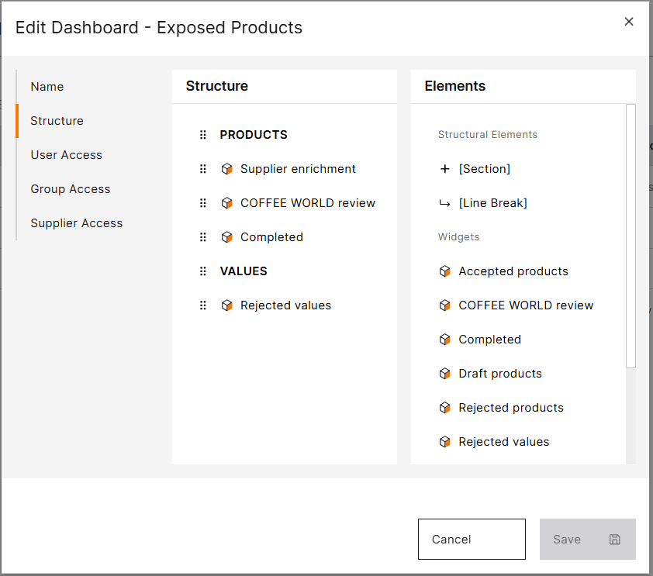
Perfion 2026-R1
Supplier Portal Administration
Previously only available in Windows client
Now you can administer all aspects of the Supplier Portal within web client
Define settings and expose configuration
Manage dashboards, users and organizations

Slide 8
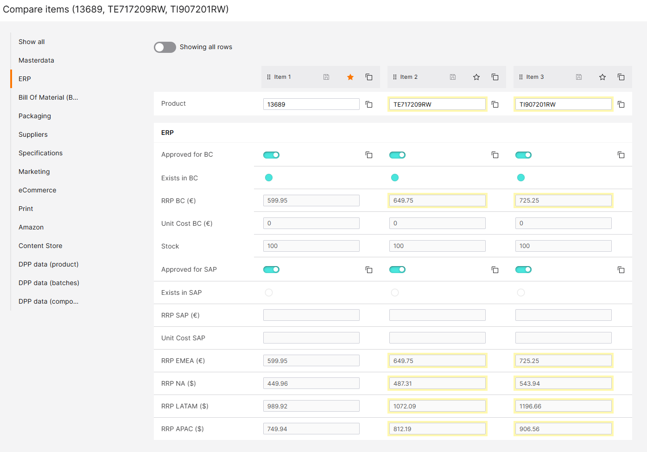


Perfion 2026-R1
Compare Items
Compare multiple items
Copy all values or just individual values
Structure based on Item Editor (Top View Groups)
Change the 'Master' item after selection

Slide 9
Perfion 2026-R1
Compare Items
Compare multiple items
Copy all values or just individual values
Structure based on Item Editor (Top View Groups)
Change the 'Master' item after selection

Slide 10
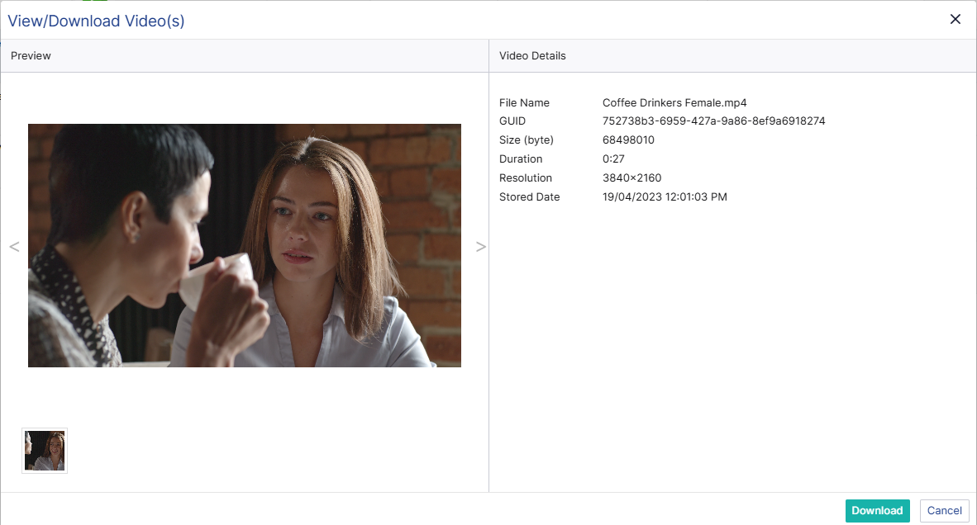

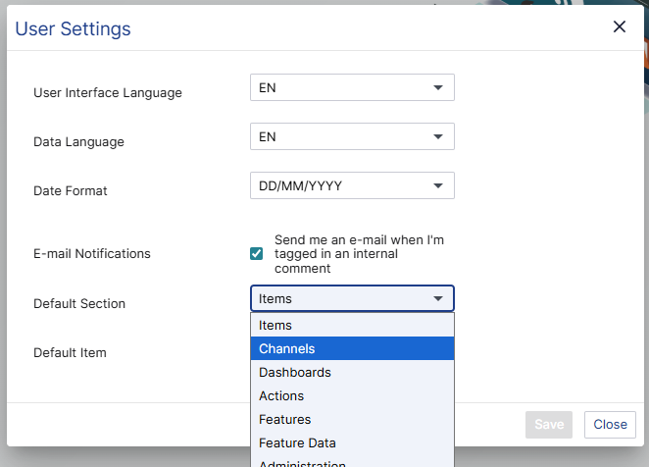
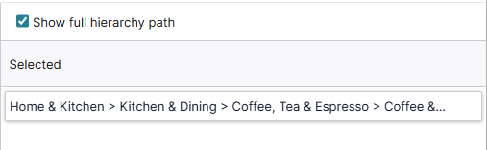
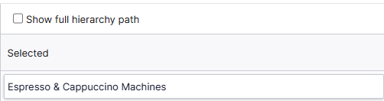
Perfion 2026-R1
Usability Improvements
Default sections when logging in
Video playback
Show full hierarchy path in grid and item editor
Video preview
Default section
Show full hierarchy path

Slide 11
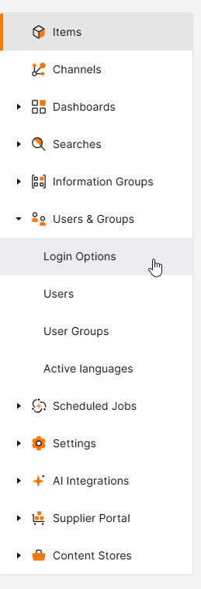
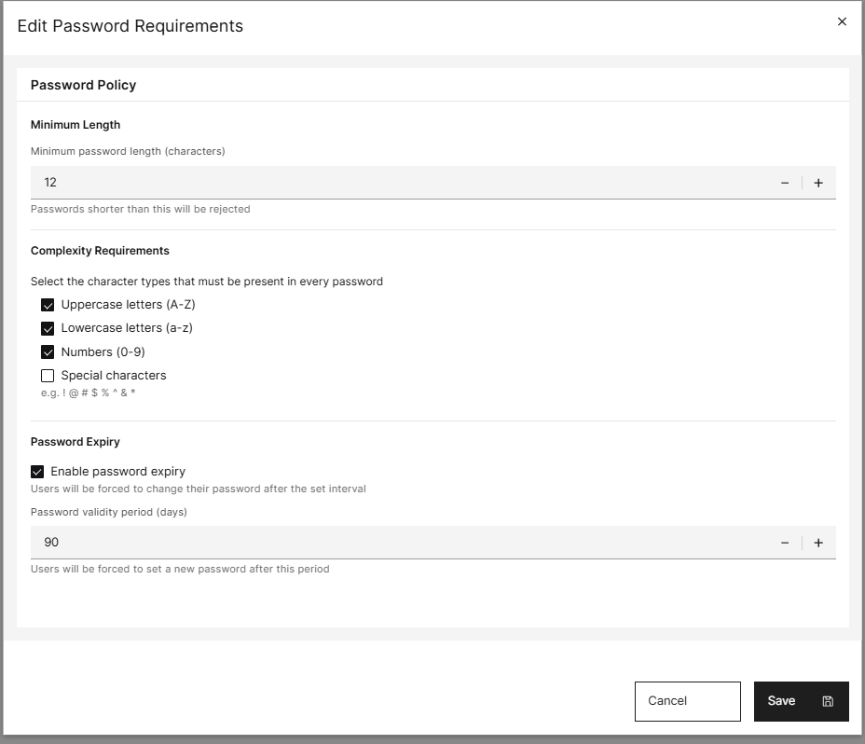
Perfion 2026-R1
Security Package - Password Requirements
Define password requirements for your organization.
Set expiration on password and enforce password updates.

Slide 12

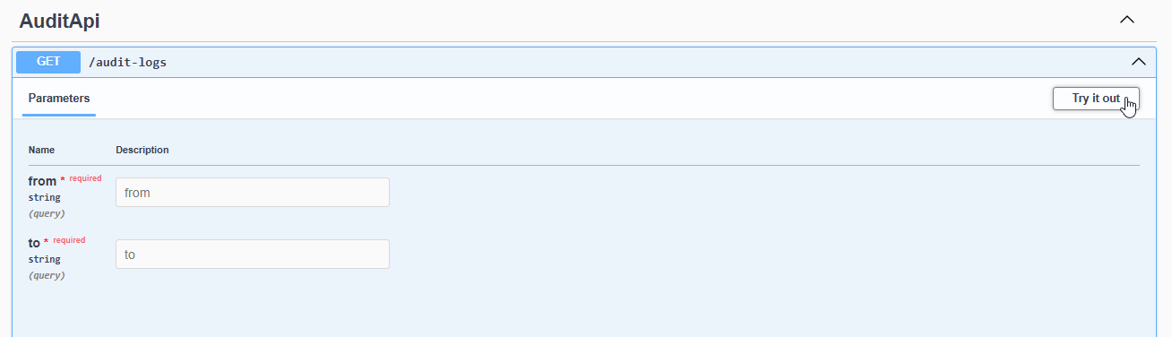
Perfion 2026-R1
Security Package – User Audit Logging
User logins and changes are now logged and can be audited through the API
What is logged:
Logins - successful and failed
Changes to users

Slide 13
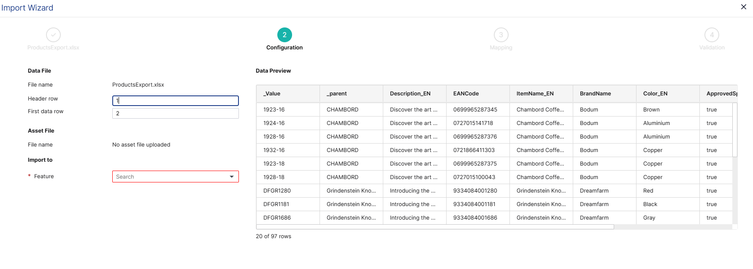
Perfion 2026-R1
Import Wizard – Data Preview & Default Option Changes
Preview window of data to be imported
Allows pre import ‘sense check’ of data source
Import options now default based on user permissions

Slide 14
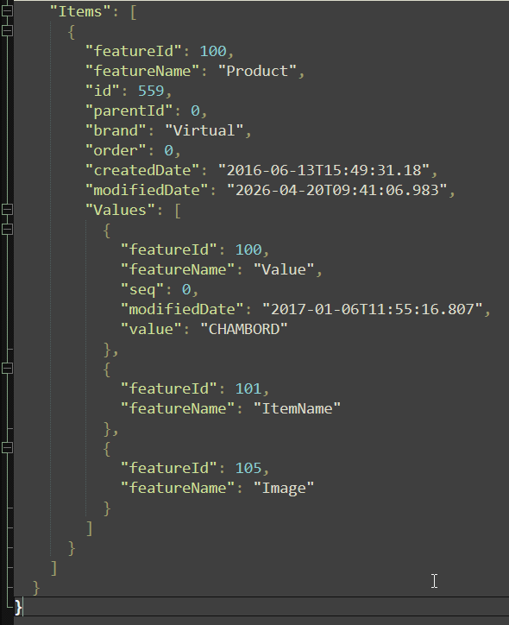
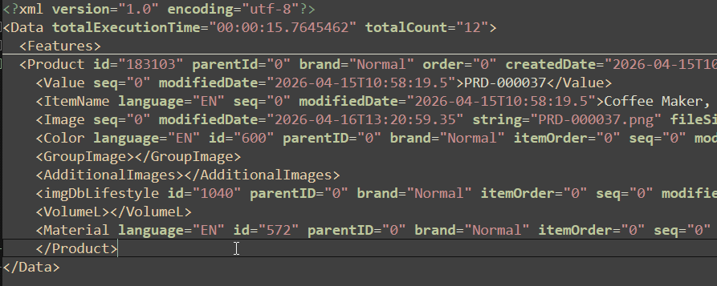
Perfion 2026-R1
API Improvements – Return Empty Values
With the IncludeEmptyValues option in API it is now possible to get empty features in the response.
Allows external systems to know which features exist in the configuration, but are currently empty for an item

Slide 15
Perfion 2026-R1
API Improvements – Return Empty Values
With the IncludeEmptyValues option in API it is now possible to get empty features in the response.
Allows external systems to know which features exist in the configuration, but are currently empty for an item

Slide 16
2025-R3
Build: 5.8.0
Released: December 2025

Slide 17
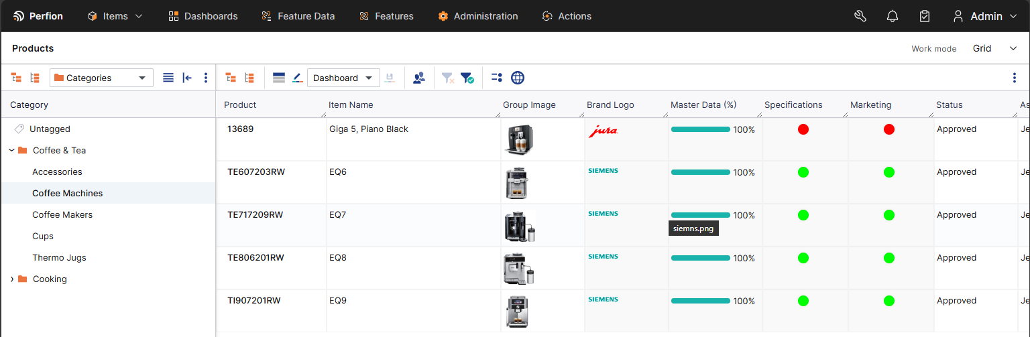
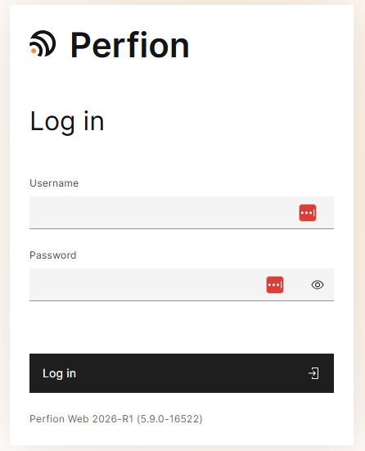
Boyum Makeover Part I
Perfion 2025-R3
New Modern Look
Alignment with the Boyum brand look and feel
Accessibility updates (readable text, more contrast in colours, theming, keyboard navigation, ease of use etc)
Technical update for the frontend to achieve additional value for customers (brand ability)
Also important focus: We are not restructuring, trying not to disrupt current customers, keeping familiarity in the architecture as much as possible

Slide 18
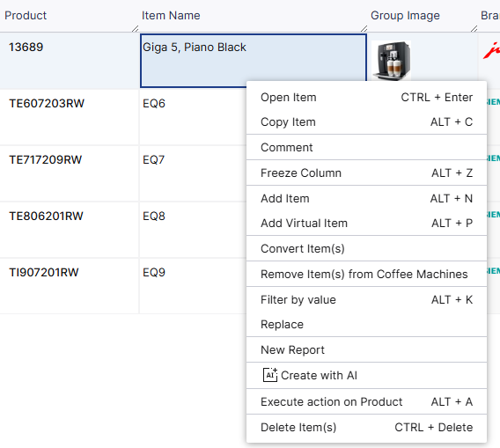
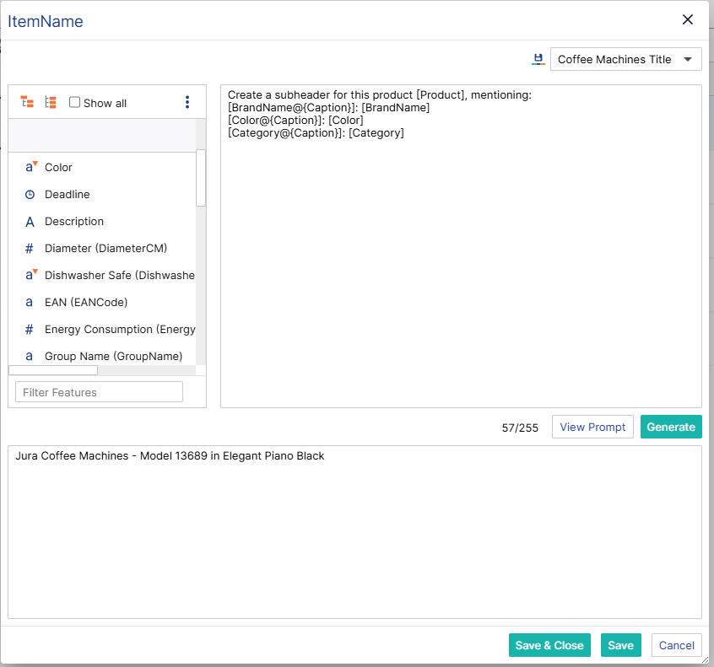
AI – Template Based Value Generation
Perfion 2025-R3
Create Text With AI
On string & text features you can now "Create with AI"
Use feature values in prompts dynamically
Save templates and reuse them
Works with Rich Text
Build on the formula editor

Slide 19
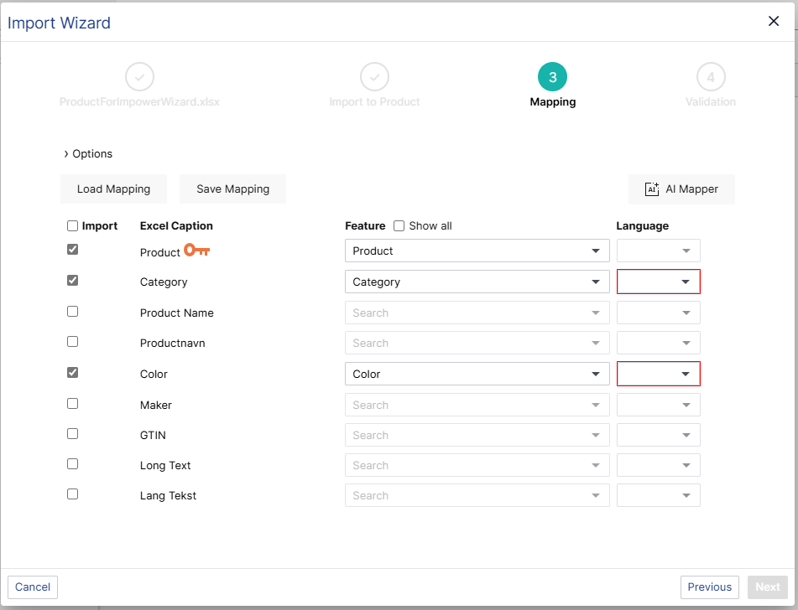
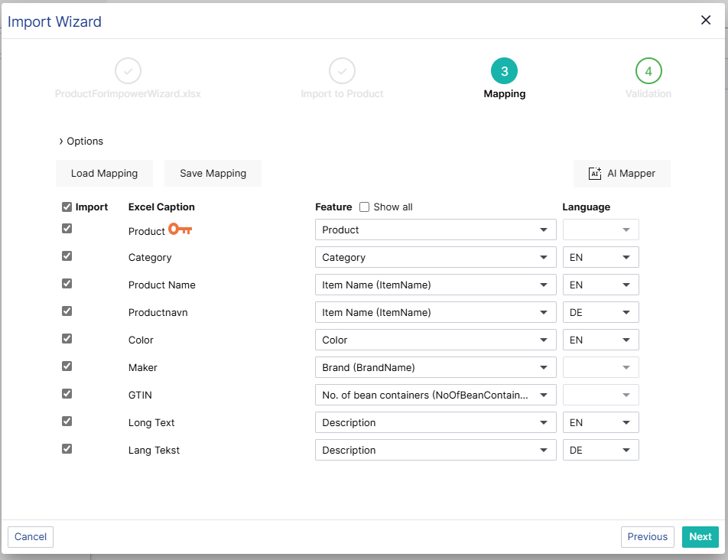
AI – Automapping in Import Wizard
Perfion 2025-R3
Use AI To Help Map Large Import Files
Saves times
Also maps languages

Slide 20
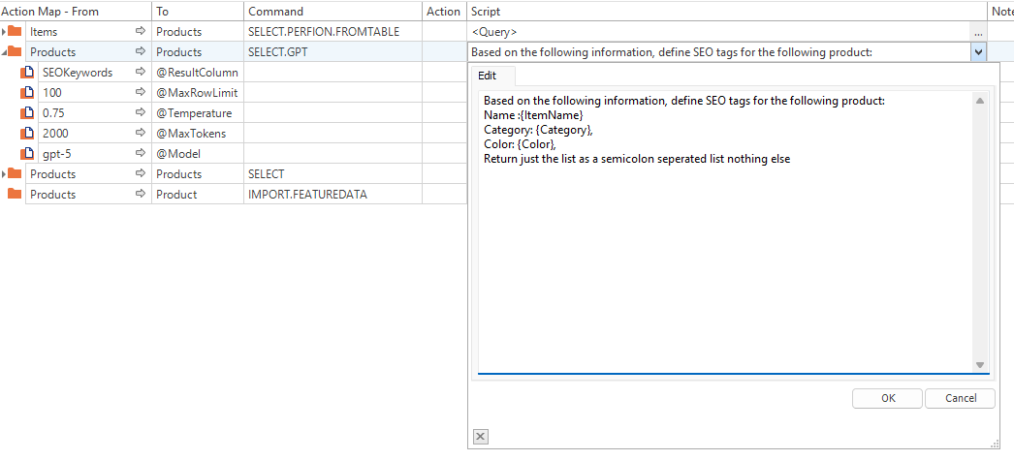
AI – Dedicated AI/GPT Command
Perfion 2025-R3
AI Actions without coding
Calls LLM for each row in input table
Write dynamic texts
Customize call with temperature, tokens usage and which model to use

Slide 21
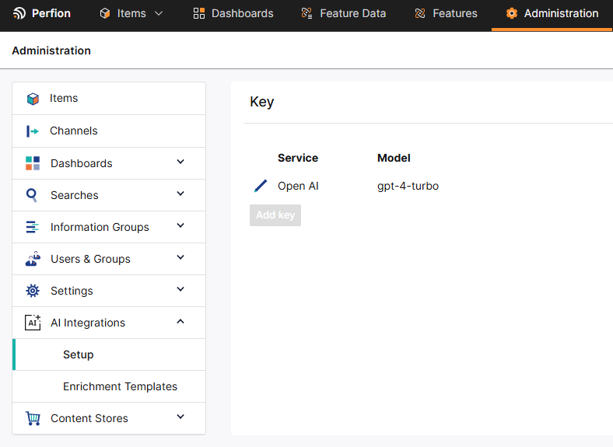
AI – Administration
Perfion 2025-R3
Prompt Templates and AI Keys can be managed in Administration
Define the default gpt model
Manage license key
Define enrichment template for users

Slide 22
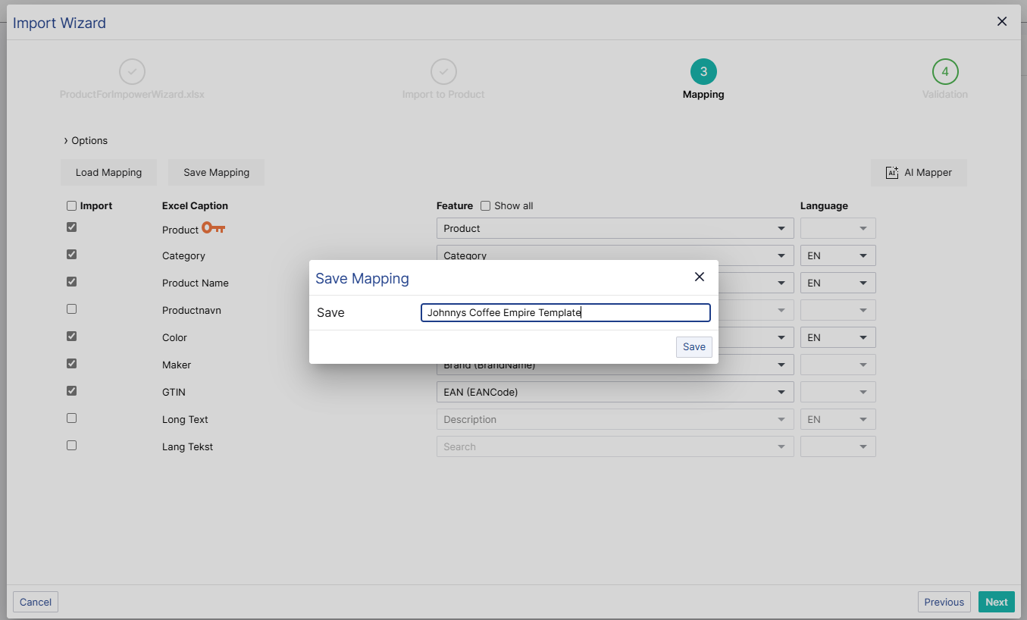
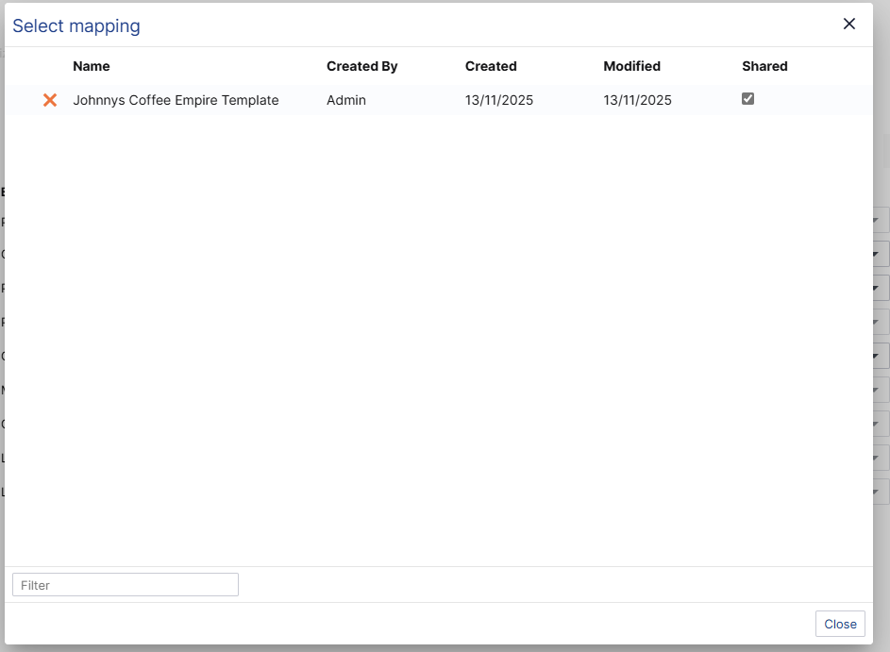
Import Wizard – Save & Load Mappings
Perfion 2025-R3
Save mappings and share them with others
Save mappings, so you don’t have to redo mappings every time
Also saves options
Choose which templates should be shared with other users

Slide 23
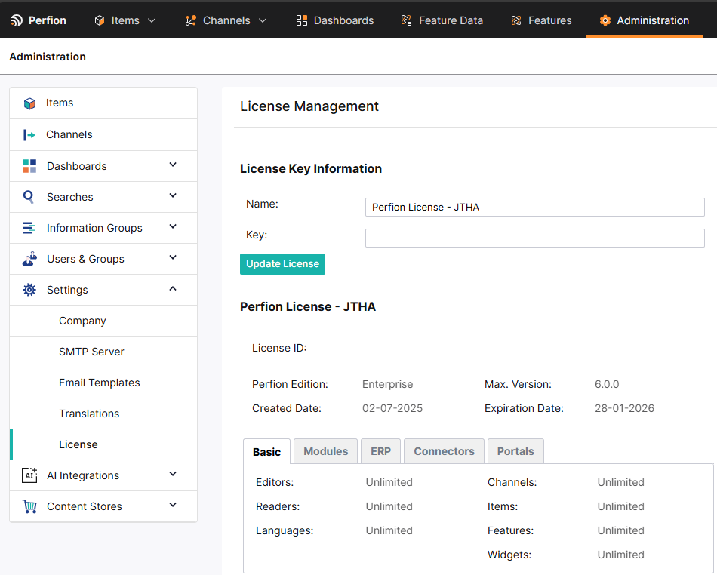
Administration in Web client
Perfion 2025-R3
Administer basic settings in the web client
Company Settings (mainly for supplier portal)
Setup and manage SMTP Servers
Customize email template
Manage translations & translation dictionaries (DeepL)
See and update license

Slide 24
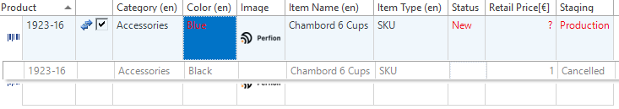
New Importer – Staging & Update Item Parent
Perfion 2025-R3
Import Products to Stages In New Importer
Import Stage by feature name or by _stage
Update Parents with _ToParentPath
Update the item hierarchy

Slide 25
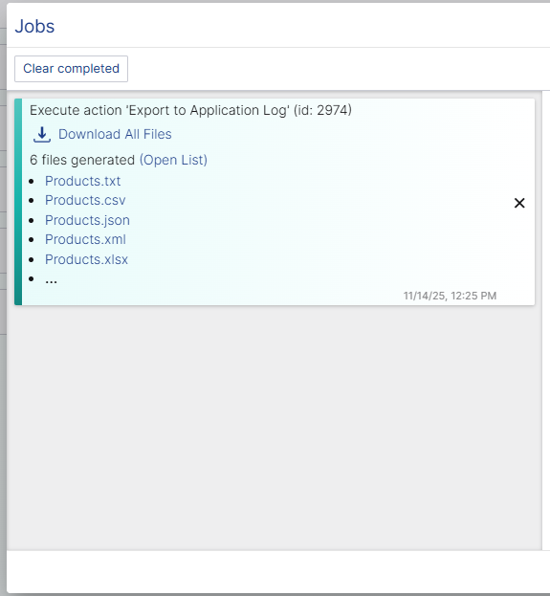
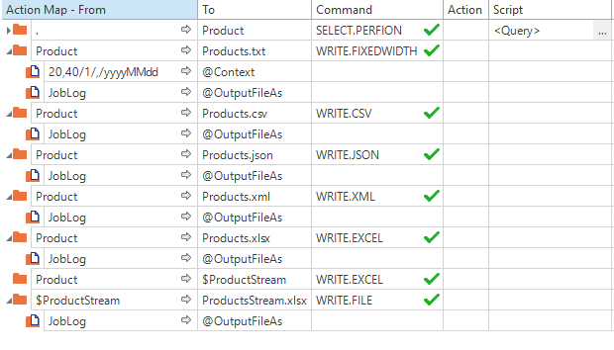
Actions Improvements – Write To Job Log
Perfion 2025-R3
Use Any WRITE.* command to write files to application server
Retrieve file outputs without a local drive
Export multiple files
Works with all existing commands

Slide 26

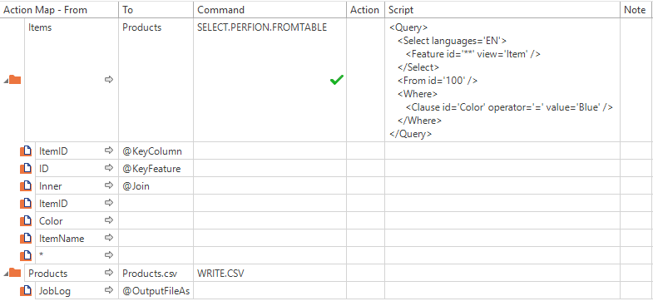
Actions Improvements SELECT.PERFION.FROMTABLE
Perfion 2025-R3
Query additional information directly on a datatable
Complicated scripts and loops are no longer needed to fetch additional information to a data table
Works well with triggers and context actions
Join options
  Left – Keep entire input table
  Inner – Only keep results that are found

Slide 27
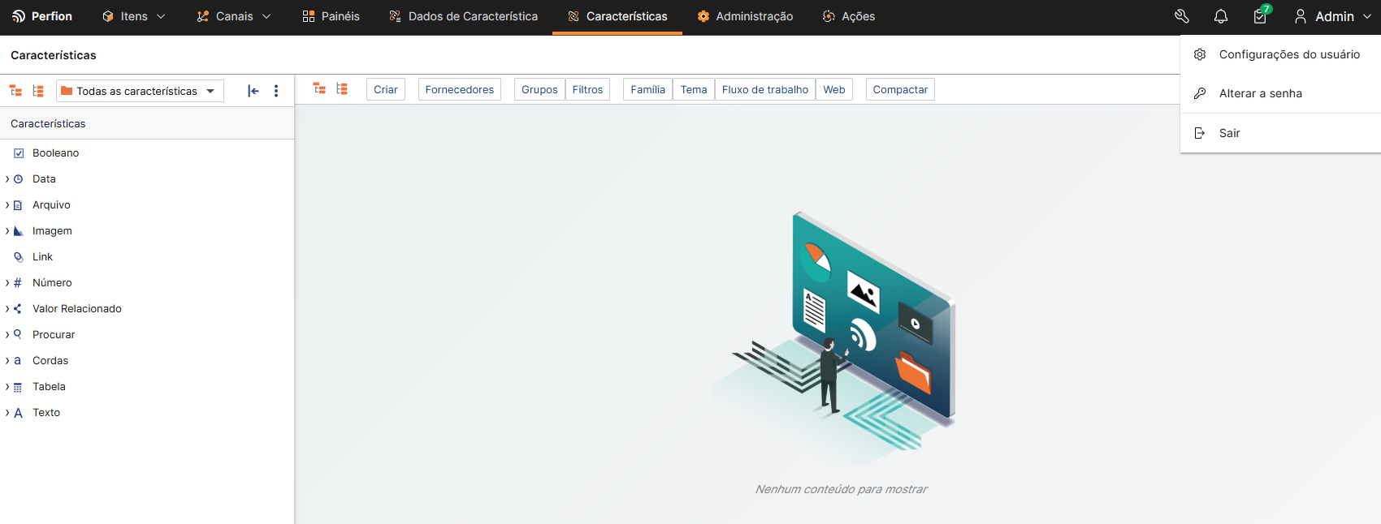
Portuguese (Brazil) User Interface
Perfion 2025-R3

Slide 28
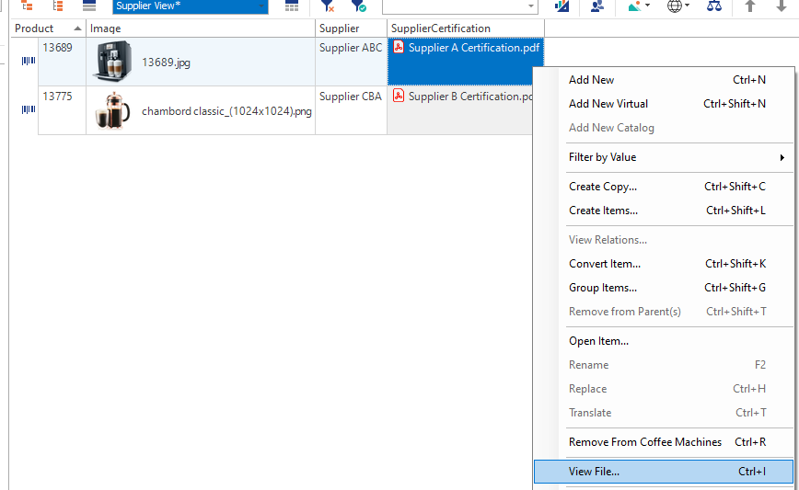
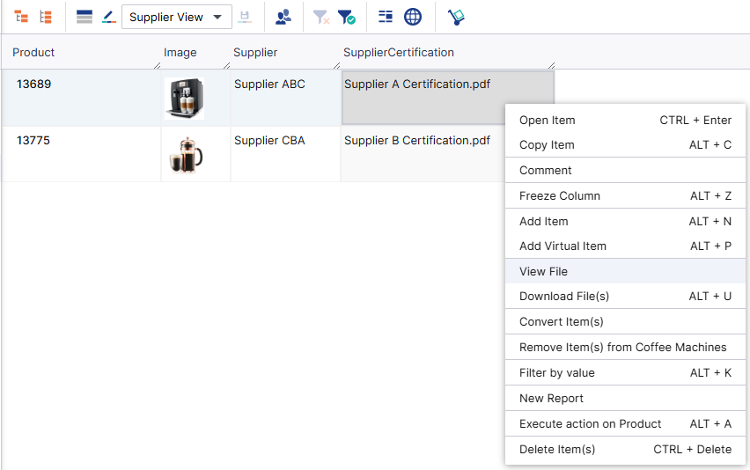
Files as Related Values
Perfion 2025-R3
Was never properly supported in either web or windows
Now fully supported in both
Works as you would expect a file feature to work

Slide 29
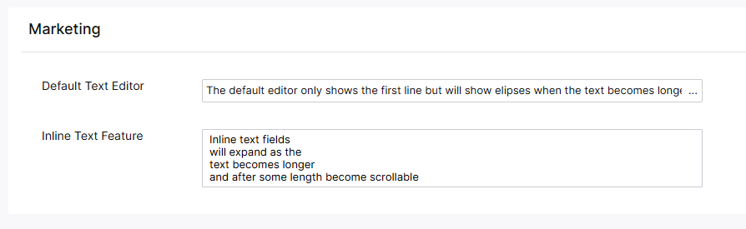
Inline Texts in Web Client
Perfion 2025-R3
Better overview when managing many Text feature
Respects Control Type

Slide 30
2025-R2
Build: 5.7.0
Released: Juli 2025

Slide 31
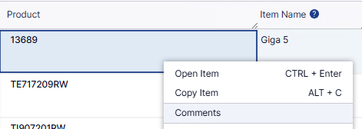
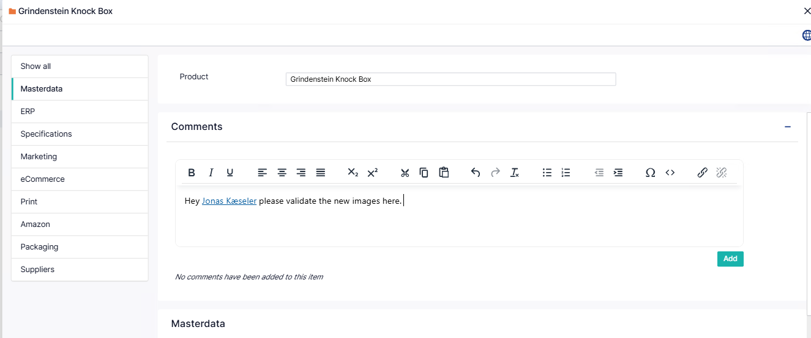
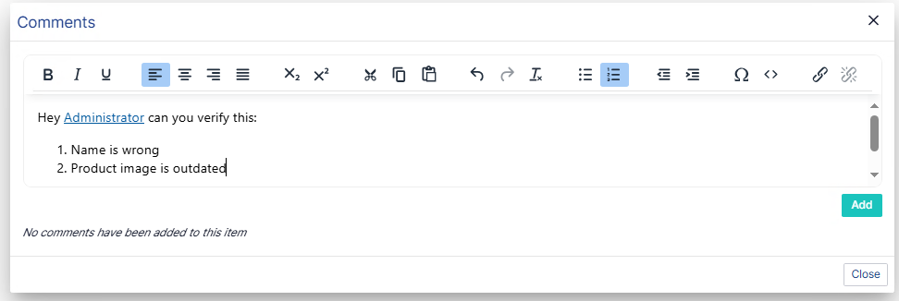
Comments
Add comments to any selectable item
Tag other users
Available in grid (right-click) and in Item Editor

Slide 32
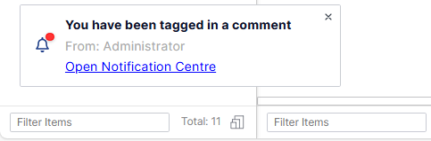
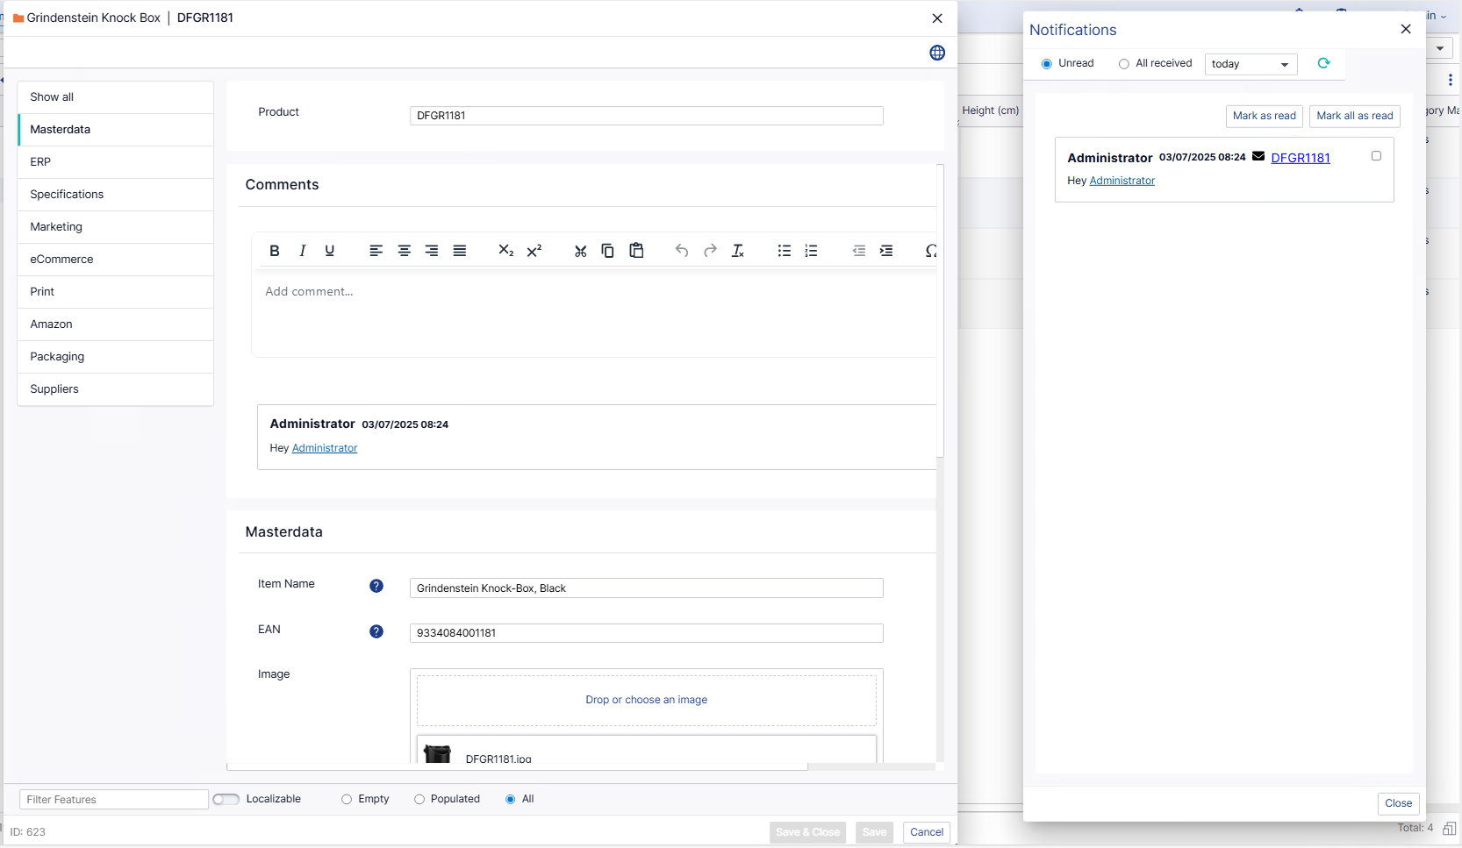
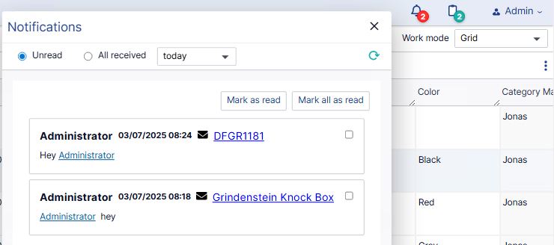
Notification Centre
When a user tags you in a comment, you get pop-up Notifcation
The new Notification icon shows how many unread comments you have
From the Notification Centre you open the item you’re tagged in

Slide 33
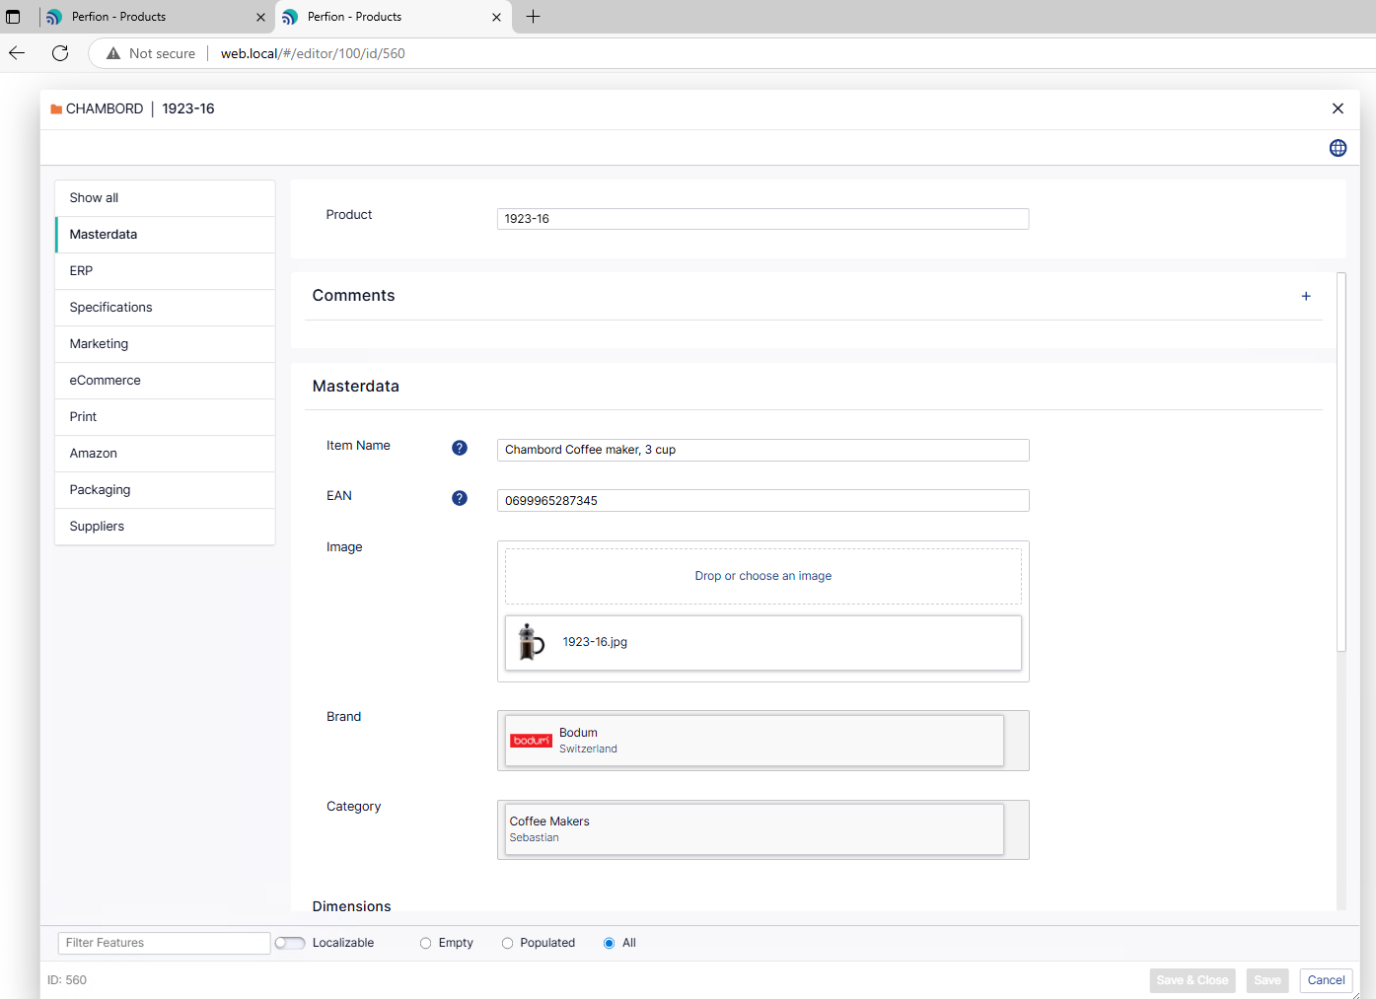
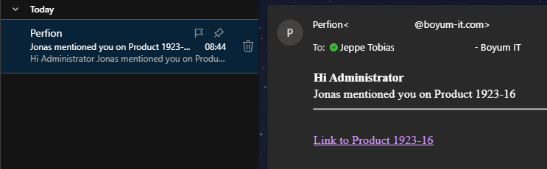
Notification Emails
When a user tags you in a comment, you get Notification email (can be disabled)
The link opens the Item Editor for that product

Slide 34
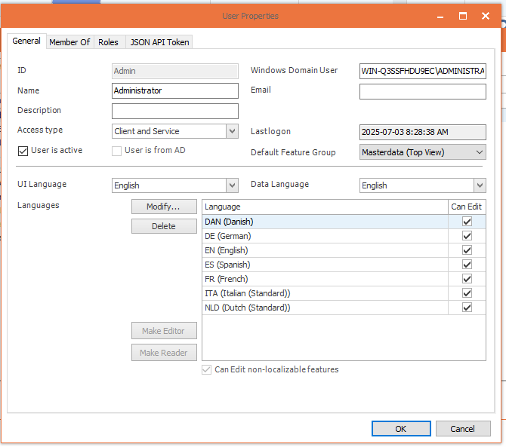
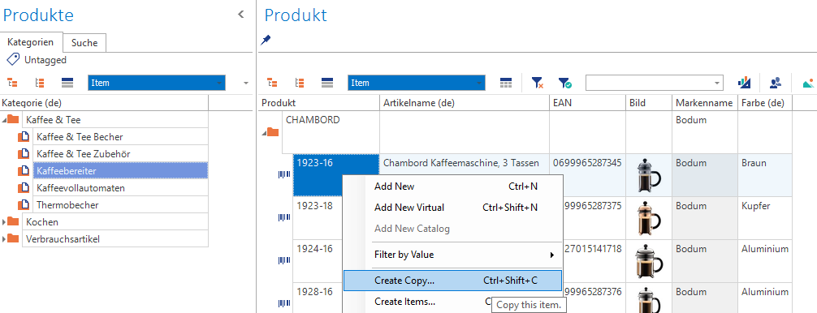
Split Data & UI Language – Windows Client
You can now have a different UI and data language in Windows
Ensures you have the UI you prefer, no matter what language you need to manage

Slide 35
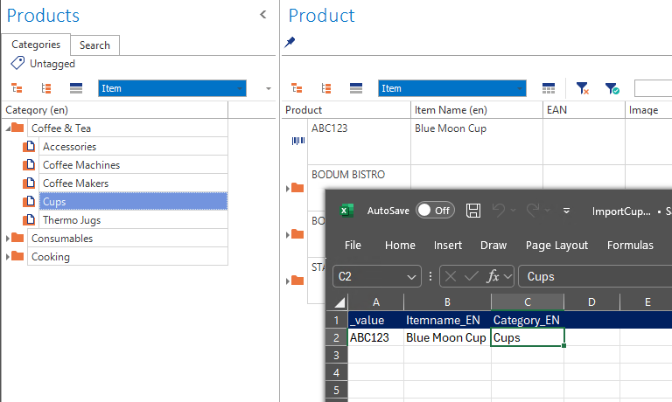
Split Data & UI Language – Windows Client
New Importer finds the item in the hierarchy if the item is unique
If the item (Cups) exist in root and other positions it will be added to root
If the item exists in multiple non-root positions, an error is thrown.

Slide 36


New Importer in Windows Client
Use the new importer directly in Windows client
New importer see vastly increased performance on large data set
Can run imports in parallel
Previously only in Actions & Import Wizard
The “legacy” importer is still available

Slide 37
Import without hierarchy path
New Importer finds the item in the hierarchy if the item is unique
If the item (Cups) exist in root and another position, it will be added to root
If the item exists in multiple non-root positions, an error is thrown.

Slide 38

Import with API
You can now upload excel & asset zip files through API and start imports remotely
Authenticate
Upload import file
(option) upload asset file (.zip)
Start import
Check status
Documentation & Postman collection available on Knowledge Base (soon)

Slide 39
2025-R1
Build: 5.6.0
Released: May 2025

Slide 40

Content Store 1.0
Full Self-service content portal
Easy to configure
Find & download the content in the available languages

Slide 41
Content Store 1.0 - Administration
Content Store fully configurable from Perfion Webclient
Uses well-known Perfion principles

Slide 42
Content Store 1.0 - Administration
Content Store fully configurable from Perfion Webclient
Uses well-known Perfion principles

Slide 43

Import Wizard
Import any excel file, no need to preformat
Map columns to features
Uses the new importer

Slide 44

User Access Types
Control User Access
Made dedicated API Users

Slide 45

Free Service Account
Dedicated User for API & Application Server
Does not count against licensed Users

Slide 46


Exposes Multiple Base Features In Supplier Portal
Expose not only Products but also
Colors
Price lines
Complex data such as
  Bill of materials
  Ingredients

Slide 47

DeepL Glossary Translations
Create reserved tranlsations
Personalise translations
Ensure Company language is intact

Slide 48
Boyum IT Solutions
Headquarters (Denmark)
Boyum IT Solutions
Sintrupvej 7 1b, 1th
DK – 8220 Brandbrand
linkedin.com/company/boyumit
sales@boyum-it.com
youtube.com/user/boyumit
boyum-solutions.com
instagram.com/boyumit/

