Slide 1


Perfion Web Client Features
Highlights from 2018-2024 releases

Slide 2

2024-R2
Version: 5.5.0
Released: October 2024

Slide 3
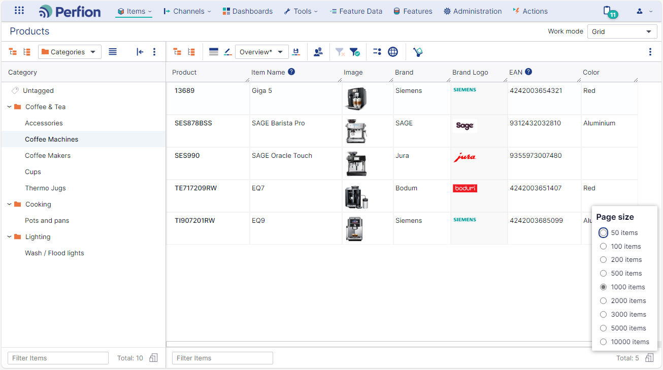
Version 5.5
Flexible page sizes
Pages sizes between 50 and 10.000
Show family works with paging
Related toolbar changes
  Simple view
  Column chooser
  View selector
  Save view
  (“All” in view selector)

Slide 4
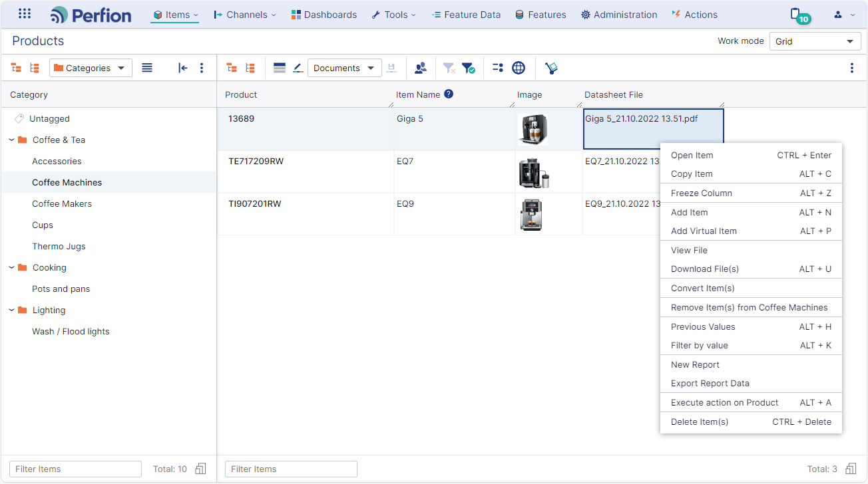
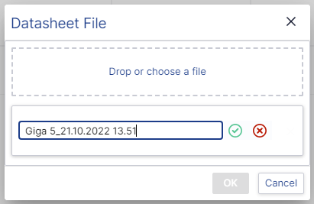
Version 5.5
View file / Edit file name
View file
  Grid context menu
  Opens file directly in new browser tab
Edit file name
  Card context menu

Slide 5
2024-R1
Version: 5.4.0
Released: April 2024

Slide 6
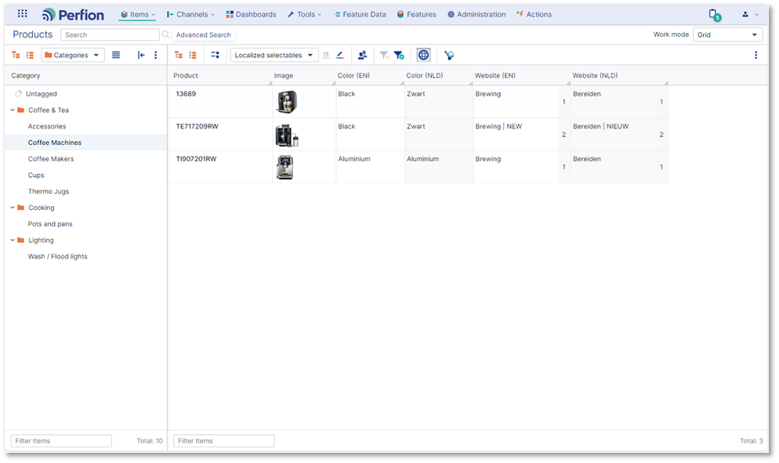
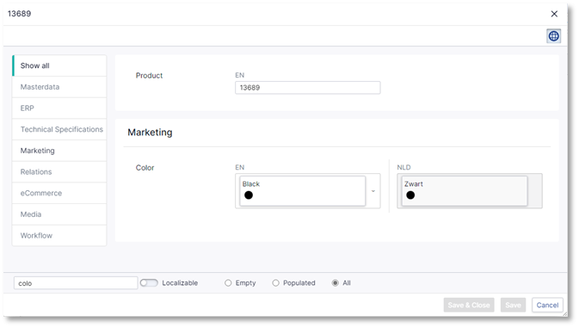
Version 5.4
Language variants on selectables
Validate selectable translations in grid and item editor
Edit translations via “Open selectable item”

Slide 7
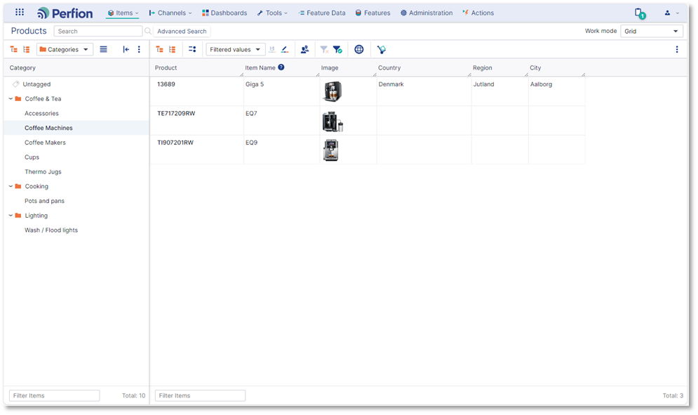
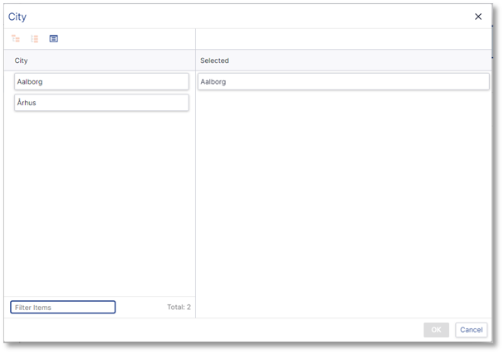
Version 5.4
Multilevel filtered values
Create multilevel filtered value “chains”
Improved maintenance in item editor

Slide 8
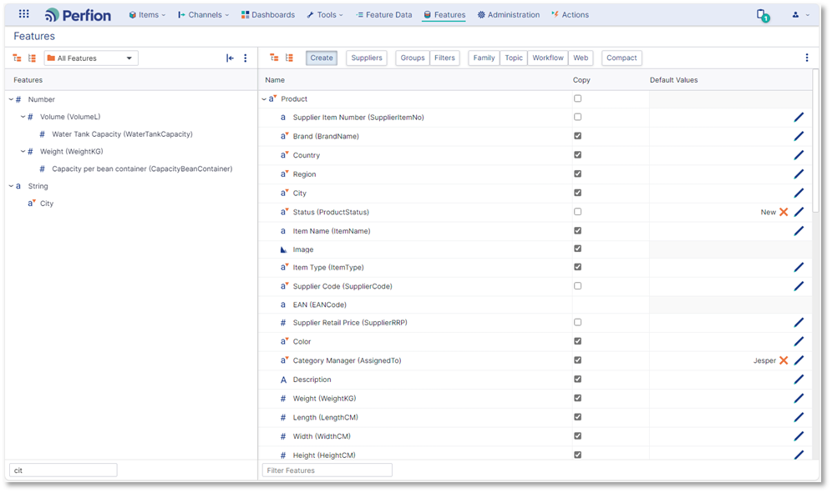
Version 5.4
Default values and Copy allowed together
Has effect when items are copied
Rules:
  Existing values are always copied
  When no value exists, default value is applied
  Parent values always win over child values

Slide 9
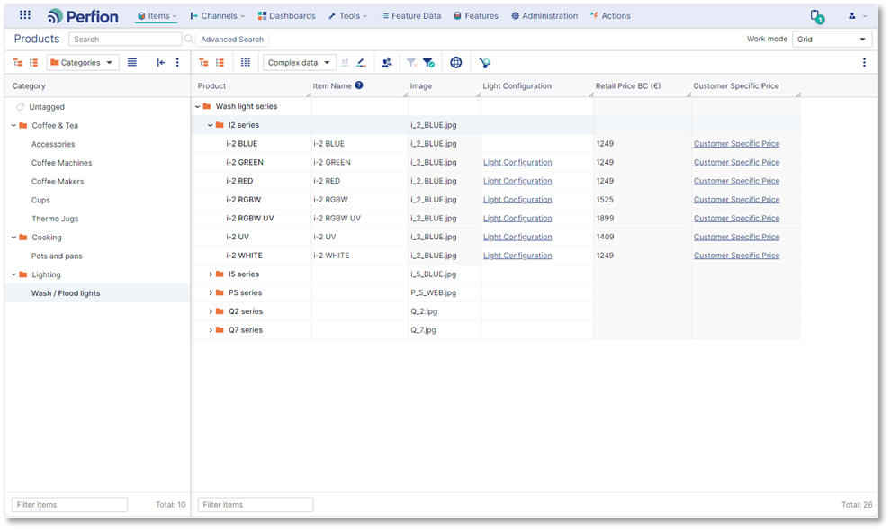
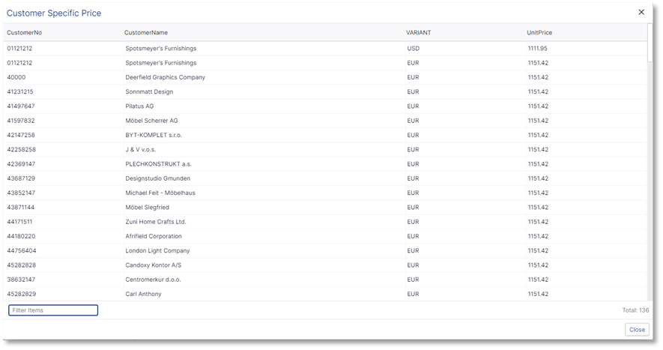
Version 5.4
SWAP and cluster remotes in grid
So far, SWAP and cluster remotes have only been visible/editable in item editor
Both feature types can now be included in grid and viewed/edited in a separate overlay grid

Slide 10
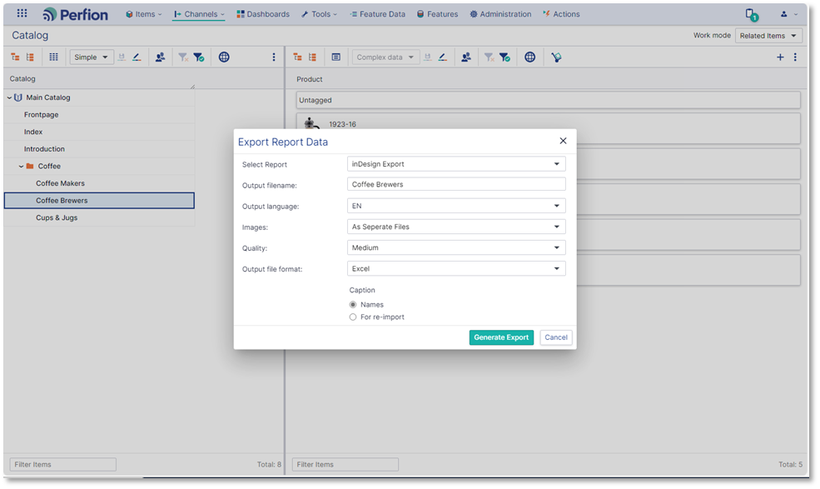
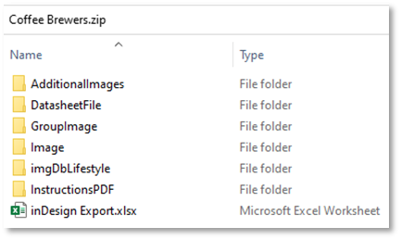
Version 5.4
Export report XML
Report data can now be exported for use in external applications (InDesign/EasyCatalog)
Available via right-click menus (special role required)
Generates output identical to windows client (zip-file)

Slide 11
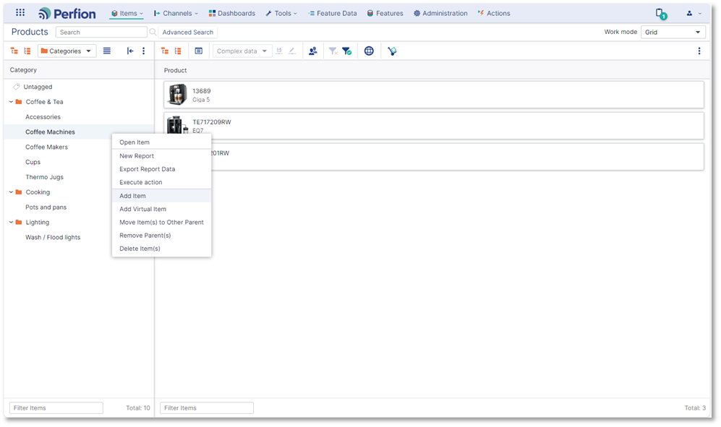

Version 5.4
Additional right-click menus
Categorizers have been extended with additional right-click options:
  Add Item
  Add Virtual Item
  Move Item(s)
  Remove Parent(s)
  Delete Item(s)
Right-click menu is now also available in white-space
Options are only available if user has required permissions

Slide 12
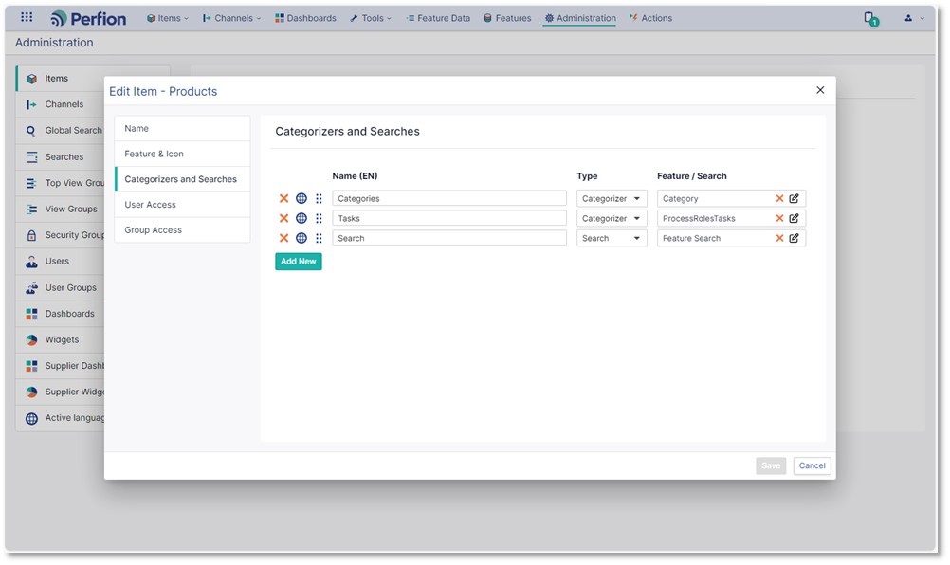
Version 5.4
Web client “Items” designer
The main menu option “Items” is now controlled separately from windows sections via a dedicated web client admin tool
All existing “web sections” will be migrated during upgrade
New Item structures can be purpose-built for web client users

Slide 13
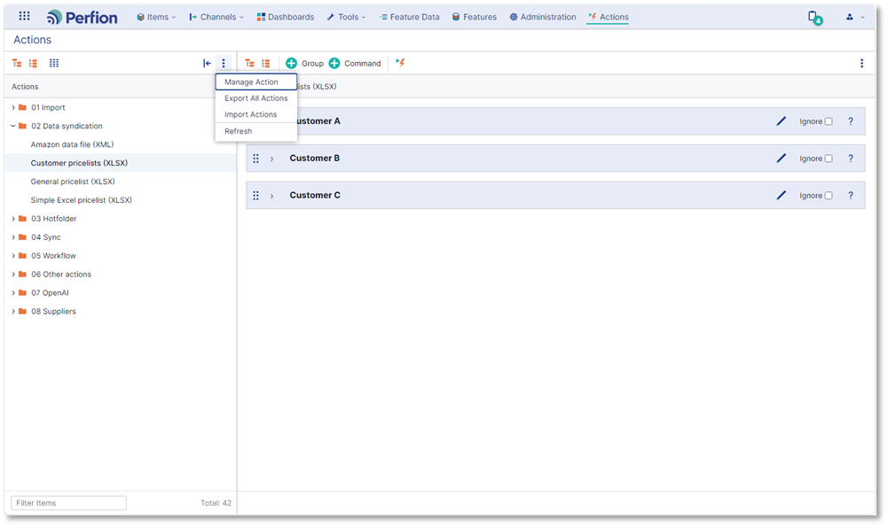

Version 5.4
Action management improvements
Ignore at group level (also in windows client)
Import/export
Delete action
Copy action
Move group/command to other action

Slide 14
2023-R2
Version: 5.3.0
Released: October 2023

Slide 15
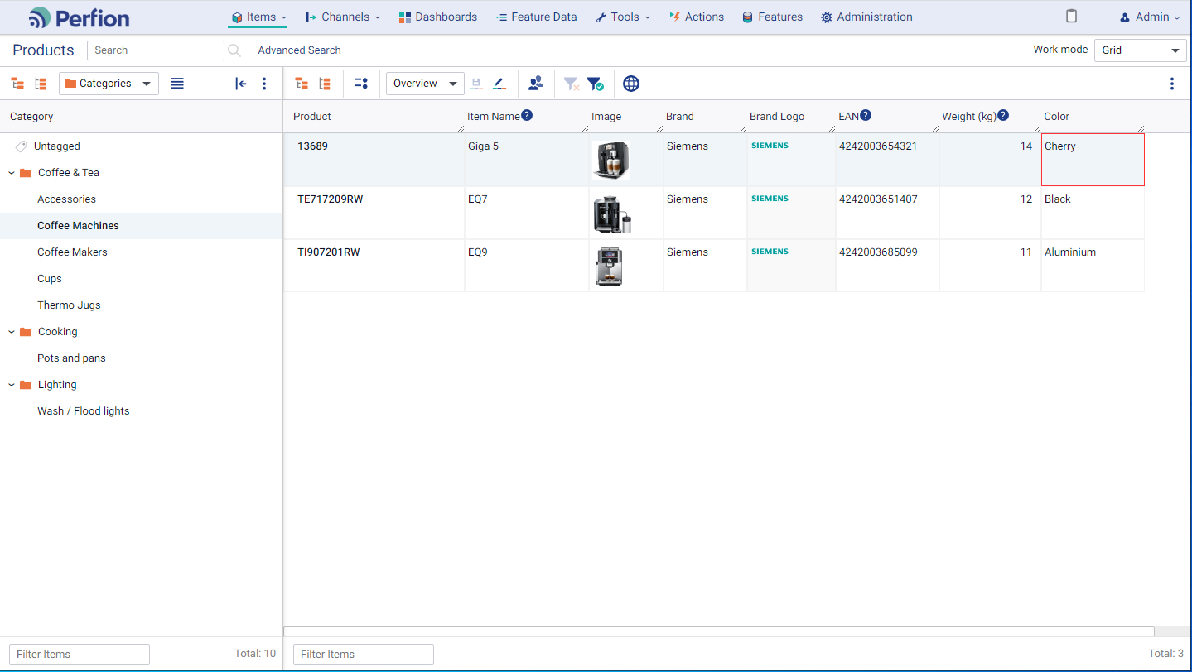
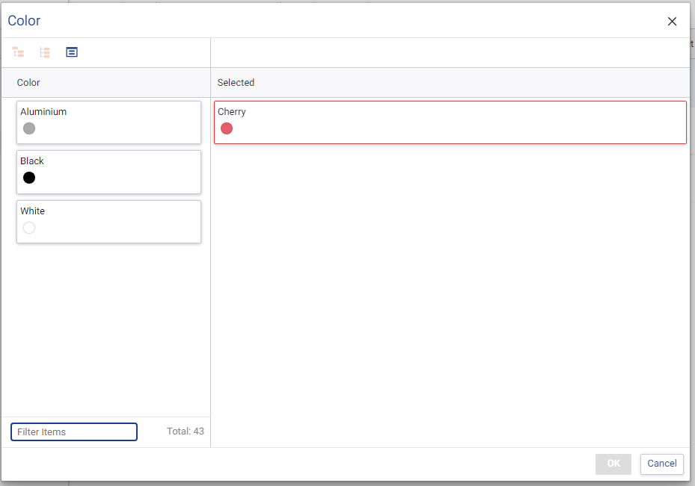
Version 5.3
Filtered Values
Filter available selectable values in any feature based on value in “controlling” feature
Highlight violations in grid and item editor
Examples:
  Allow specific Colors for each product category
  Allow specific materials for each supplier

Slide 16
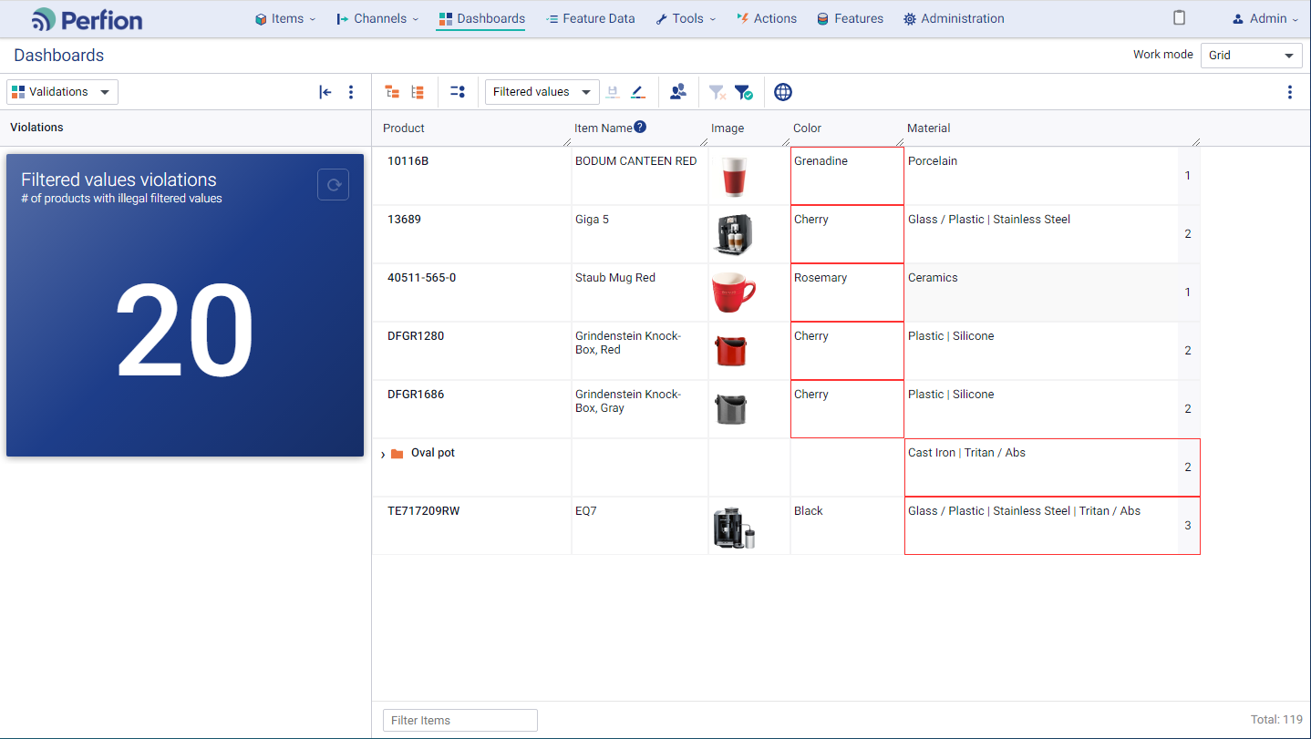
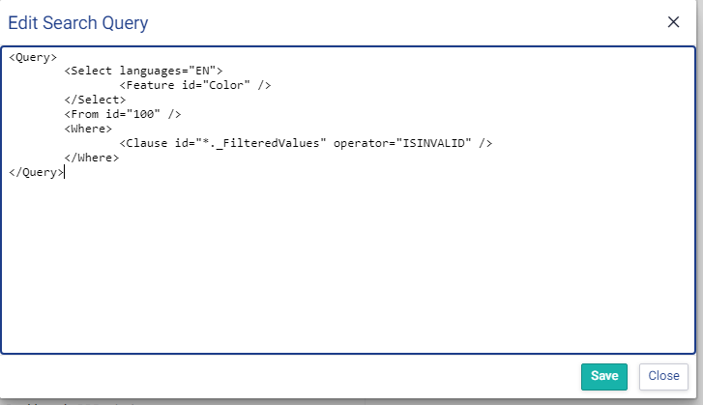
Version 5.3
Find violations via dashboards and filters
API query language now supports where-clauses to find violations of:
  Filtered values
  Feature validations
Enables you to build dashboard widgets and filters to easily identify and correct violations

Slide 17
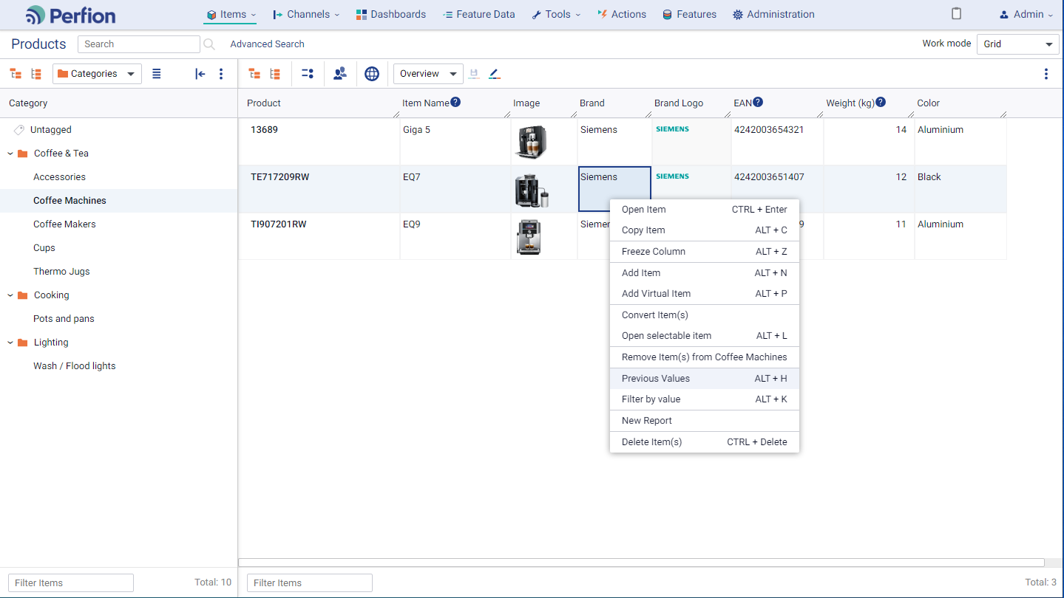

Version 5.3
Right-click menus
Right-click menus have been introduced throughout the web client
  Main grids
  Categorizers
  Item editor
  Feature management

Slide 18
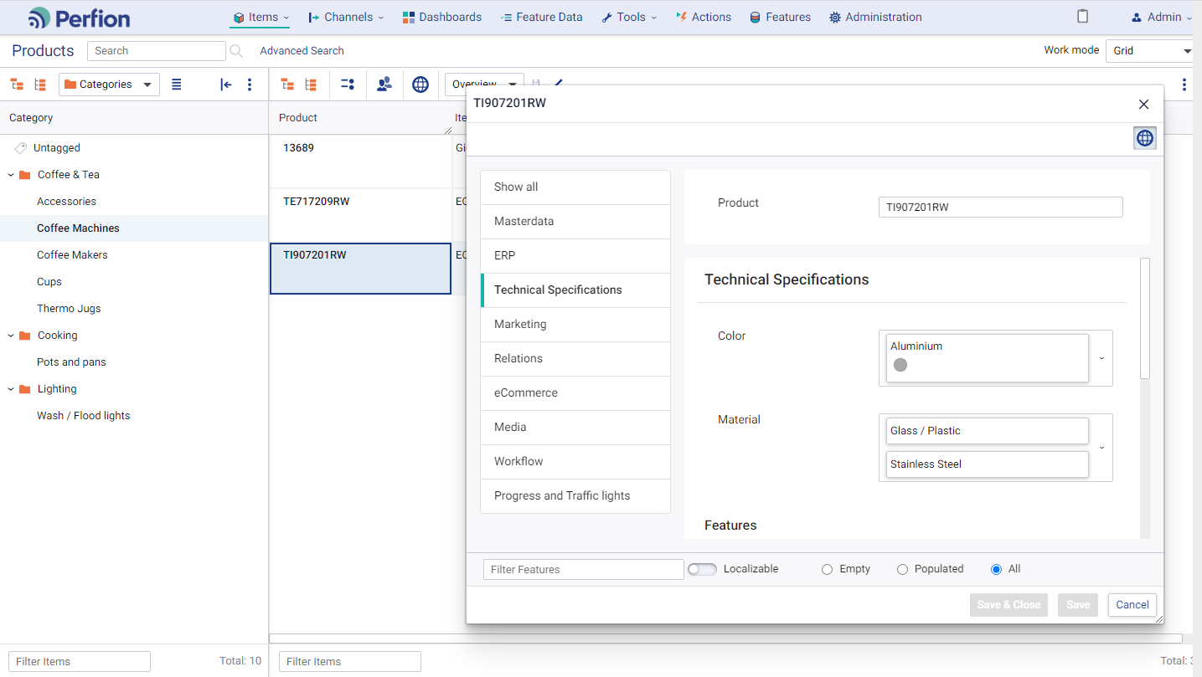
Version 5.3
“Floating” item editor
Item editor can be positioned and sized as you please
Multiple item editors can be opened at the same time
Note: Item editor cannot be moved outside the browser (e.g. to a second screen)

Slide 19
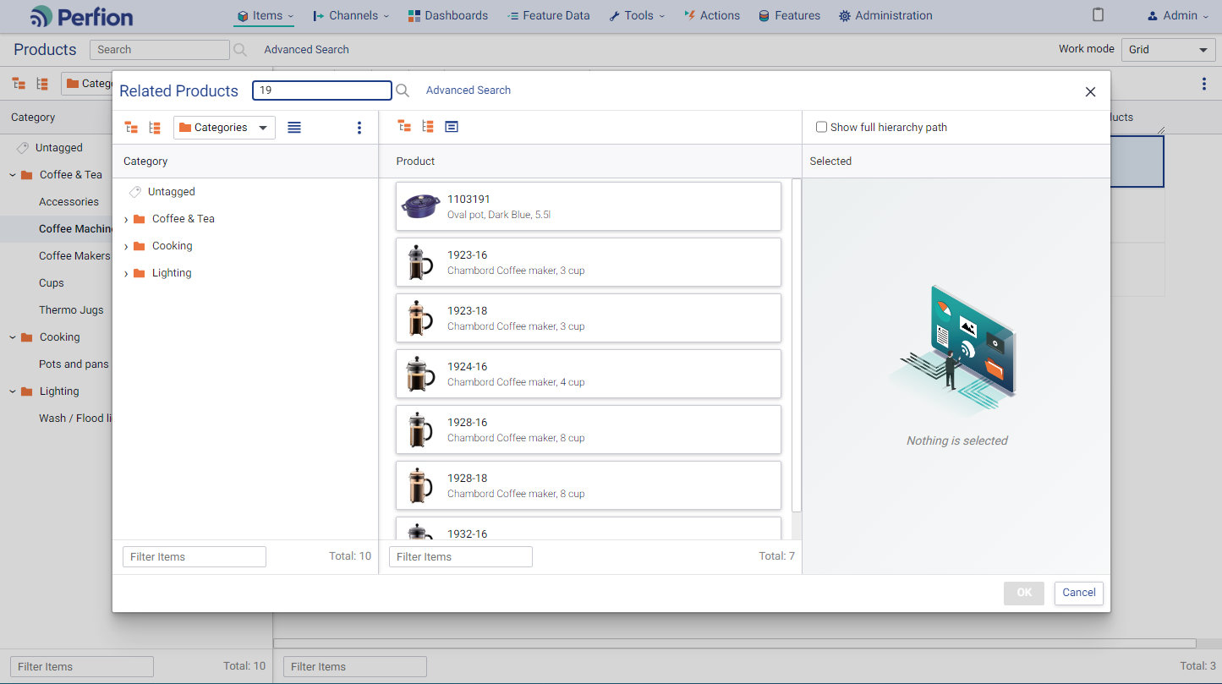
Version 5.3
Global search in “scene selector" overlays
The global search function has been introduced in scene selectors
This makes is much easier to find needed items
Global search can be activated straight from grid by typing search characters directly in cell (e.g. “19”) and pausing for a second

Slide 20
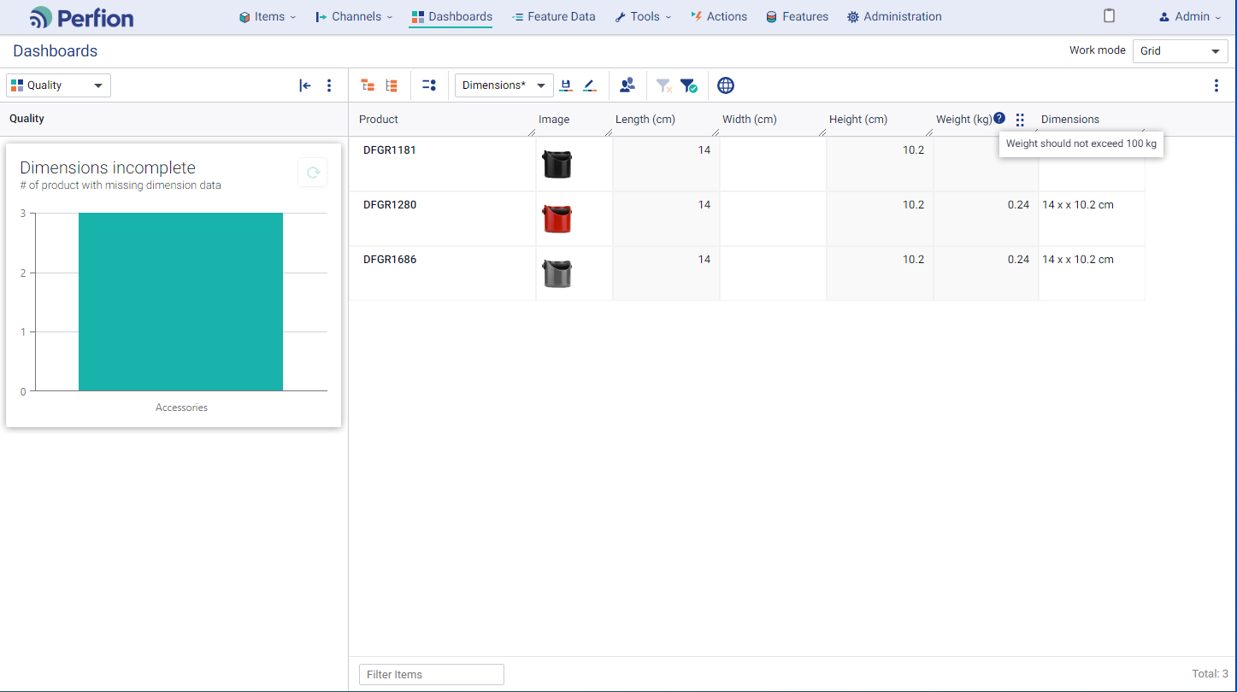

Version 5.3
Various UI improvements
Hide widget sidebar in dashboard grids
  More room for data in grid
Easier to save changes to existing view
  Current view name is suggested in Save box
Help text icons in caption line
  Users better understand purpose of feature and value requirements

Slide 21
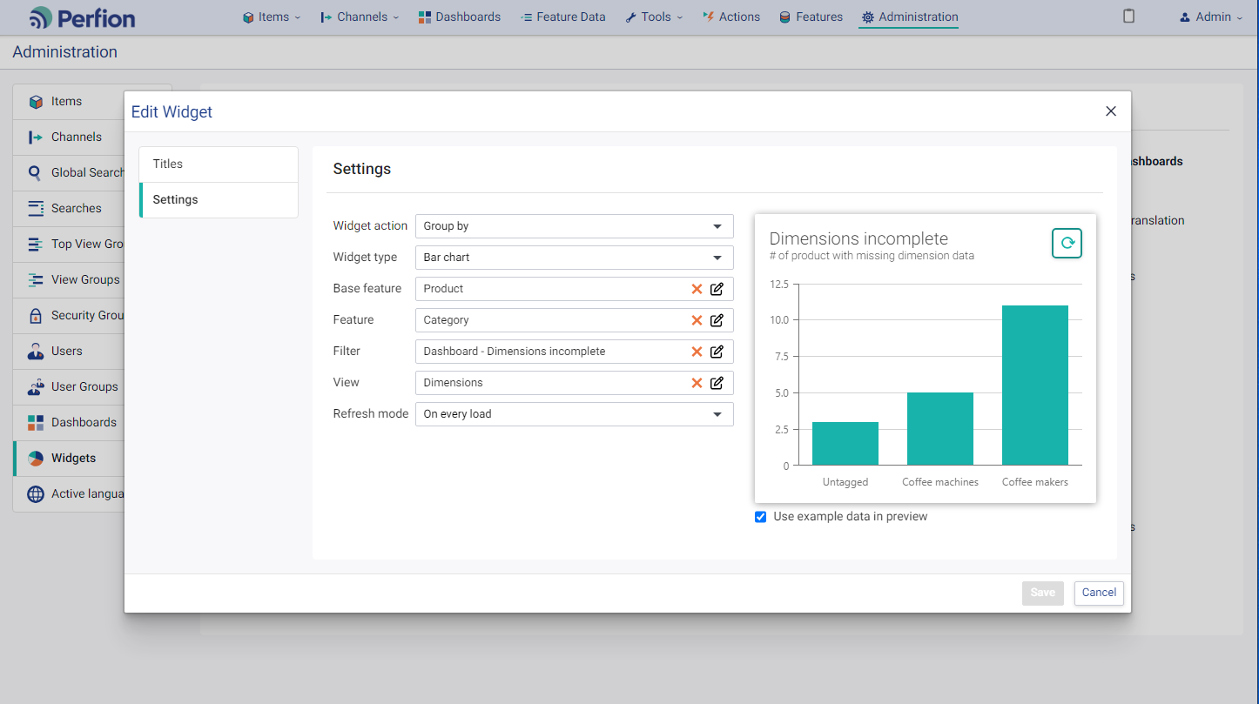
Version 5.3
Dashboard and widget management
Administrators can now manage dashboards and widgets in web client

Slide 22
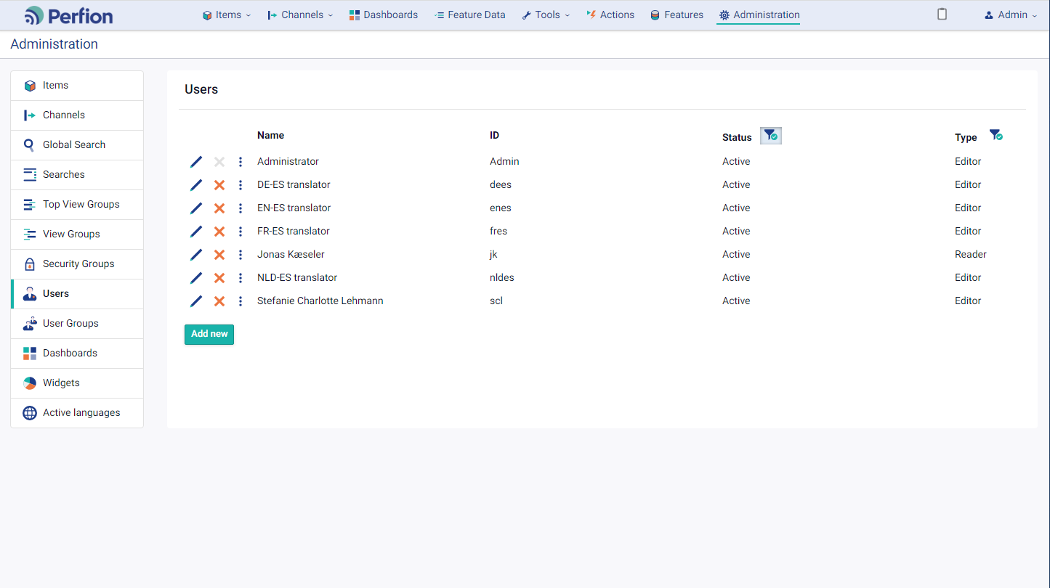
Version 5.3
Users, User Groups and Language management
Administrators can now manage users, user groups and active languages in web client

Slide 23
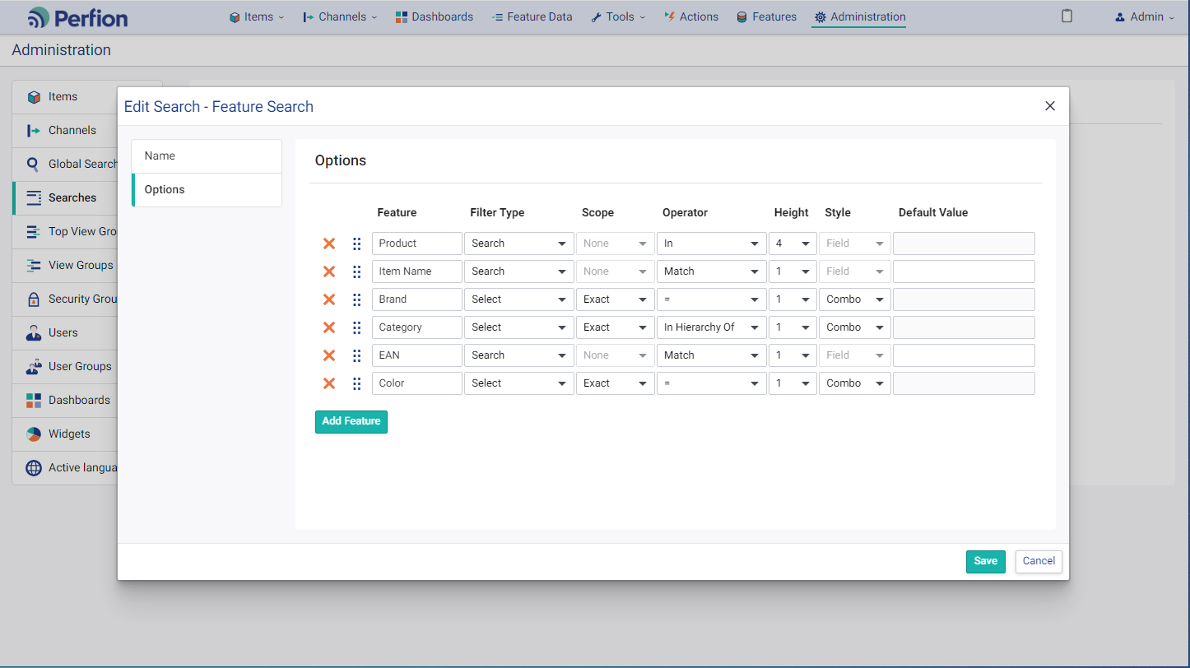
Version 5.3
Search management
Administrators can now manage “searches” in web client
Notes:
  Searches are used left-side in item sections (as alternatives to categorizers)
  Searches are called “Filters” in windows client

Slide 24
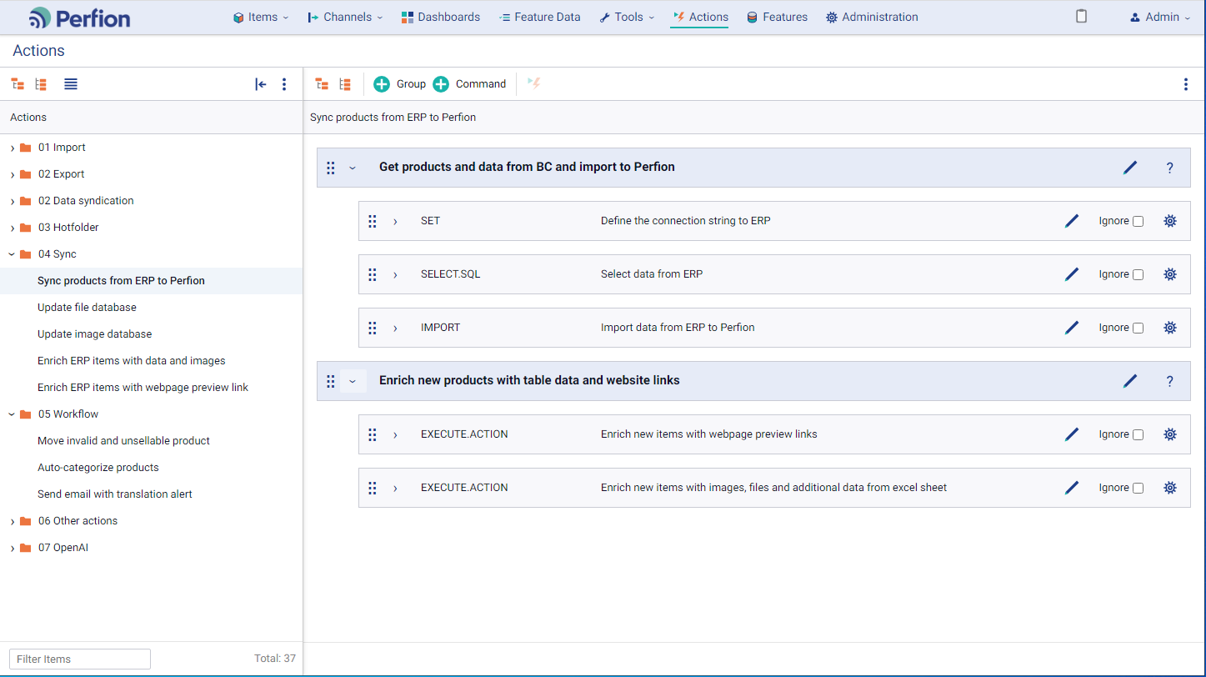
Version 5.3
Actions management
Actions can now be managed in dedicated web interface
Groups and commands are represented as “cards”
Titles on cards make it easier to understand the logic of the action
Expanding a command will show parameters, mappings, scripts, etc
Ignore-flag makes it easy to skip individual commands when action is executed

Slide 25
2023-R1
Version: 5.2.0
Released: April 2023

Slide 26
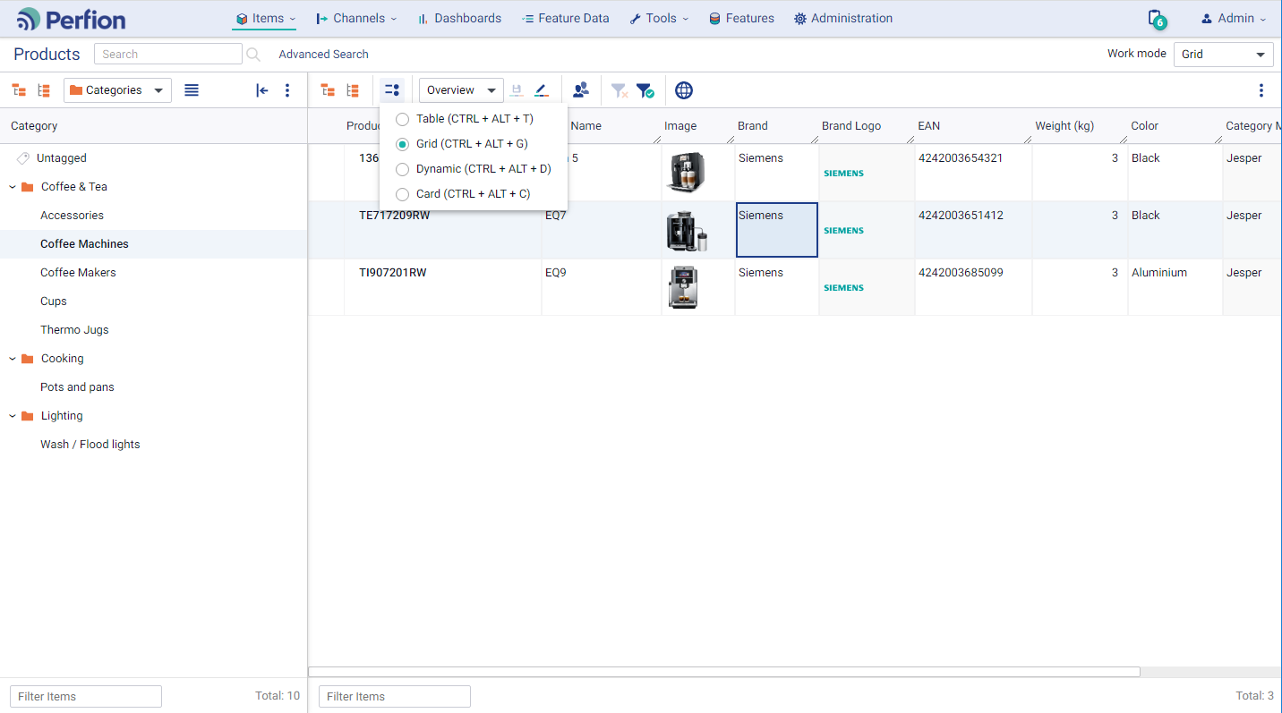
Version 5.2
General usability
Flexible panel widths
Collapsible menus
Layout menu
ESC to close overlays
Shortcut keys to mac

Slide 27
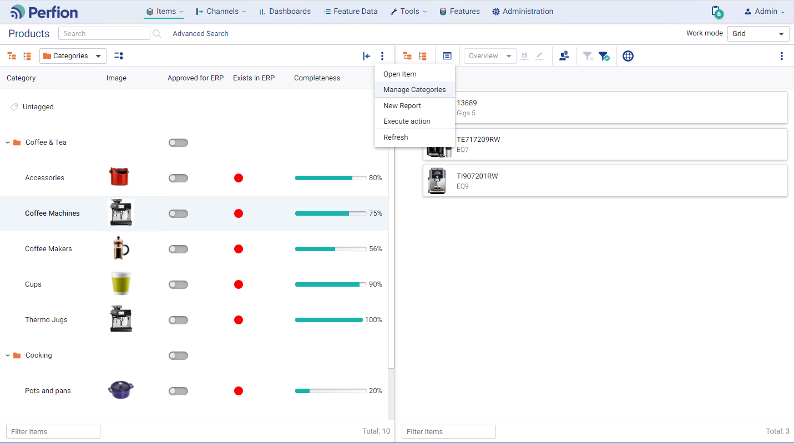
Version 5.2
Categorizers
New layout options
Booleans, traffic lights, progress bars, remote features
Images and card
Manage [categorizer]
Open item

Slide 28
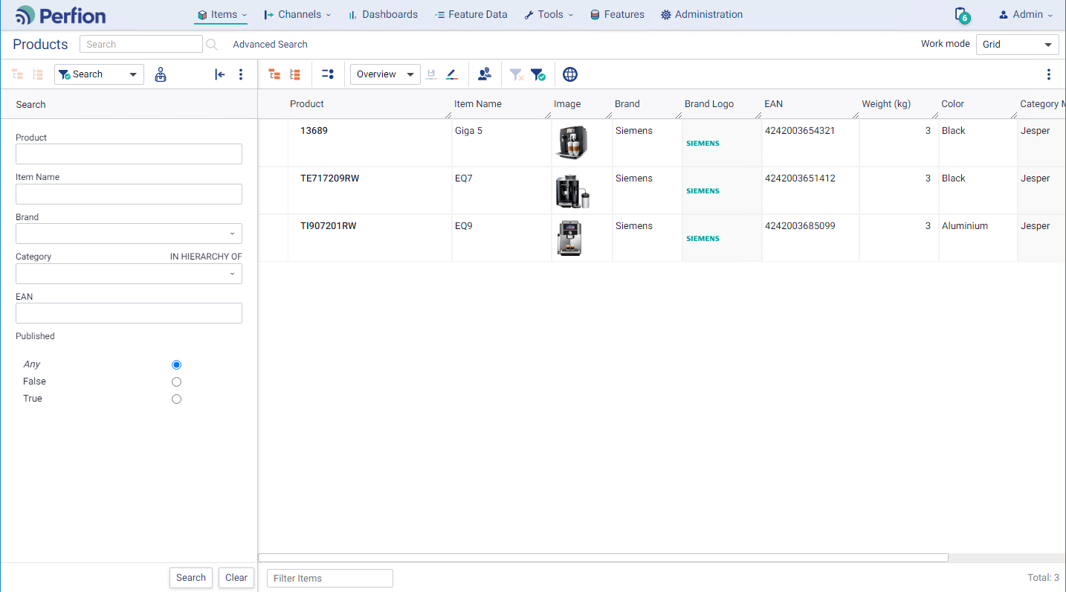
Version 5.2
Search
Click enter to execute search
Boolean control replaced with radio buttons

Slide 29
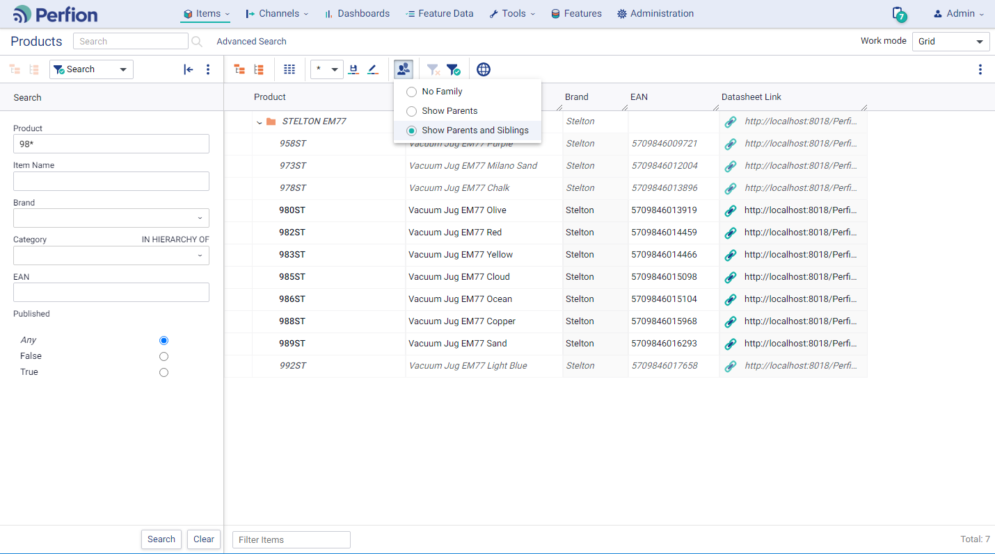
Version 5.2
Grid
Clicking outside cell saves updates (explicit values)
Link icon before URL
New “Show family” options
  Show Parents
  Show Parents and Siblings

Slide 30
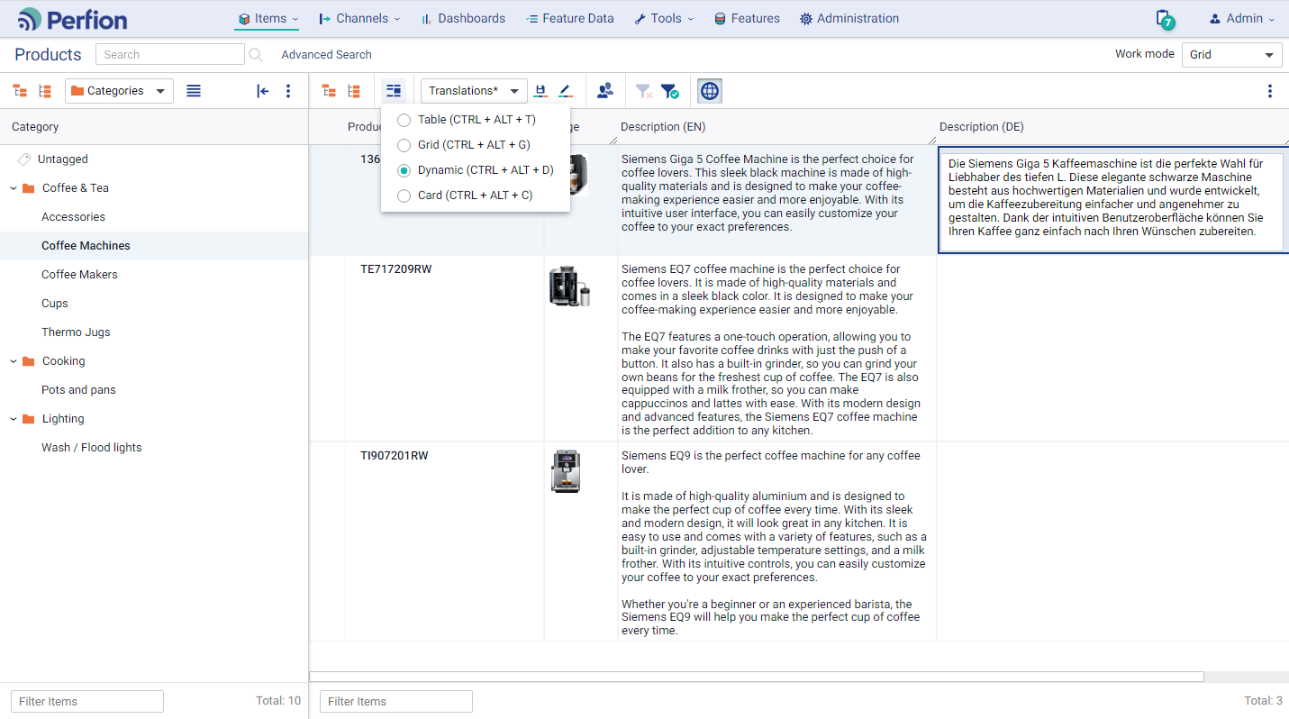
Version 5.2
Dynamic layout
Row heights automatically adjusted to fit content
In-cell editing makes it possible to see source text and edit translations at the same time

Slide 31
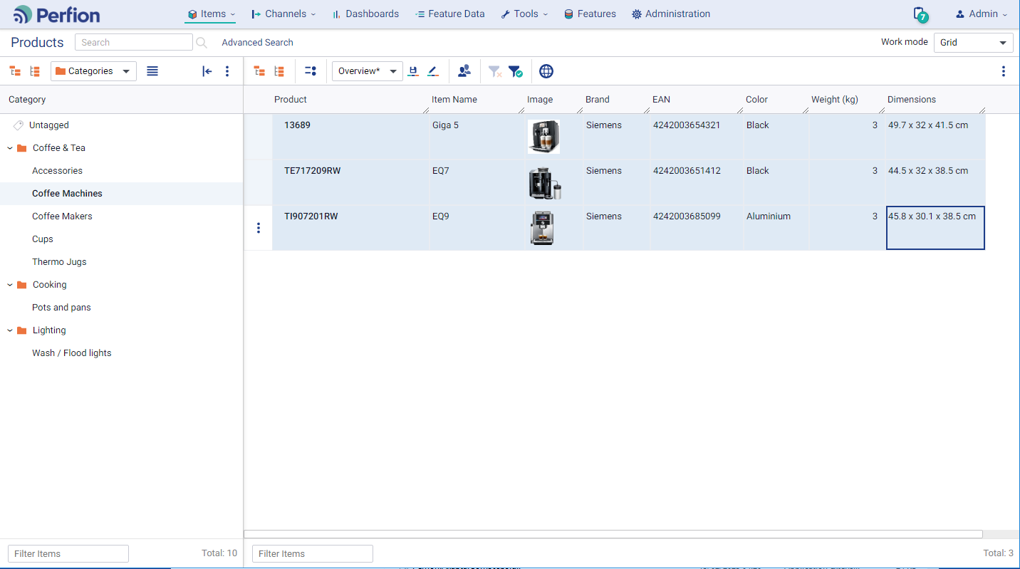

Version 5.2
Extended copy options
Copy across features inside grid (restricted by data type)
Select array of data in grid
Copy and paste to excel

Slide 32
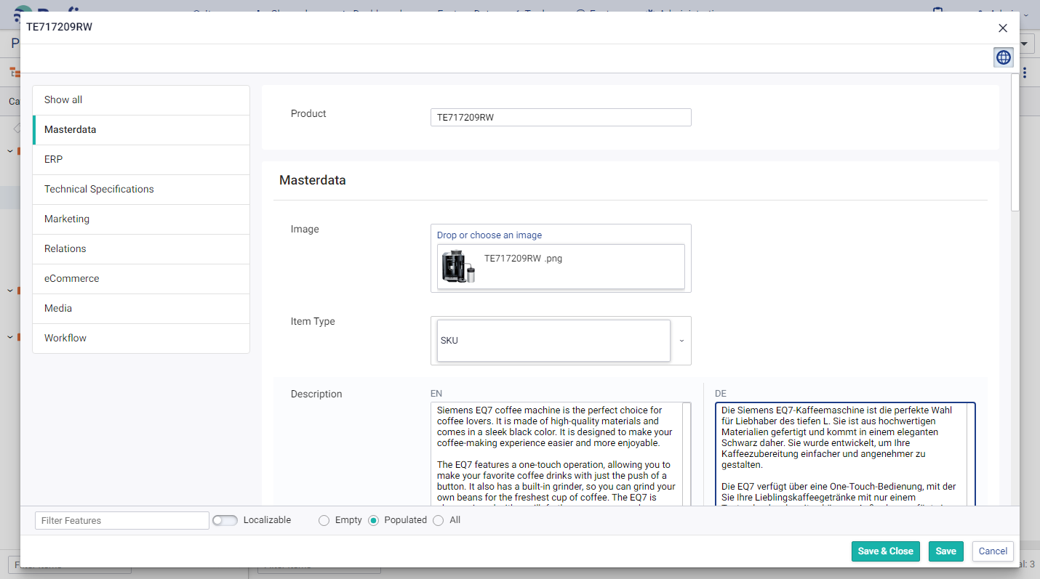
Version 5.2
Item editor
New layout with left-side menu
Save & Close / Save options
Immediate item dependency reload (prompt when controlling feature is updated)
Resolved formulas
Filter by Empty / Populated values

Slide 33
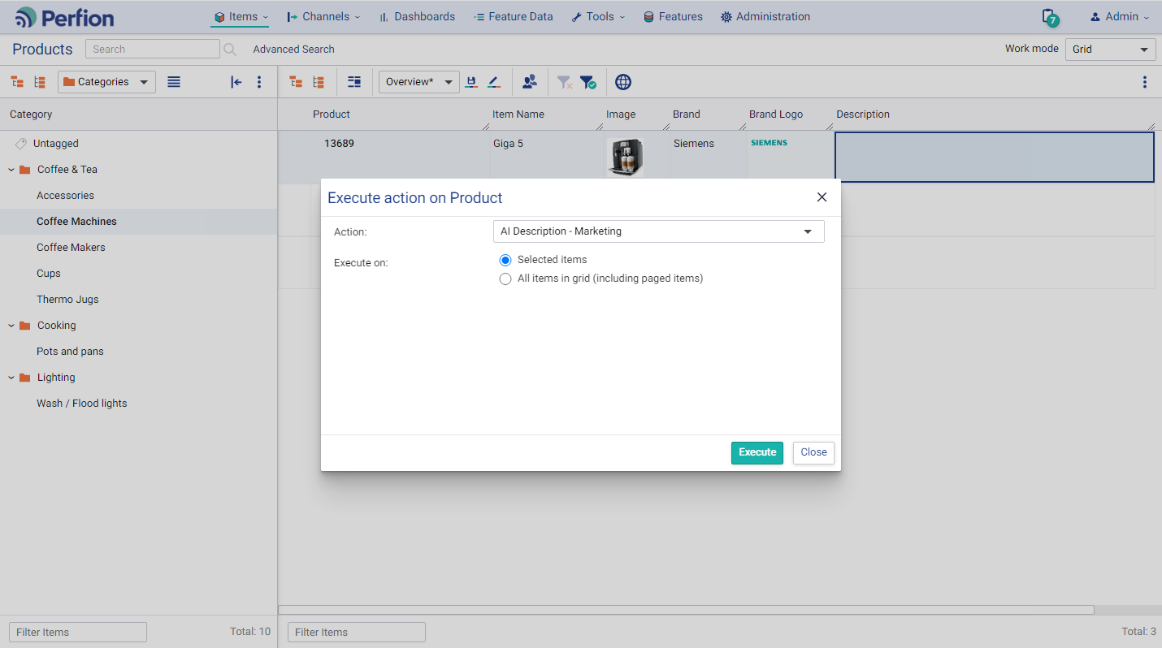
Version 5.2
Actions in context
Execute action in context of item(s) in grid or categorizer
Item ID(s) are sent to action
Actions can work their magic as always on selected items
  Update values
  Export data
  Sync data from external source

Slide 34
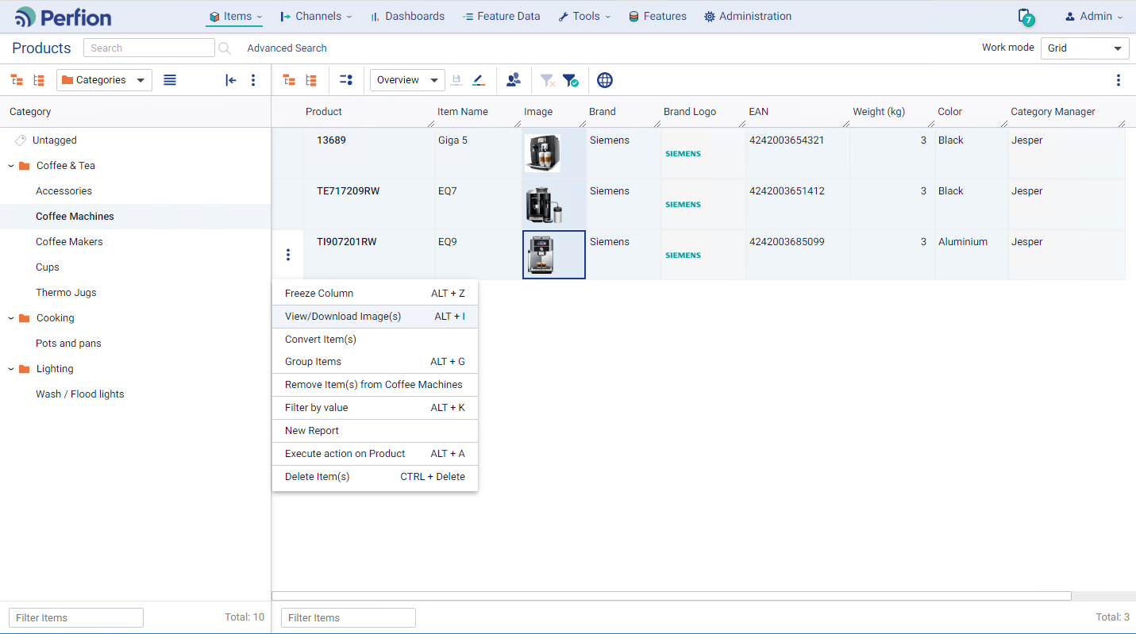
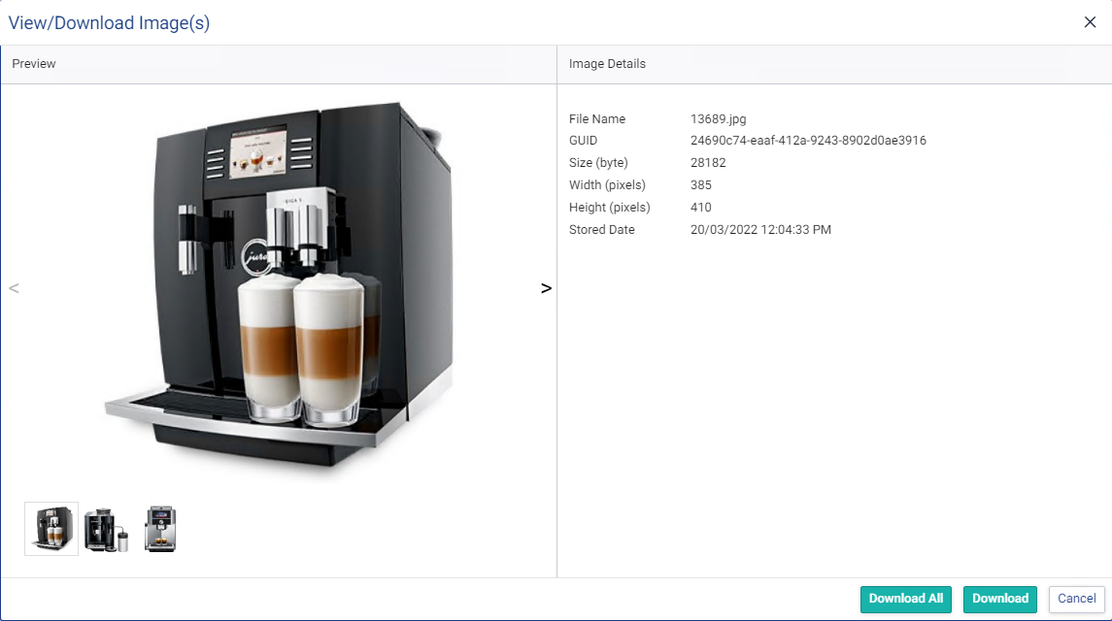
Version 5.2
View/download images
New options in 3-dot menu at item level
Also available on image cards
Shows selected image(s) in overlay
Browse images via thumbnails or arrows
Download one or all images

Slide 35
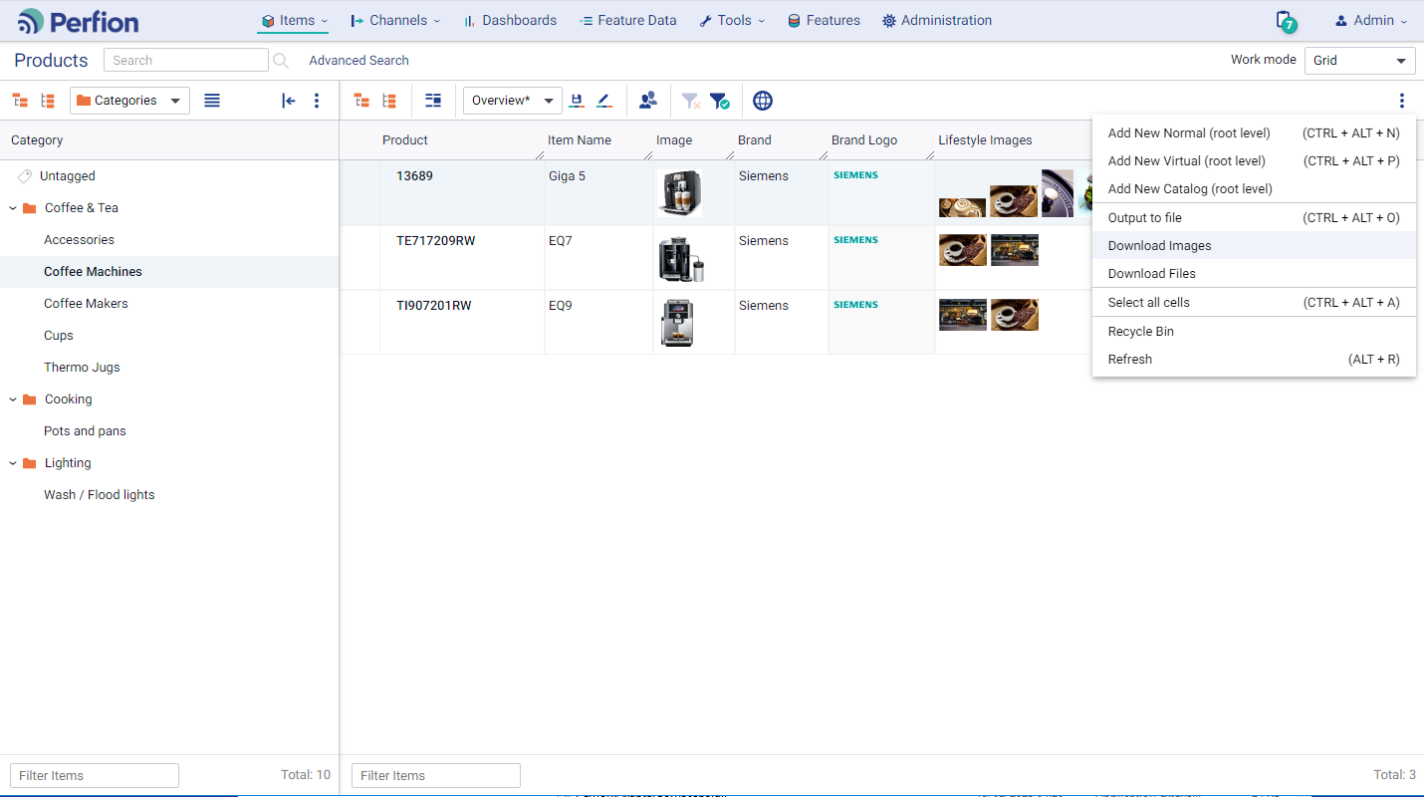
Version 5.2
Download images and files
New options in 3-dot menu at grid level
Exports all images/files in current grid
Image format and size can be set in download options menu
Images and files are exported in a zip-file (duplicates are removed)

Slide 36
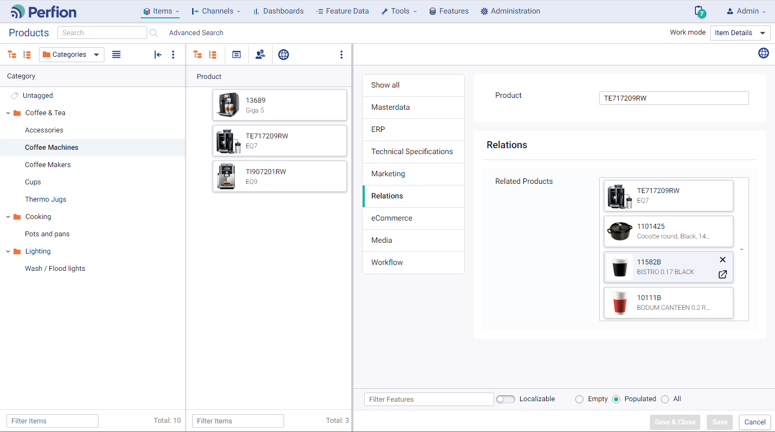
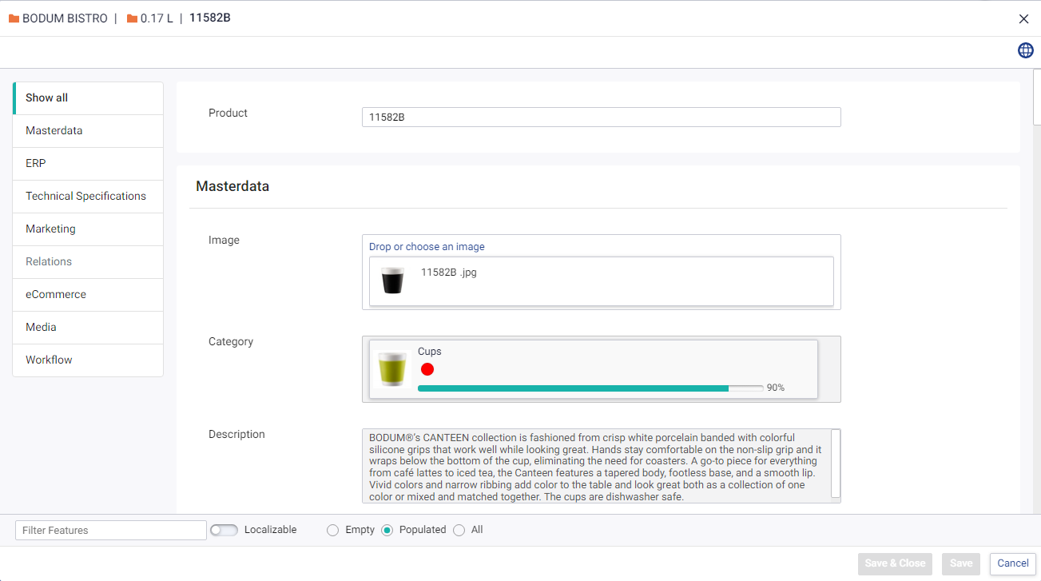
Version 5.2
Open selectable item
Available in grid and item editor
Opens the selectable item in an item editor

Slide 37
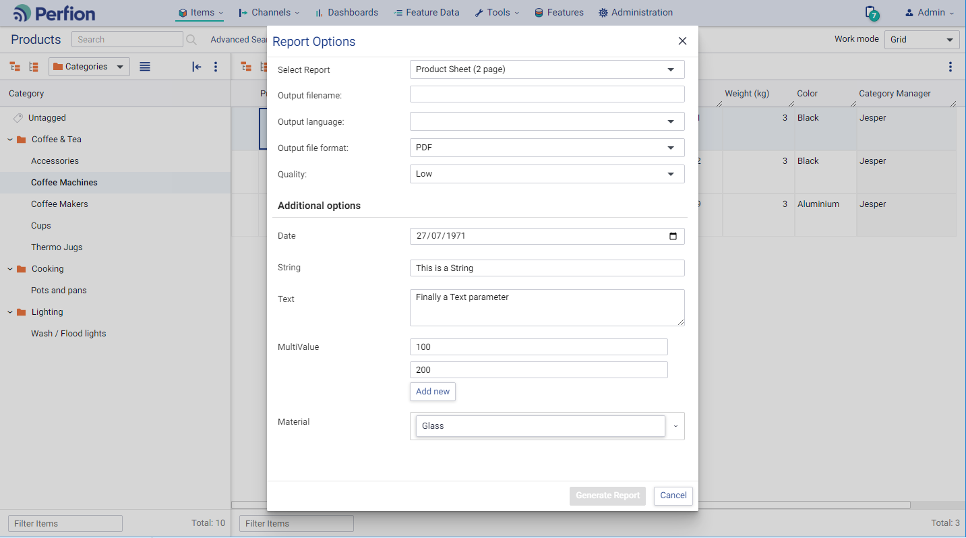
Version 5.2
Reports with parameters
Custom parameters available to user when generating report
Parameter values can be included in reports
Parameter values can be used to filter items sent to report
Parameter values can be used in table designer

Slide 38
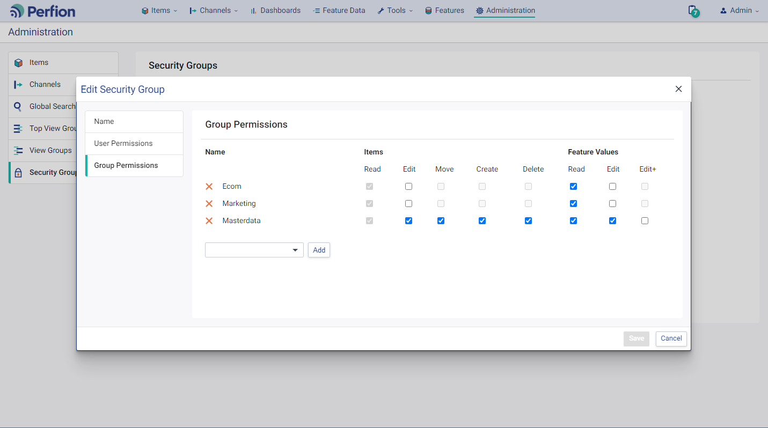
Version 5.2
Information groups
Top View Groups, View Groups and Security Groups can be managed in Administration
Allows administrators to control item editor structure and user permissions at feature level

Slide 39
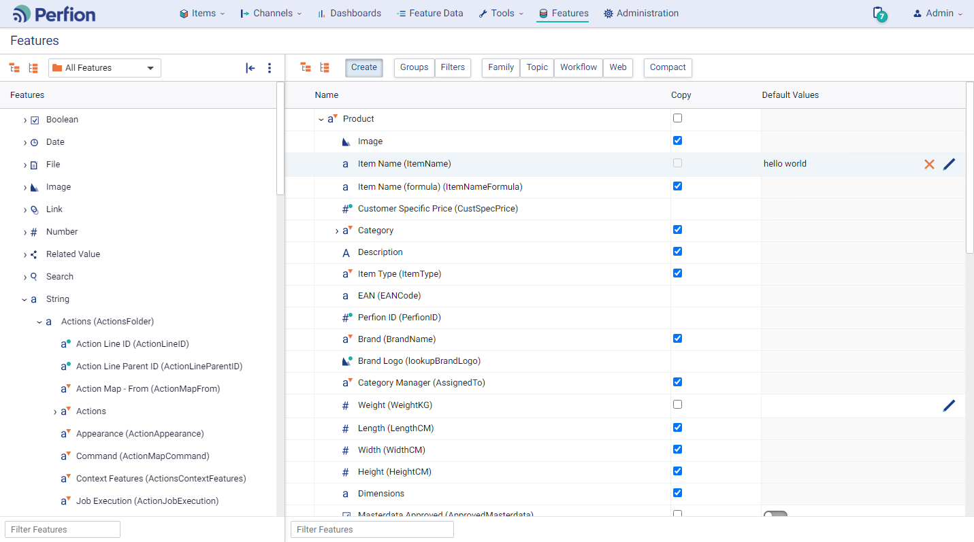


Version 5.2
Features
New icons for all data types
Visual difference between explicit, selectable ( ) and remote ( ) features
Double-click on feature to open feature definition
“Create” in toolbar to manage Copy and Default Values
  Grouped because they are mutually exclusive

Slide 40
2022-R2
Version: 5.1.0
Released: October 2022

Slide 41
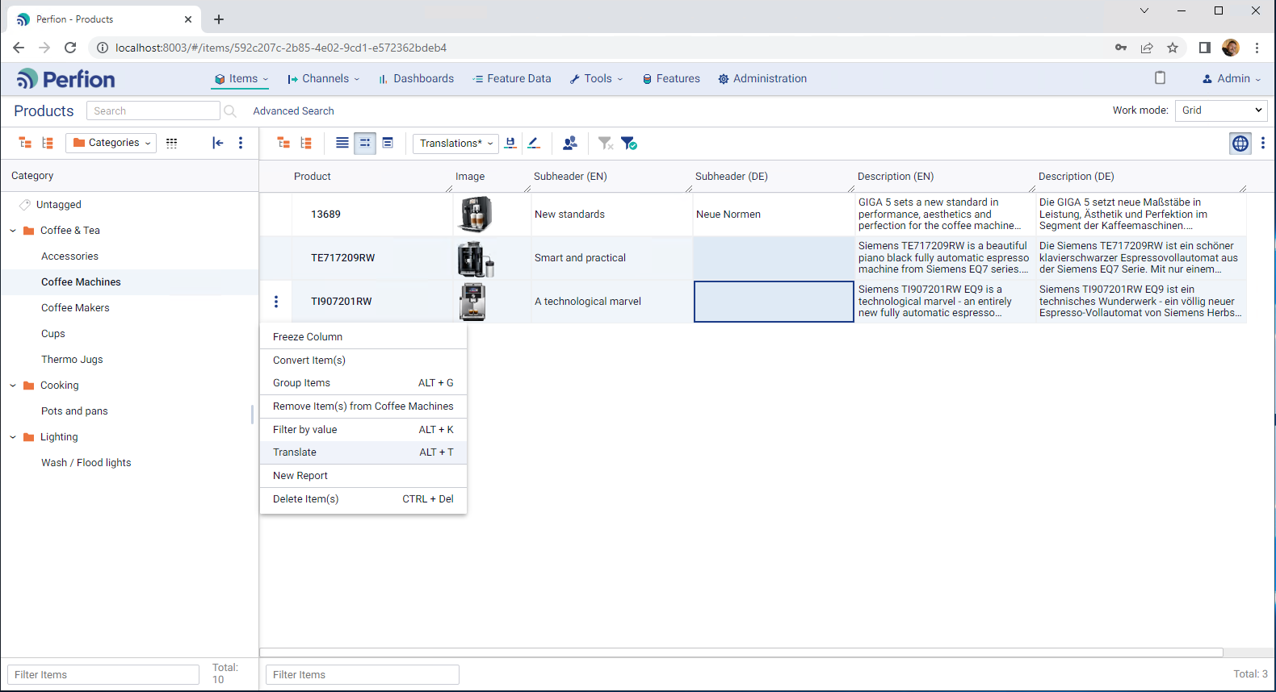
Version 5.1
Translation Management
One-click translation from Item Editor
Multi-translations in grid
Choose your method:
  Google Translate
  DeepL
Use Actions to automate translations

Slide 42
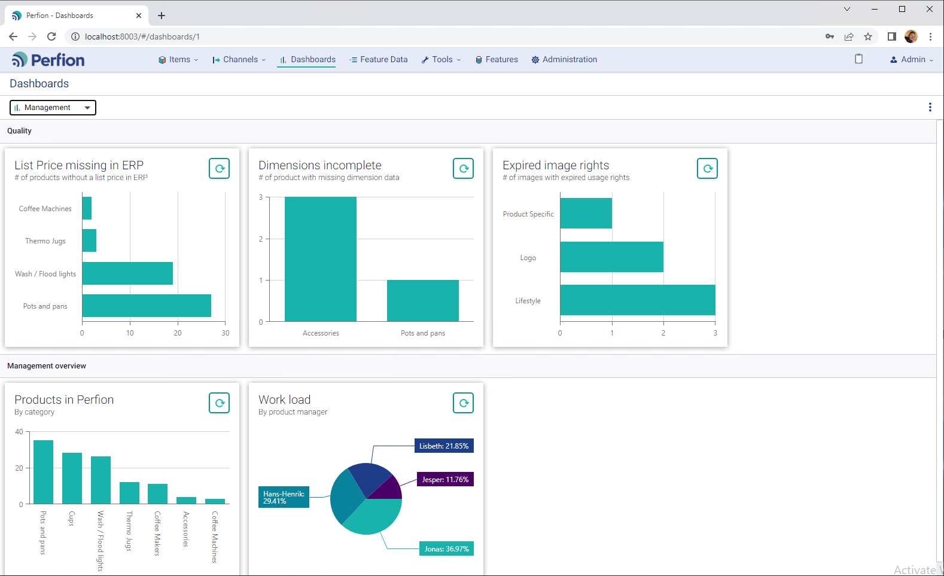
Version 5.1
Dashboard Updates
Multiple and personalized dashboards
Optimized appearance
Choose between cached mode or live-updated widgets

Slide 43
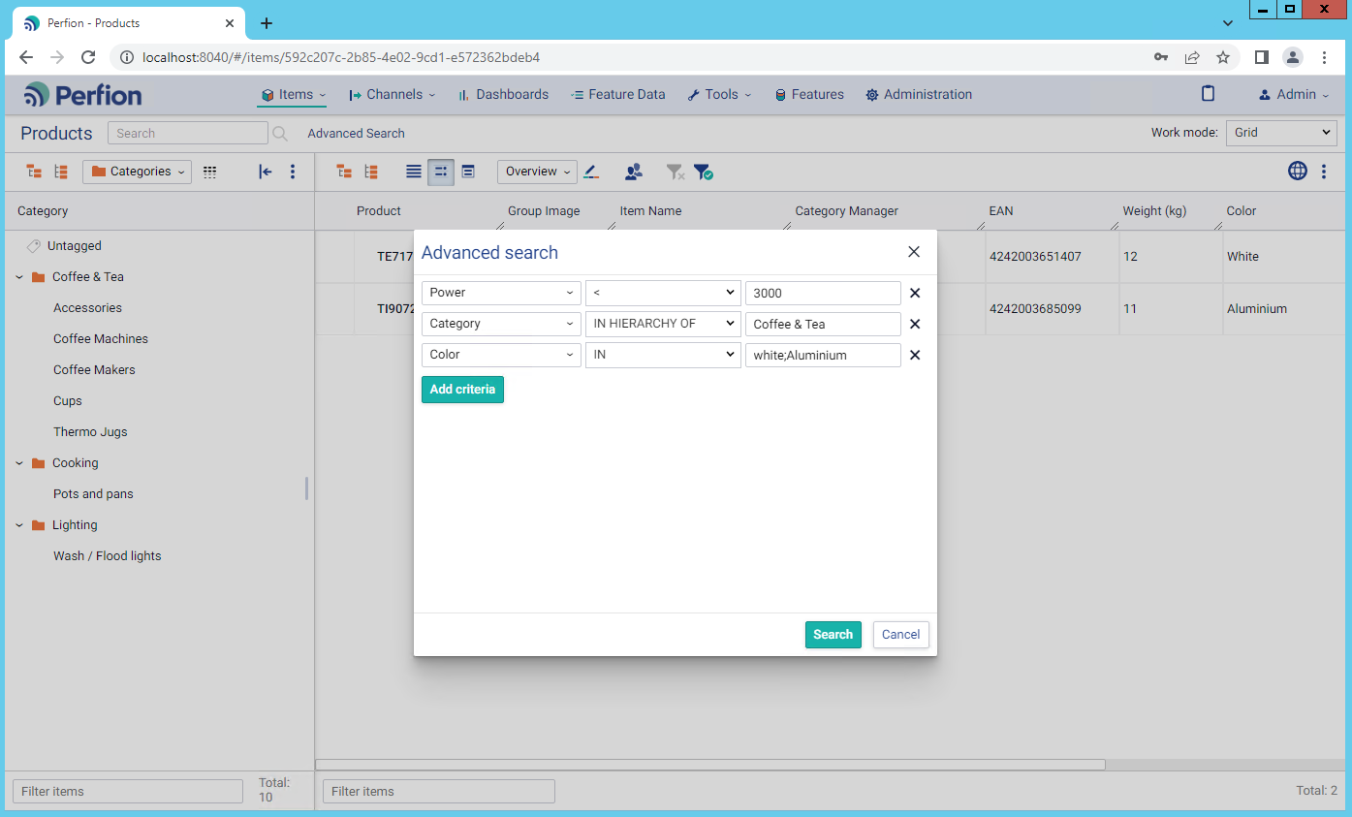
Version 5.1
Global Search
Quick search in features controlled by Admin
Advanced search for any combination of values across all features

Slide 44
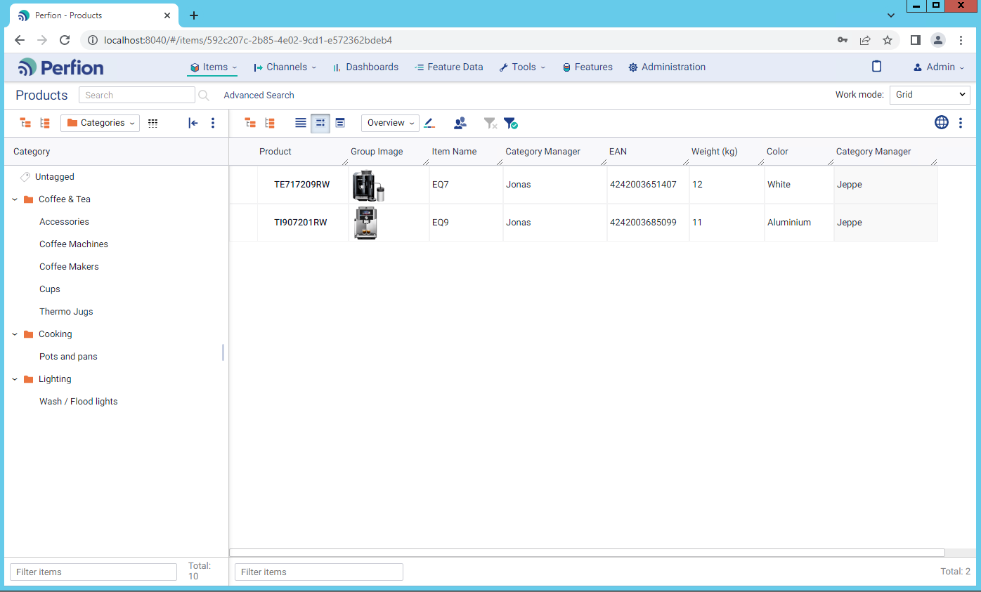
Version 5.1
Adjustable column widths
Improved “readability” in grid
Maximize number of visible features/values
Column widths saved in user’s browser cache

Slide 45
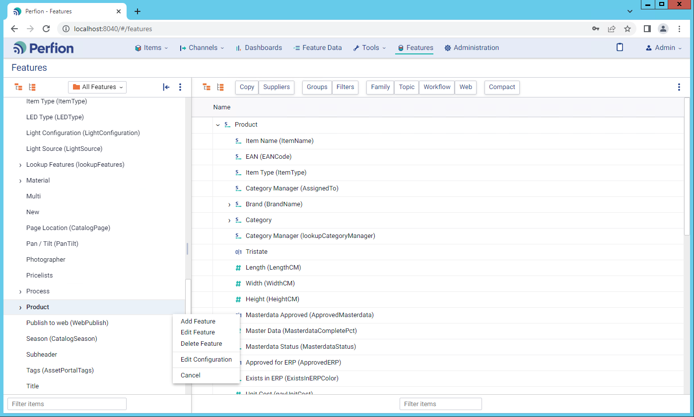
Version 5.1
Admin functionality
Create and modify features
Manage feature configurations
Manage standard views

Slide 46
2022-R1
Version: 5.0.0
Released: April 2022

Slide 47
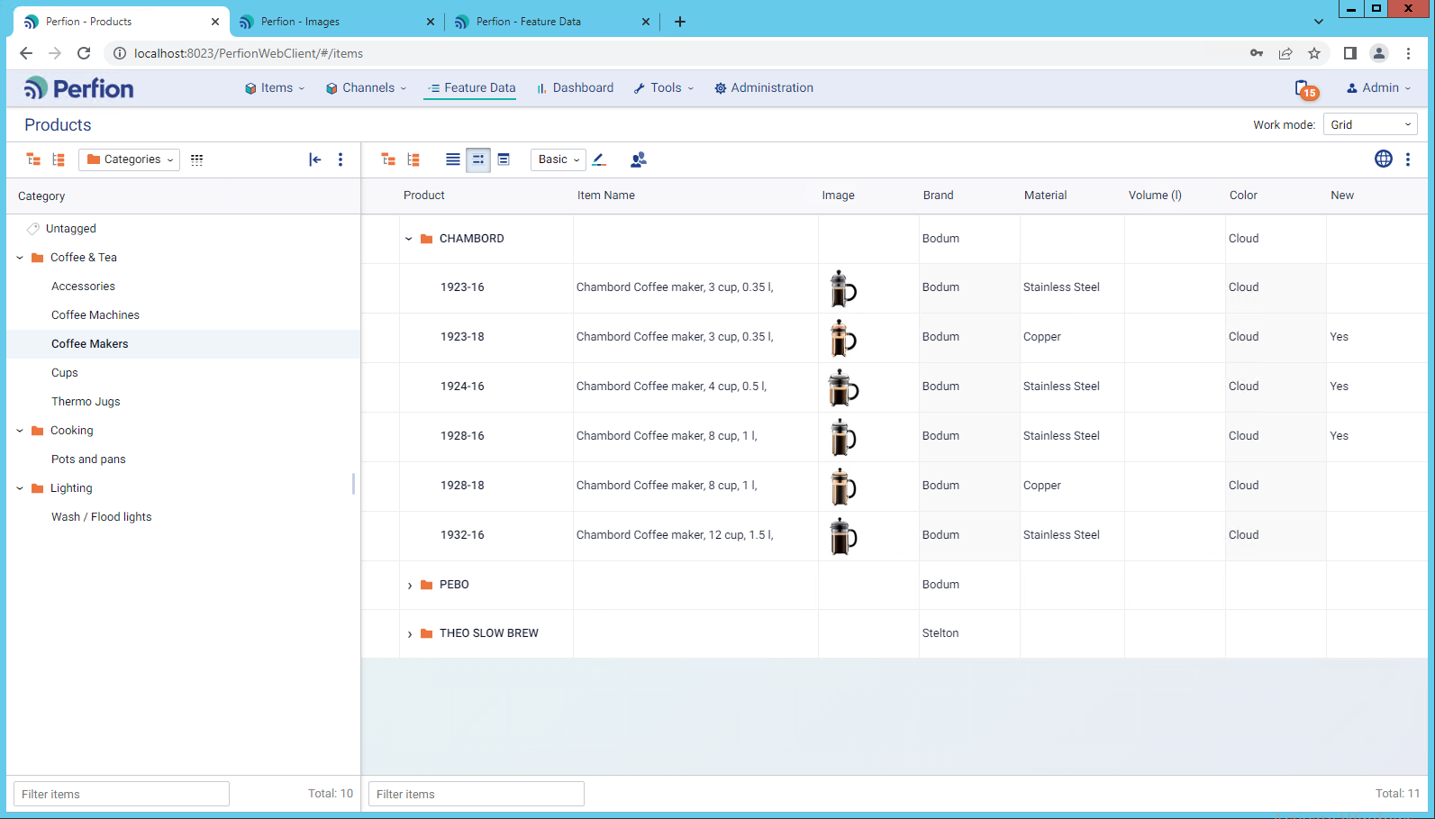
Version 5.0
Design overhaul
General improvement of consistency and look’n’feel
Four levels of menus
  Main menu
  Section header
  Toolbars
  Caption line
  See further description in release notes or manual

Slide 48
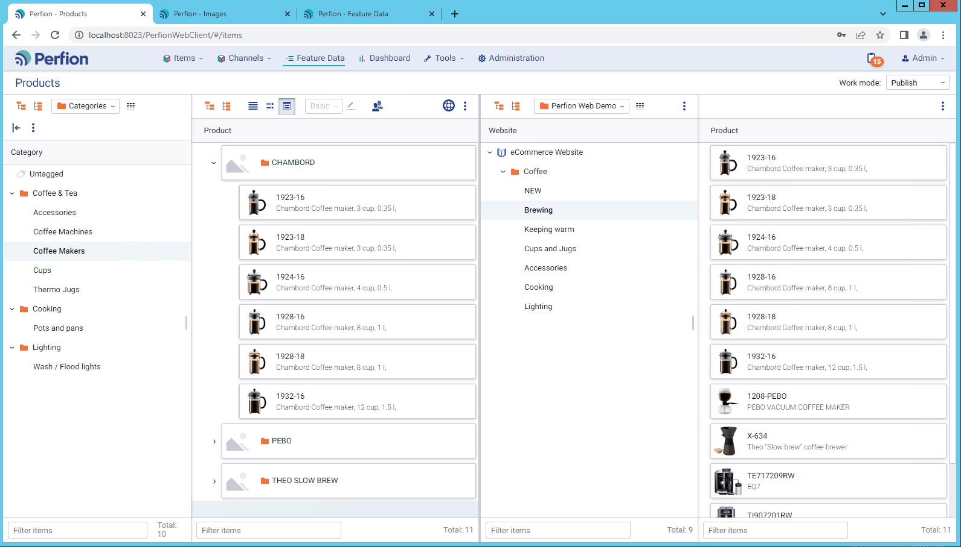
Version 5.0
Drag’n’drop
Categorize items (drag items from main grid to left-side categorizer)
Change parents and change sort order (drag items inside main grids)
Publish items into channels (drag items from main grid to channel node in Publish work mode)

Slide 49
Version 5.0
In-grid editing
Individual single-value explicit features
Updates to same feature for multiple items
Date fields (including short versions like 24, 2412 and 241225)
Copy-paste values within same feature (CTRL+C / CTRL+V)
Restoring previous values (CTRL+H)
Deleting values (DEL)

Slide 50

Version 5.0
Work mode: Item Details
Display grid and detailed Item Editor simultaneously

Slide 51

Version 5.0
Work mode: Publish
Split screen screen between main grid and a specific channel
Quick publishing via drag’n’drop
Definition of channels done by admins

Slide 52

Version 5.0
Multi-language Grid
  View and edit data in multiple languages simultaneously in the grid
  Excellent overview of translations

Slide 53

Version 5.0
Read-only Features
Lock a feature for editing (even for admins)
Useful for data from external sources, or imported values
Editing only possible via e.g., API, Actions, Triggers

Slide 54

5.0 2022 R1
Views specified by context
Automatic determination of relevant view based on “left-side”.
Define view for
  Dashboard widgets
  Search categorizers
  Filters

Slide 55

5.0 2022 R1
Access Feature Data as normal user
Non-administrators can access feature data to maintain lookup values
Permission can be granted at detailed level

Slide 56
2021-R2
Version: 4.10
Released: October 2021

Slide 57

Version 4.10
Item Editor improved
Simplified use of background color on features:
  White background = editable
  Grey background = non-editable (inherited, user rights, remotes)
“compact view” as basis for card view in selectables
Selectable values can be removed without opening overlay
Remote completeness and “traffic lights” show both the remote value and the icon
Dates can be filled via date picker or manually:
  24 = 24th of this month this year
  2412 = 24th December this year
Various filter options available:
  Filter features by caption
  Filter localizables
  Show missing value

Slide 58


Version 4.10
Compact View
Display selectable values more intuitively
Defined in feature configuration
Turns selectables into “cards”

Slide 59
2021-R1
Version: 1.7
Released: April 2021

Slide 60


Version 1.7
Import
  Import data from files
  Control import options
  View complete import log

Slide 61

Version 1.7
Log/trash bin
  See previous values for items
  Review changes and track “who-did-what-and-when”
  Works on individual features

Slide 62


Version 1.7
Google Translate
  Define source and target languages
  One-click translation of words or texts

Slide 63


Version 1.7
Views, sorting
  Sort Sort columns in grid
  Use “column chooser” to add features to the grid
  Select, edit and save views to quickly switch between different focus areas

Slide 64
2020-R2
Version: 1.6
Released: December 2020

Slide 65

Version 1.6
Reports
  Ability to execute reports
  Actual work is performed by the application server in the background
  (Application Server is mandatory)

Slide 66

Version 1.6
Actions
  Ability to execute Actions
  Actual work is performed by the application server in the background
  (Application Server is mandatory)

Slide 67

Version 1.6
Filtering in Item Editor
  Show only localizables
  Show only empty values
  Filter features by name

Slide 68
Version 1.6
UI languages
  English (default)
  German
  Danish
  French
  Dutch

Slide 69
2020-R2
Version: 1.5
Released: October 2020

Slide 70
Version 1.5
Move/assign Items
  New view mode
  Allows moving or assigning products to catalogs, channels
  Easily assign untagged items to correct category
  Rearrange items quickly

Slide 71
Version 1.5
Feature Data
  Feature data can now be edited in Perfion Web

Slide 72
Version 1.5
Context Menu for Selected Items
  Select multiple items and see actions available to the group of selected items

Slide 73
Version 1.5
Sorting
  Grid items that are set up to allow users to reorder them will display arrows that enable it.

Slide 74
2020-R1
Version: 1.3
Released: May 2020

Slide 75

Version 1.3
Dashboard
  New option in Web Client to show dashboard
  Admin-configurable content of widgets
  Jump from widget to specific data in one click
  Pilot program from May 2020 will lead to public release

Slide 76

Version 1.3
Searches and filters
  Admin-configurable search sections
  Locate and process data more efficiently (searches)
  Display data by workflow status (filters)

Slide 77

Version 1.3
Grid Hierarchy
  Navigate data in a structured way
  Use the power of inheritance to avoid redundant data editing

Slide 78

Version 1.3
View options
  Tailor you grid to displaying only the features you need for a specific process
  Standard Views
  Security Views
  Group Views
  Customized Views

Slide 79

Version 1.3
New Item Editor
  Fold groups of features in/out of display
  Work with multiple languages in parallel
  Consistent input help for selectables and other data types

Slide 80
Various Updates
Version 1.3
Context menu for each item
Grid modes (compact/normal) updated
Compatibility improvements for various devices, operating systems, browsers, screen resolutions
RTF Editor
Formula editing

Slide 81
2019-R2
Version: 1.2
Released: October 2019

Slide 82

Version 1.2
Interface improvements
  Virtuals shown as orange folders
  Left side can be resized/hidden
  Item editor opened by clicking base value
  Non-editable cells shown with dimmed grey text rather than dark grey background
  Much more…

Slide 83


Version 1.2
Card view
  Items can be viewed as “cards”
  Data can be edited directly in “card grid”

Slide 84

Version 1.2
Standard views
  Standard views available in grid
  Loads same features as in Windows client

Slide 85
2019-R1
Version: 1.1
Released: July 2019

Slide 86

Version 1.1
Grid editing
  Values can now be edited in grid

Slide 87

Version 1.1
Reports
  Right-side reports (data sheets) can now be generated in the web client
  Left-side reports (catalogs and publishing) not possible yet

Slide 88
2019-R1
Version: 1.0
Released: February 2019

Slide 89


Version 1.0
General
  Access to Perfion via a web browser
  Users have same rights as in Windows client
  Possible to create, edit and delete items
  Possible to manage all values in item editor

Slide 90
Single Source of Truth

